Slide 1
Physician Leadership and the Future of Health Care
Bruce A. Scott, MD President
American Medical Association
November 2024

Slide 2
Fighting for physicians and our patients
The AMA is working at the highest levels to:
Reform Medicare payments to promote thriving practices and innovation;
Reduce Administrative Burdens including Prior Authorization;
Stop Scope Creep that threatens patient safety;
Reduce burnout and address stigma around mental health; and
Advance digital health, including telehealth, to maintain coverage and payment
Notes:
. We need to stop dwelling on what divides us and start focusing on what binds us together - our professional oath, our dedication to our patients, and our commitment to care.
Physicians must be able to practice in the mode they choose to best deliver high quality care, be professionally satisfied, and appropriately compensated for the care they provide.
That summarizes what our AMA is fighting for.
The shrinking reimbursement system, growing administrative burdens and new scope of practice threats, surfacing seemingly every day…these are the issues that are the focus of my presidency.
- When I joined the AMA 36 years ago, I believed the AMA could and did make a difference. And I continue to believe that to this day.
I believe in the power of our profession.
I believe the tide is turning.
I believe that if we unite, we are positioned to win!

Slide 3
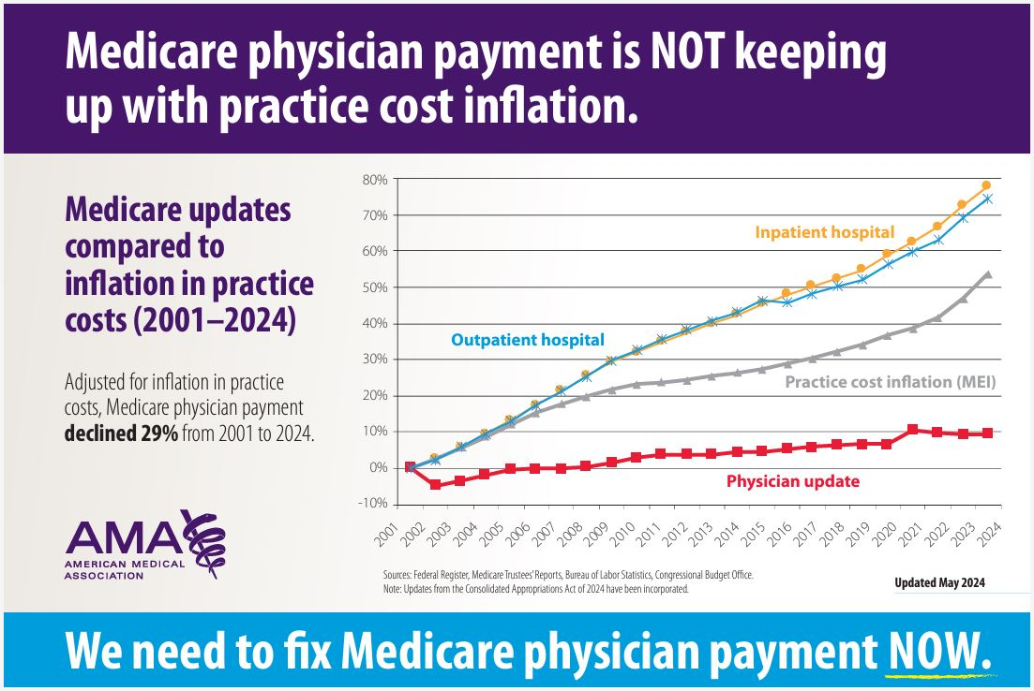
Advocating for a rational Medicare payment system
Physician Medicare payment has declined 29% since 2001
AMA advocacy to spur Congress to reduce the cuts in 2021, 2022, 2023 and 2024.
A rational payment system would provide financial stability, including annual inflation-based payment updates.
With plans for another 2.8% cut next year!
*According to an AMA analysis; adjusted for inflation in practice costs

Slide 4
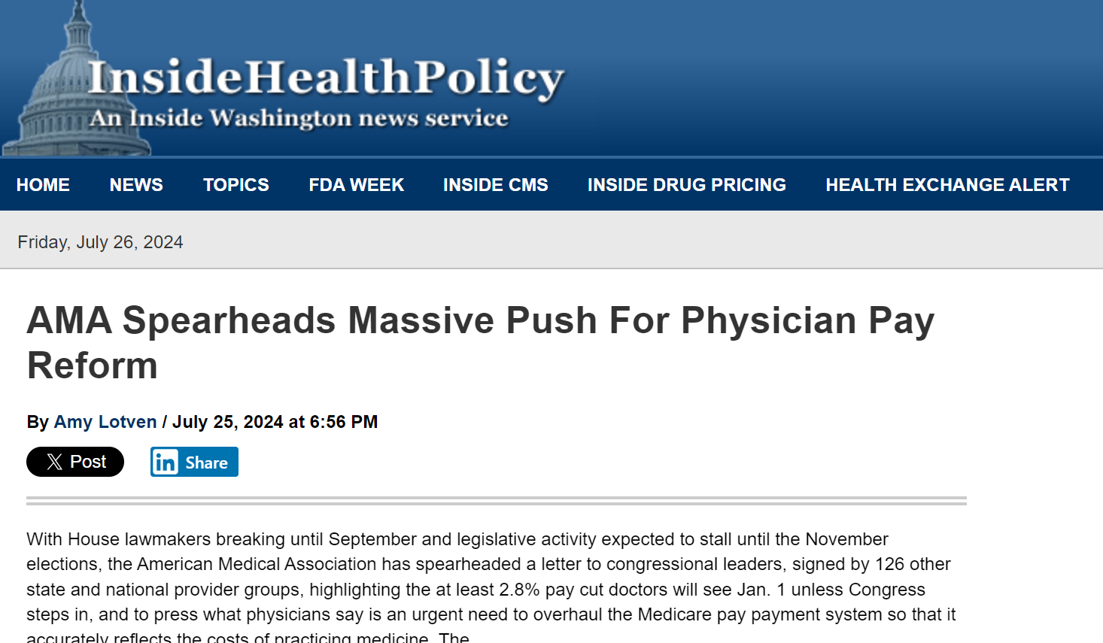
AMA continues to press for Medicare payment reforms
Annual inflationary Medicare payment update that is tied to the Medicare Economic Index (H.R. 2474)
Budget neutrality reforms (H.R. 6371)
Overhaul of the Merit-based Incentive Payment System (Data-Driven Performance Payment System)
Modifications to Alternative Payment Models (S. 3503/H.R. 5013)

Slide 5
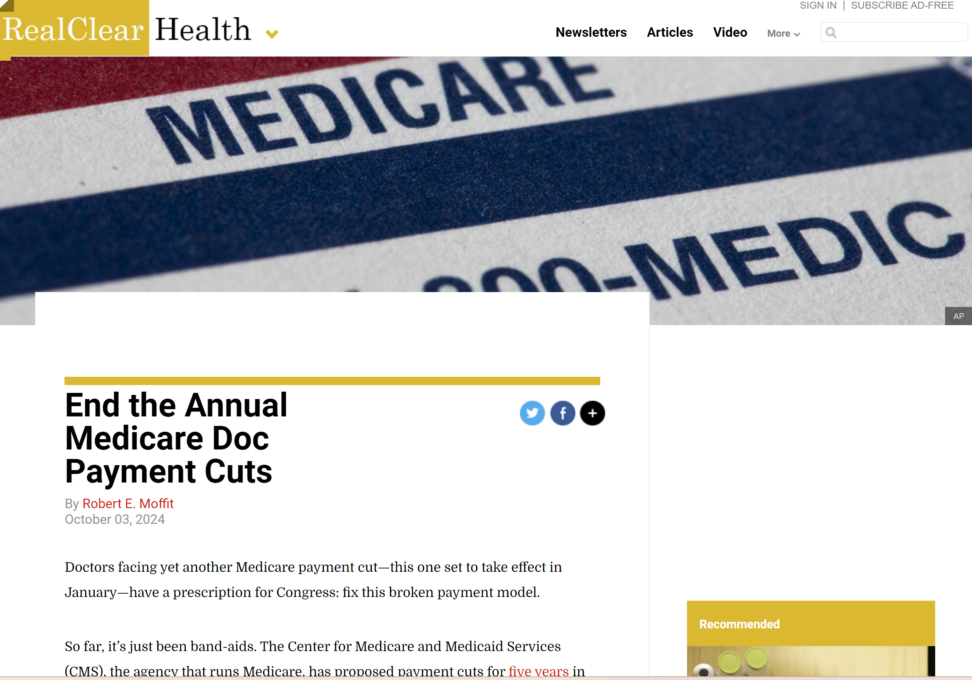
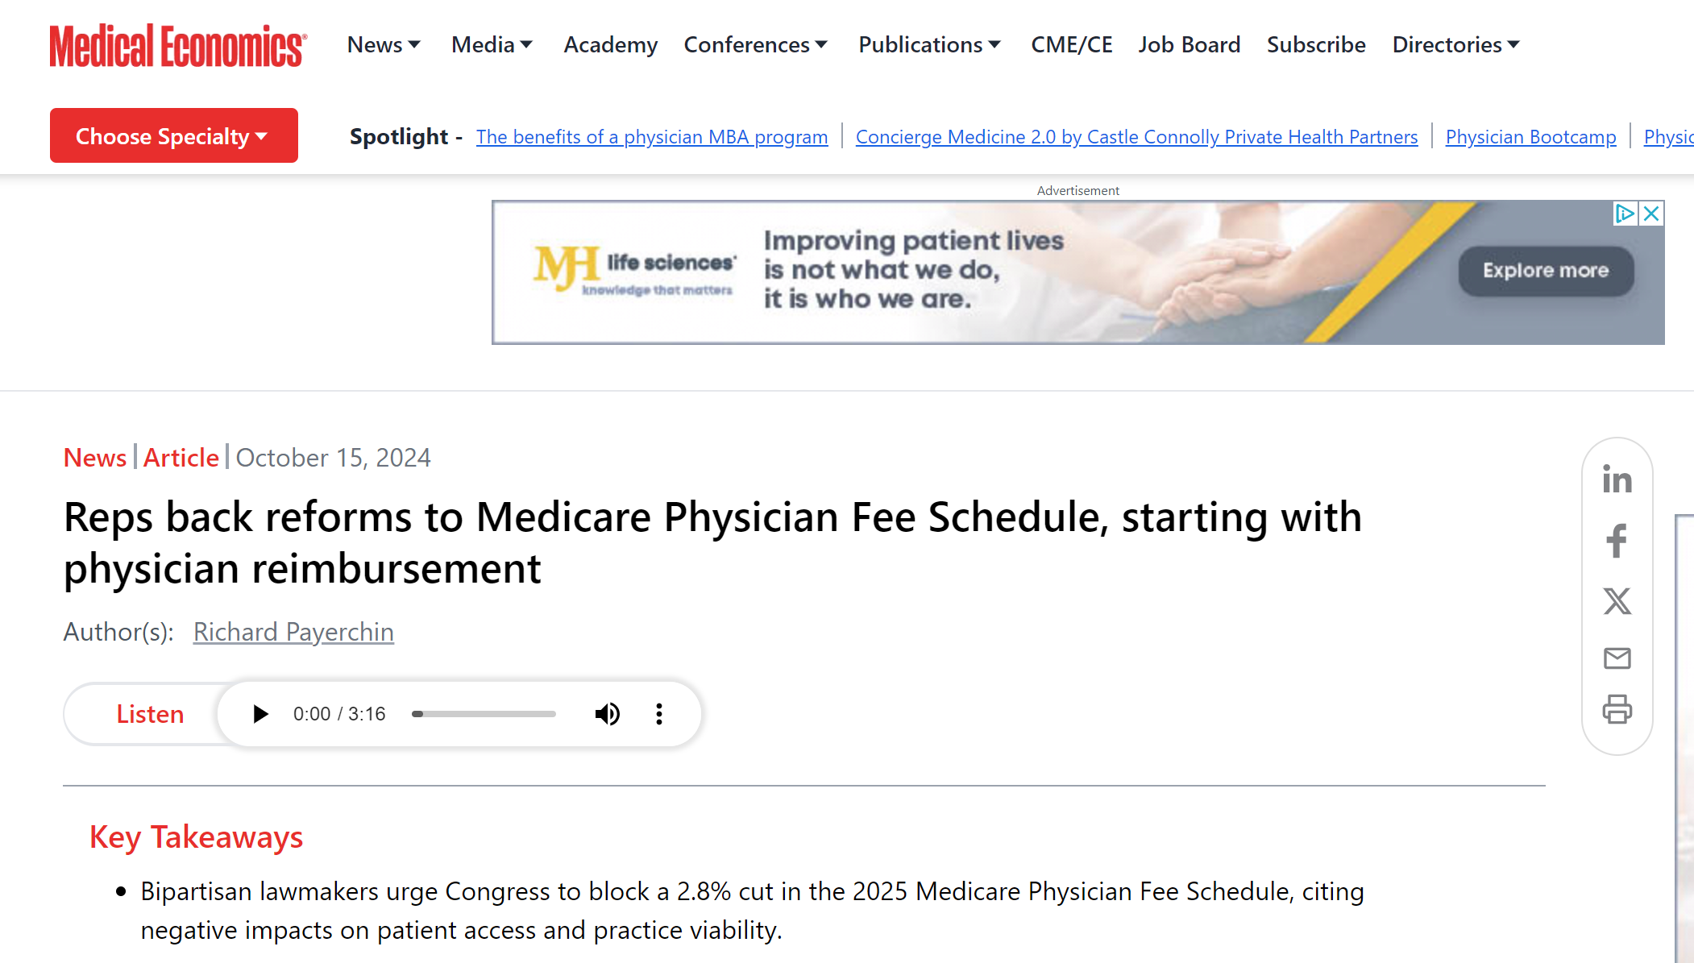
And, Congress is hearing the message!

Slide 6
And, Congress is hearing the message!
Medicare Patient Access & Practice Sustainability Act (H.R. 10073)

Slide 7
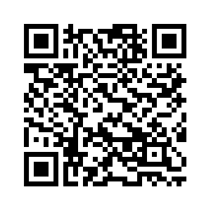
Tell us how Medicare payment cuts are impacting you, your practice and your patients. Click the QR code to schedule a video interview at Interim 24 and help us urge Congress to Fix Medicare Now

Slide 8
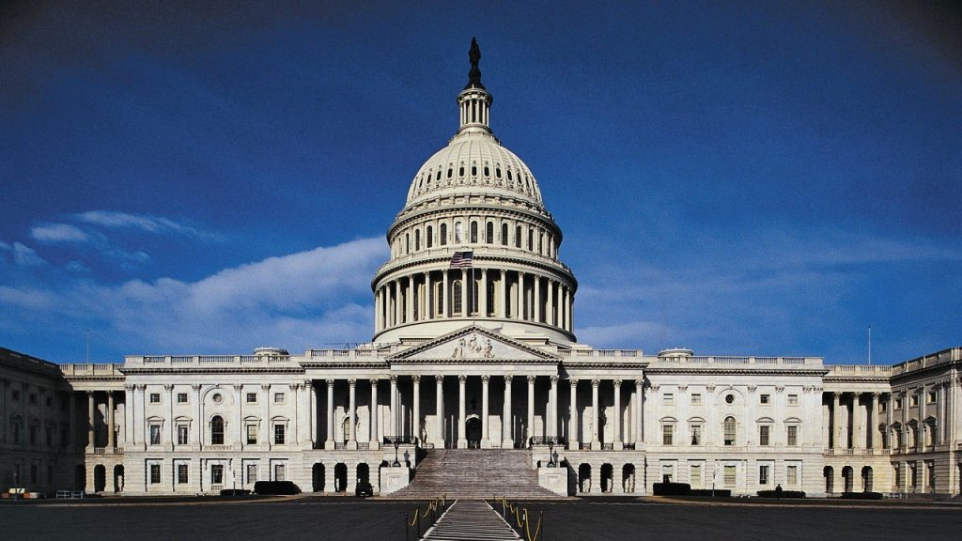
Federal PA Legislation
Improving Seniors’ Timely Access to Care Act
Expand on prior authorization reforms finalized by CMS!
Reintroduced with CBO cost estimate of zero.
H.R. 4968 “Getting Over Lengthy Delays in Care as Required by Doctors” (GOLD CARD) Act
Exempts qualifying physicians from Medicare Advantage plan prior authorization requirements
Join us in the fight at FixPriorAuth.org

Slide 9
Stop scope creep that threatens patient safety
Patients prefer physician-led care
Non-physicians use more resources
Increased overall health care costs
Worse health outcomes
80+ scope bills defeated in 2024
Notes:
And patients agree – Based on a series of nationwide surveys, patients
overwhelmingly want physicians to lead their health care team.
--Four out of five patients want a physician leading their health care team
-- 95 percent believe it is important for physicians to be involved in their medical diagnoses and treatment decisions
---Pts prefer physicians even if they have to wait longer and pay more to be seen.

