Slide 1


OSMAP
“Thriving Through Innovative Change”
Gene M. Ransom, III
Chief Executive Officer
MedChi, The Maryland State Medical Society

Slide 2

MedChi is the seventh oldest medical society, formed in 1799 in Annapolis, MD.
The Mission of MedChi, The Maryland State Medical Society, is to serve as Maryland's foremost advocate and resource for physicians, their patients, and the public health of Maryland.
MedChi is the largest physician organization in Maryland
  Physicians – Primary Care and Specialists
  Medical Residents and Students
  Practice Managers and Medical Staff
Introduction to MedChi

Slide 3
Medchi before AND AFTER
2010 – Net worth 10M
2020 – Net worth 17.5 M
2010 – Dues as a percentage of revenue 65%
2020 – Dues as a percentage of revenue 11%
2010 – One corporate subsidiary MedChi Insurance Agency
2020 – 3 corporate subsidiaries Unity Insurance, MedChi Network Services LLC and MedChi Practice Transformation LLC
When I became CEO, we had an operational deficit of 750K we now have an operational surplus.

Slide 4

Strategic direction change
The Board asked and trusted the CEO to change direction.
Our goals were:
  - Increase non-dues revenue as a percentage of revenue.
  - Improve operations of current business lines.
  - Achieve these goals without deviating from our mission.

Slide 5


Five Important Questions to Ask
WHEN CONSIDERING An OPPORTUNITY
Does the opportunity fit with your mission?
What is the opportunity cost?
Is the opportunity legal and ethical?
What is the true cost benefit analysis of the proposed deal?
What is the risk to the Medical Society brand?

Slide 6

MEDCHI CURRENT Non-Dues REVENUE
For Profit Businesses MedChi Operates
Government Contracts / Sub-contracts
Affinity Relationships / Royalty agreements / Sponsors

Slide 7


INSURANCE BROKER
MEDCHI AGENCY to UNITY INSURANCE AGENCY
Reviewed this business and made changes
New data system to better track leads
Increase broker fees
New dynamic CEO
New brand to expand to non-healthcare clients

Slide 8


Value based care (MNS LLC MPT LLC)
MedChi Network Services LLC – ran four Advanced payment ACOs using a physician friendly model, now runs nearly 15 EQIP entities
MedChi Practice Transformation Services LLC – Created a CTO in the MDPCP program and EQIP work. Developing AAPMs for physicians

Slide 9


Collections
Royalty Debacle - then we decided to acquire our own company.
Designed by a Maryland medical practice for medical practices, Mid Atlantic Medical Collection Services offers a single point of contact and complete transparency with proven results. Our Staff utilizes a patient-first approach, reducing costs and maximizing revenue, all while delivering a positive payment experience. No matter what size your practice, we’ll handle your debt recovery so that you can focus on providing the best care for your patients. Unlike other debt recovery businesses, MAMCS specializes in medical-owed debt and is up-to-speed in healthcare rules and regulations.

Slide 10

HEALTH INFORMATION EXCHANGE (HIE) Crisp contract
CRISP is Maryland’s Statewide Health Information Exchange (HIE). An HIE is the technology that supports the flow of health information among physician practices, hospital labs, radiology centers, and other health care institutions. HIE allows delivery of the right health information to the right place at the right time, providing safer, more timely, efficient, patient-centered care.
On or around 2014 MedChi got the support contract for HIE helping all physicians with encounter notification and other services.

Slide 11

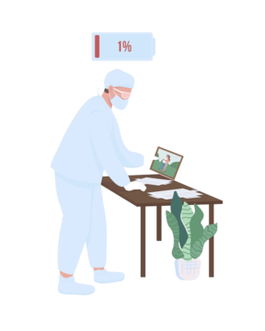
STATE CONTRACT Physician Health and Rehab
The Maryland Physician Health Program is a private, confidential, non-disciplinary program that provides clinical care for physicians and allied health professionals. Administered by MedChi’s foundation, the Center for a Healthy Maryland, this HIPAA-compliant program provides assessment, monitoring, referral, and support services for physicians impaired by:
Anger Management
Substance Abuse
Behavioral Issues
Anxiety
Alcohol Abuse
Boundary Issues
Physical or Cognitive Impairments
Depression
Anger Management
MedChi – Got contracts with the Board of physicians and Board of Vicenarians making this business line profitable

Slide 12


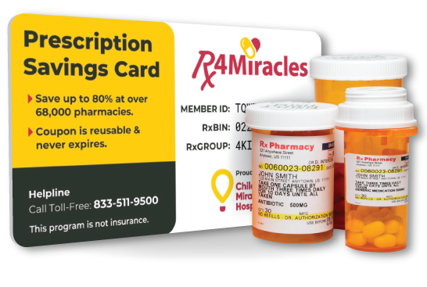


Other Royalty Vendor AGREEMENT

Slide 13

Keys to SUCCESS FOR MEDCHI
The Board, and Members needs to understand the risk
Trust between CEO and Physicians
Focus on mission
Willingness to allow CEO and staff to be involved in outside activities and explore new ideas.

Slide 14





Contact Us and Check Us Out on the Web!
www.medchi.org
gransom@medchi.org
Medchi Medchi | Facebook
members@medchi.org
MedChi (@MedChiupdates) / Twitter
Gene Ransom (@GeneRansom)
LinkedIn: https://www.linkedin.com/in/generansom/

