Slide 1
The AMA and OSMAP: Partners in solving health care challenges
Patrice A. Harris, MD, MA
President
American Medical Association

Slide 2
AMA’s commitment to equity across health care

Slide 3
AMA works to create greater health equity in America
Policy
Advocacy
Tools
The AMA’s House of Delegates has adopted dozens of policies calling for: reducing racial and ethnic disparities in health care; increasing diversity in the medical profession; and eliminating bias among health professionals.
The AMA advocates for policies, such as expanded access to care for all, and for adequate funding of safety net programs.
The AMA creates tools such as the Health Disparities Toolkit, for physicians to use to implement better health literacy and culturally competent care in their own practices.

Slide 4
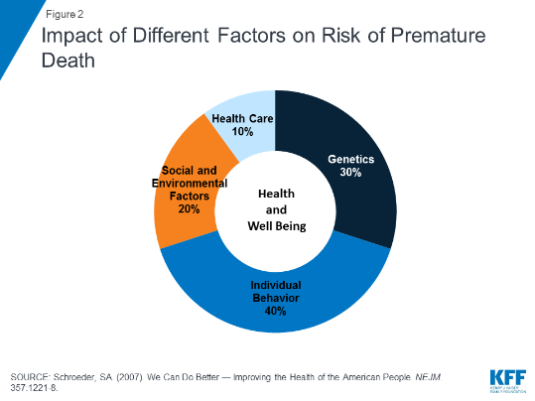
Impact of social determinants of health

Slide 5

Efforts to protect patient access to care
The AMA remains committed to protecting coverage for the 20 million Americans who acquired it through the ACA and expanding coverage for those who do not currently have it.
AMA supports policies that would improve the coverage options for many who are underinsured and/or cite costs as a barrier to accessing the care they need.
AMA supports Medicaid expansion as a means of reducing the number of uninsured individuals.
AMA filed an amicus brief in opposition to plaintiff arguments in Texas v. Azar and is working to reverse the December 2018 district court decision.

Slide 6
Fully integrating mental health
AMA policy:
Supports parity of coverage for mental illness, alcoholism, substance use and eating disorders; (H-185.974)
Supports health care policies that ensure access to and payment for integrated medical, surgical, and psychiatric care regardless of the clinical setting; (H-345.983)
Supports increasing public awareness, reducing stigma and expanding patient access to quality care for depression and other mental illnesses; (H-345.984)
Encourages all physicians to acquire the knowledge and skills to recognize, diagnose and treat depression and other mental illnesses; (H-345.984)
Supports competent mental health care and outreach for at-risk communities; (H-345.984)

Slide 7
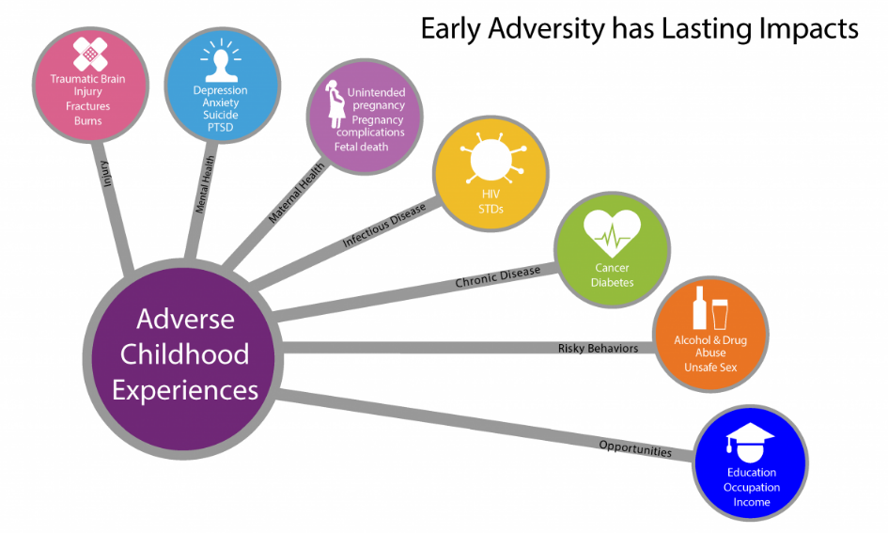
The Impact of Adverse Childhood Experiences
Source: CDC

Slide 8

Advocacy for immigrant children and families
Health and safety at the southern border
Asylum-seekers and vaccines
Mental health of children in DHS custody
Family detention policies
Deferred action for critically ill children
Inadmissibility on public charge grounds
Source: Georgia Health News

Slide 9
Representing physicians
with a unified voice

Slide 10

Working with CMS to overhaul E/M codes and reduce paperwork burdens
AMA has been working with CMS to achieve the first overhaul of E/M office visit documentation and coding in more than 25 years.
AMA recommendations are included in the 2020 Medicare Physician Fee Schedule Final Rule.
This new approach is a significant step in reducing administrative burdens that get in the way of patient care.
Visit ama-assn.org/cpt-office-visits

Slide 11
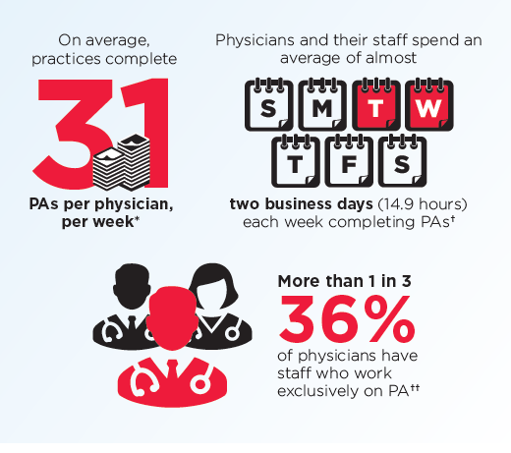
Right-sizing prior authorization
Working directly with national partners and the insurance industry to “right-size” prior authorization
Pushing state legislation to address prior authorization and step therapy and advocating to national policymaking organizations for regulation of these programs and entities
Creating new resources to help practices streamline prior authorization
  Visit FixPriorAuth.org
Source: 2018 AMA Prior Authorization Physician Survey

Slide 12
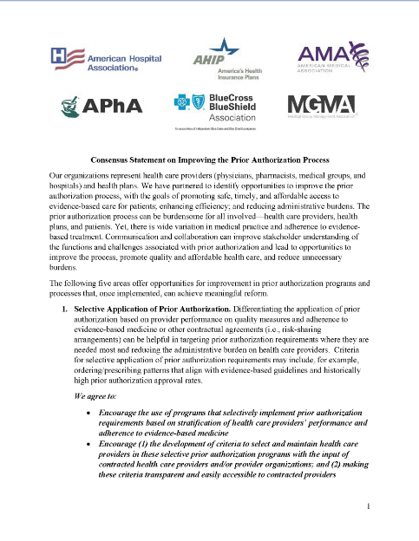
Consensus statement on improving prior authorization
Released in January 2018 by the AMA, American Hospital Association, America’s Health Insurance Plans, American Pharmacists Association, Blue Cross Blue Shield Association, and Medical Group Management Association
Five “buckets” addressed:
  Selective application of PA
  PA program review and volume adjustment
  Transparency and communication regarding PA
  Continuity of patient care
  Automation to improve transparency and efficiency
GOAL: Promote safe, timely, and affordable access to evidence-based care for patients; enhance efficiency; and reduce administrative burdens

Slide 13

Progress of the AMA Opioid Task Force
Opioid prescribing has decreased by 33 percent since 2013.
PDMP registration and use continues to increase; more than 450 million queries were made in 2018.
Treatment capacity is increasing. More than 66k physicians are certified to provide buprenorphine to treat opioid use disorder.​
Physicians are enhancing their education – more than 700k physicians and others took CME in pain management and substance use disorders in 2018.​
Naloxone prescriptions increased to nearly 600k in 2018.
(Source: AMA Opioid Task Force 2018 Progress Report)

Slide 14
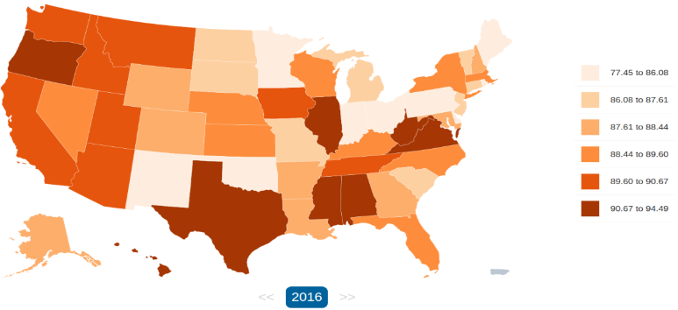
Percent population needing, but not receiving, treatment
Source: NSDUH, http://opioid.amfar.org/indicator/pctunmetneed

Slide 15

New recommendations from the Opioid Task Force
Remove prior authorization, step therapy and other administrative burdens for MAT
Enforce state and federal mental health and substance use disorder parity laws
Remove barriers to pain care
Increase access to treatment for pregnant women and mothers
Support access to treatment within the civil and criminal justice systems

Slide 16

National Opioid Policy Roadmap highlights efforts in four states making a difference
Key to success is medical societies taking action to support:
Vigorous state oversight and enforcement of mental health and SUD parity
Access to comprehensive, multidisciplinary, multimodal pain care
Removing prior authorization and other barriers to medication-assisted treatment
Evaluating current policies to determine what works and what needs revision or removal

Slide 17
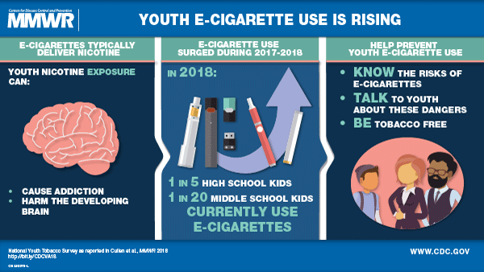
The urgent threat of vaping
Mysterious and serious lung illness linked to vaping found in 49 states.
More than 2,000 cases in U.S.
  39 deaths
AMA urges the public to avoid use of e-cigarette products until health officials further investigate and understand the cause of these illnesses.
AMA calls on e-commerce platforms to better police illicit and illegal vaping products on their sites.
CDC Morbidity and Mortality report, 2018

