Slide 1
Political Advocacy One Physician at a Time
Thomas T Lee, MD, FAANS, MBA

Slide 2
New York State Insurance Market Realty
NY State, in 2009, reached settlement with Wellpoint, United, Cigna, and Aetna to abandon utilization of Ingenix (subsidiary of United) as the payment database, and mandated formation of third party independent database, FairHealth
Insurer trend post 2009: narrower physician network, higher co-payment, higher deductible, and higher co-insurance resulting in reduced coverage and cost shifting to patients and consumers = real causes of “surprise bills”

Slide 3
New York State Out of Network (OON) Transparency Law of 2014-5
Patients held harmless with mandatory assignment of benefits for emergency and surprise bills;
Encourages negotiation between insurers and providers before IDR;
Independent Dispute Resolution (IDR) process utilizing independent out of network charge database (FairHealth);
Transparency and disclosure rules for insurers and providers
Network adequacy for PPO’s

Slide 4
New York State OON Transparency Law Physician Advocacy
2012-2014: 30-40 physicians for fundraiser events and meetings
Political fundraisers (~10-15) $350-$400K
Albany and in-district meetings (>40-50 including Governor, senate majority leader and assembly speaker and majority leader – Assemblyman Morelle )
Key lawmaker champion (top-down) – majority leaders and health committees chairs
MSSNY, state specialty societies, and county medical societies coordinated support
Build coalition of patient group/consumer group
AARP, Consumer Union, Community Service Society
Law passed on March 31, 2014 and effective April 1, 2015
Post-legislation monitoring and participation in NY Governor’s out of network task force and final report to the legislature, 2016: Hospital part of the law 2019

Slide 5
New York State OON Transparency Law
A compromise which benefited the consumers: $400 million saving for consumers over 3 ¾ years
34% reduction of out of network billing
9% reduction of in-network emergency physician payments
13% reduction of physician payments
Surprise bill went from top consumer complaint to “barely an issue”
IDR in 0.01% of claims
Praised by most stakeholders, including NY Health Plan Association as being fair: “The current Independent Dispute Resolution process has worked well, ensuring that reimbursements for emergency services are fair and reasonable while holding individuals harmless”…“These bills take a balanced approach”
Georgetown University Health Policy institute, May 2019
NY State Dept of Financial Services, September 2019
NYHPA Press release, October 2019

Slide 6
Federal Surprise Medical Bill Legislation
Caught the medical profession by surprise
Promulgated by BCBS and its allies at the Brooking Schaeffer Institute
Modeled after California AB-72 passed in 2017, and benchmarked against % Medicare or “average contracted rate”
Bipartisan Senate HELP Committee Alexander (R)-Murray(D) bill and House E & C Pallone(D) –Walden(R) bill advancing quickly in Spring 2019 and passed respective committees

Slide 7
Federal Surprise Medical Bill Law Strategies
Quick call-to-action in May-June 2019 with the following strategies:
Core physicians: 40-50 for fundraiser events, logistics, and meetings - $500-750K
Fundraisers for key leadership and committee members
DC and in/near-district meetings (Senate Majority and Minority leaders; House Majority and Minority leaders and minority whip; House Ways & Means members: with assistance from association staffs and lobbying firms – top down approach
Recruiting Key lawmaker champions (Congressman Morelle*, Congresswoman Shalala, Senator Cassidy) and educated lawmakers on merits of NY State laws

Slide 8
Federal Legislator & Senior Staff Contacts over 3-4 months
Senate
Senator Mitch McConnell (R-KY)
Senator Charles Schumer (D-NY)
Senator John Cornyn (R-TX)
Senator Lamar Alexander (R-TN)
Senator Bill Cassidy (R-LA)
Senator Susan Collins (R- ME)
Senator Maggie Hassan (D-NH)
House
Congresswoman Nancy Pelosi (D-CA)
Congressman Steny Hoyer(D-MD)
Congressman Richard Neal (D-MA)
Congressman Steve Scalise (R-LA)
Congressman Kevin Brady (R-TX)
Congressman Frank Pallone (D-NJ)
Congresswoman Nita Lowey (D-NY)
Congressman Eliot Engel (D-NY)
Congressman Tom Rice (R-SC)
Congressman Drew Ferguson (R,GA)
Congressman Tom Reed (R-NY)
Congressman Tom Suozzi (D-NY)
Congressman Brad Wenstrup (R-OH)
Congresswoman Donna Shalala (D-FL)
Congressman Joe Morelle (D-NY)

Slide 9
Federal Surprise Medical Bill Law Advocacy Strategies
Coalition of organized medicine and hospital associations (GNYHA*, AHA)
Public relation campaign: op-ed, social media*

Slide 10
Federal Surprise Medical Bill Law Advocacy Strategies
Economic study to rebut CBO assumptions and data dissemination
Advocated House Ed & Labor Ruiz(D)-Roe(R) bill with ~100 co-sponsors (esp. to Chairs and ranking members of Ways and Means; E & C; E & L; Appropriations; Foreign Affairs, etc) to gain senior member support
Feedback from top leadership (Speaker and Majority Leader) level, especially in the House: current E & C bill is a “done deal” barring another passed committee bill; Do not rock the boat

Slide 11
Federal Surprise Medical Bill Law Advocacy Renewed
Renewed Focus: Offense is the best defense
United front of organized medicine (AMA*, specialty societies, state medical societies) to fully stand behind the NY model: AMA October 16 press release signed on by 111 specialty societies and state medical societies
Intensified public relation and media campaign
Social media (Twitter, Facebook, Linkedin)
Numerous op-ed’s amplified by social media
Print and radio ads in key markets
Further communication and coordination of messaging with hospital associations (GNYHA, AHA): press releases and Hill/in-district visits
Focus on the Senate, especially with key majority members, amongst whom skepticism of current bills remains high

Slide 12
Federal Surprise Medical Bill Law Advocacy Renewed
Will we succeed?
Definition of “Success”

Slide 13
Does $ Matter?
Definitely Yes, but it is not everything
Public opinion and votes matter, perhaps even more so in an election cycle, and $ can influence and change public opinion

Slide 14
Top 20 PACS by Expenditure 2019-20
PAC Name | Total Expenditures
ActBlue | $343,861,556
EMILY's List | $21,616,098
Service Employees International Union | $12,123,594
Need to Impeach | $11,915,591
NextGen Climate Action | $10,310,752
End Citizens United | $8,077,013
Laborers Union | $8,007,530
Freedom Partners | $6,474,000
Moveon.org | $6,333,266
Progressive Turnout Project | $6,284,170
Ryan for Congress | $5,926,051
International Brotherhood of Electrical Workers | $5,624,304
American Federation of Teachers | $5,258,065
Senate Majority PAC | $5,220,815
Planned Parenthood | $5,123,827
National Assn of Realtors | $5,088,172
American Bridge 21st Century | $4,573,743
Operating Engineers Union | $4,359,807
Plumbers/Pipefitters Union | $4,179,080
Congressional Leadership Fund | $4,172,705
Totals include subsidiaries and affiliated PACs, if any.
Based on data released by the FEC on October 27, 2019.
Center for Responsive Politics

Slide 15
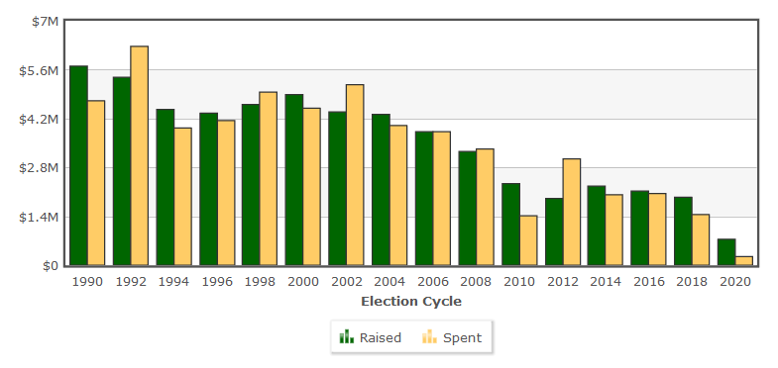
AMA-PAC

Slide 16
Pharmaceutical Research and Manufacturers of America - 2019

Slide 17
Insurance Industry -2019
Client/Parent | Total
Blue Cross/Blue Shield | $14,448,390
America's Health Insurance Plans | $7,200,000
Cigna Corp | $6,360,000

Slide 18
Advocacy Common Theme
Strong grass root physician-led efforts
Long-term relationship building with legislators and executive branch at federal and state levels
Continued dialogue with Congressional leadership level and cultivate issue “champions”
Unified organized medicine messaging (AMA)
Coalition building– issue oriented
Active PR/mass media/social media campaigns and engage our adversaries on all fronts
Expand donor base of organized medicine PAC’s and collaboration with individual physicians/group funding – think outside the box and put your $ where your mouth is
Better off stopping a bad bill

Slide 19
Special Thanks
AMA, AANS-CNS, MSSNY, CMA
Michael Brisman, MD, FAANS
Daniel Choi, MD, FAAOS
Katie Orrico, AANS-CNS
Moe Auster, MSSNY SVP Governmental Affairs
Arthur Fougner, MD, MSSNY President
Andrew Kleinman, MD, MSSNY Past President
Greater New York Hospital Association (GNYHA)
The hundreds of physician leaders and association staffs we worked with…

