Slide 1
November 15, 2019
OSMAP Update
Presented By: Gary Price, M.D.
President, The Physicians Foundation
Notes:
Good afternoon. I would like to thank the OSMAP steering committee on behalf of the Physicians Foundation for inviting me to update you on a few of the recent activities of the foundation. The Physicians Foundation is now in it’s 16th year, and we continue to be very pleased to support OSMAP as well as keep you updated on our work.

Slide 2
Areas of Focus
OSMAP 2019
2019 Survey of America’s Patients
Physician Wellbeing
Notes:
The Foundation currently focuses on Physician Leadership, Physician Wellbeing, Research in the area of the Physician Practice Environment, and the impact of Social Determinants of Health on the cost and quality of the care we all deliver. Today I would like to briefly update you on our recently released survey of America’s patients, as well as two of our projects around physician wellbeing.

Slide 3
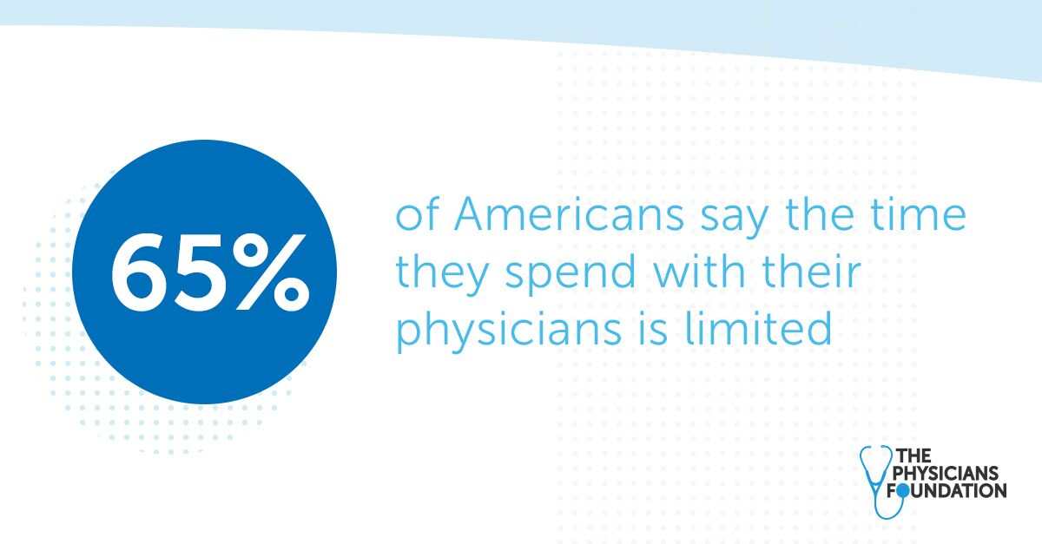
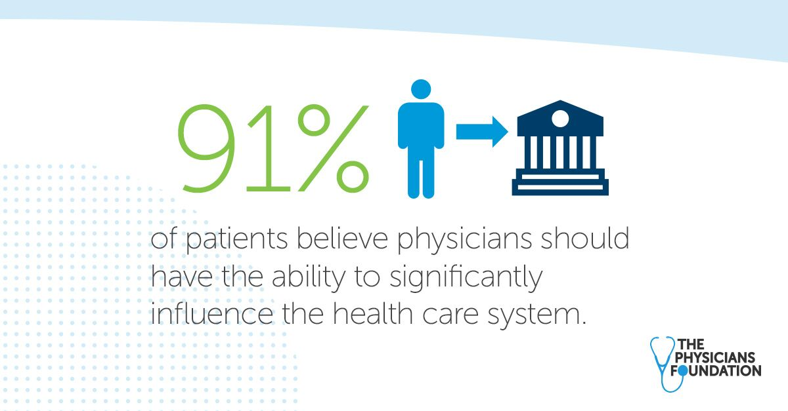
The Physicians Foundation’s 2019 Survey of America’s Patients
Evaluated attitudes of 2,000+ patients on the physician-patient relationship, the cost of health care and key drivers of health care outcomes, such as social determinants of health and the opioid epidemic.
In addition to the physician-patient relationship, patients are concerned about:
Cost
Politics
Opioids
Notes:
Our Biennial survey of patients was released just two weeks ago. Over 2,000 patients were surveyed on many topics, and the detailed results are available online at Physiciansfoundation.org.
A majority of patients reported that they felt that their time with their physician was limited, and as in previous surveys, they almost universally felt that their doctors should have significant influence on our health care system.
They are also very concerned about the cost of healthcare, Politics, and Opiods.

Slide 4
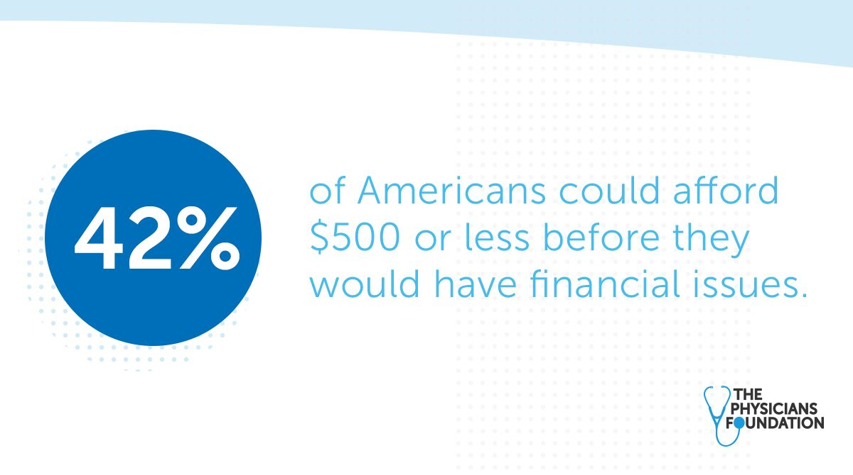
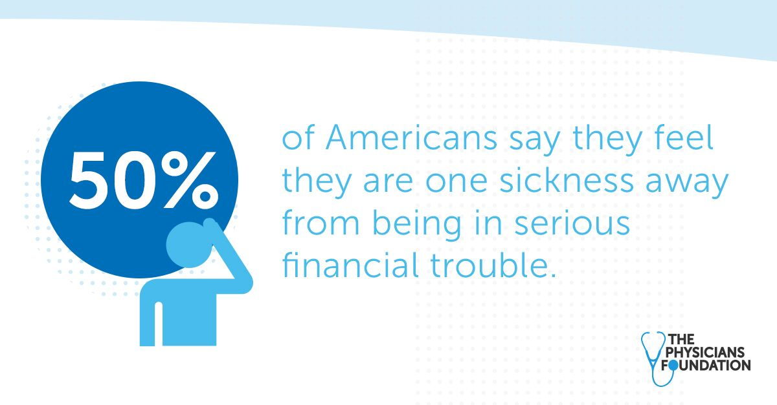
OSMAP 2019
The Most Pressing Things on Patients’ Minds: Cost
73% of Americans are concerned about their ability to pay for medical treatment if they were to get sick or injured and half of Americans say they feel they are one sickness away from being in serious financial trouble.
42% of Americans could afford $500 or less before they would have financial issues.
84% of Americans say they are concerned about how much health care costs will affect them in the future.
86% of Americans say cost and 72% say waiting for insurance pre-approvals negatively impact patient care.
Notes:
It probably surprises no one that foremost on the minds of our patients is the issue of the cost of healthcare. Most of them are worried about their ability to pay for care, and 42% report a $500.00 threshold for a healthcare expense causing significant financial issues.
84 percent of patients are concerned about the effects of future healthcare costs, while 86% say the cost of care has the greatest negative impact on that care. 72% feel that the preapproval process negatively impacts their care.

Slide 5
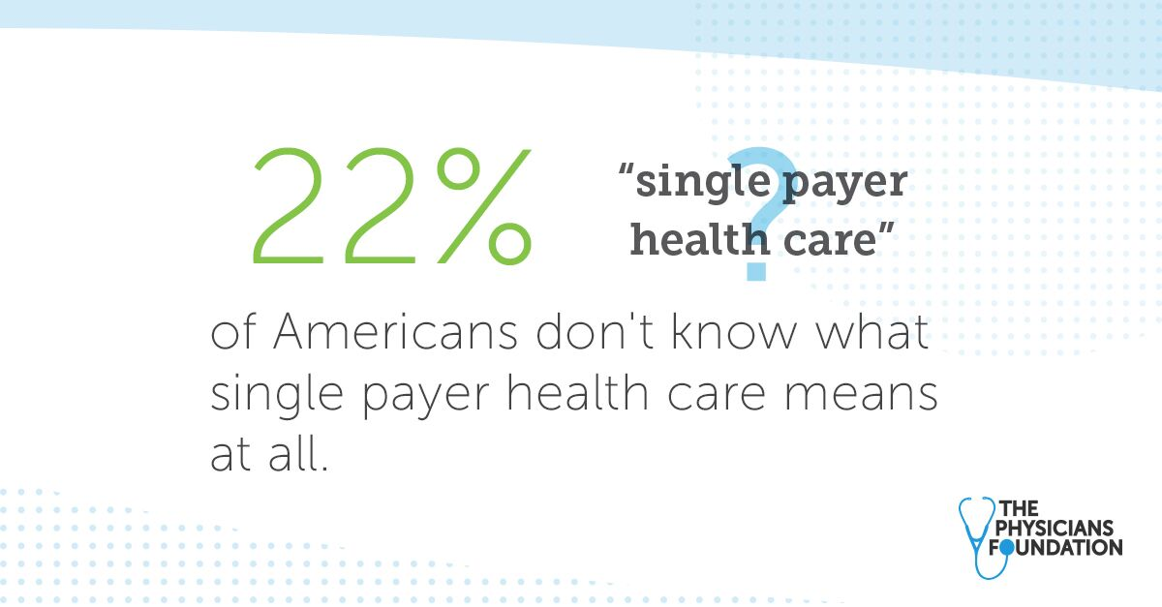
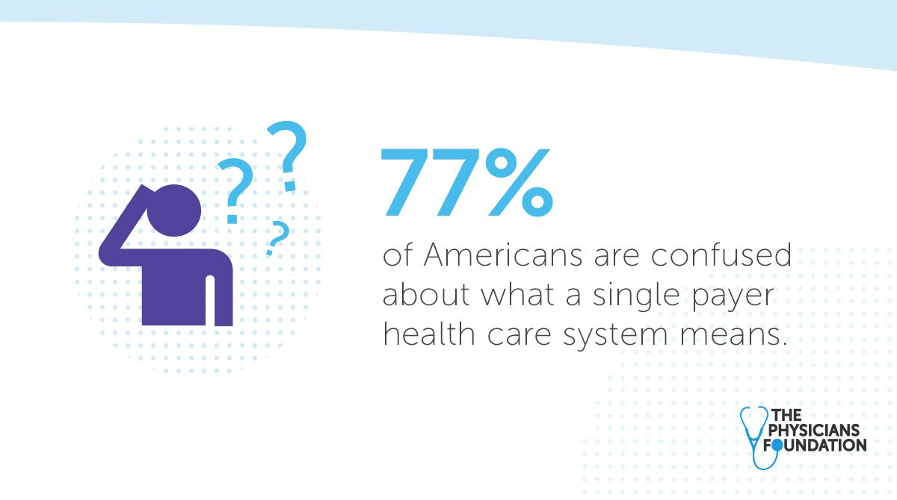
OSMAP 2019
The Most Pressing Things on Patients’ Minds: Politics
22% of Americans don’t know what single payer health care means at all.
77% cannot agree on one definition.
55% of Americans are more likely to vote for a presidential candidate who advocates for expanding private insurance reforms.
62% of Americans say rising health care costs are due to cost of prescription drugs, while 49% point to hospital costs.
Notes:
There were some very interesting, as well as pertinent findings regarding the current politics of healthcare reform. 22% of Americans have absolutely no idea as to what “single payer” health care means whatsoever. 77% can not agree on one definition of “single payer care. 55% say they would be more likely to vote for a candidate who is in favor of expanding private insurance reform. 62% of Americans blame pharmaceutical costs for the rising cost of care, while 49% blame hospital costs

Slide 6
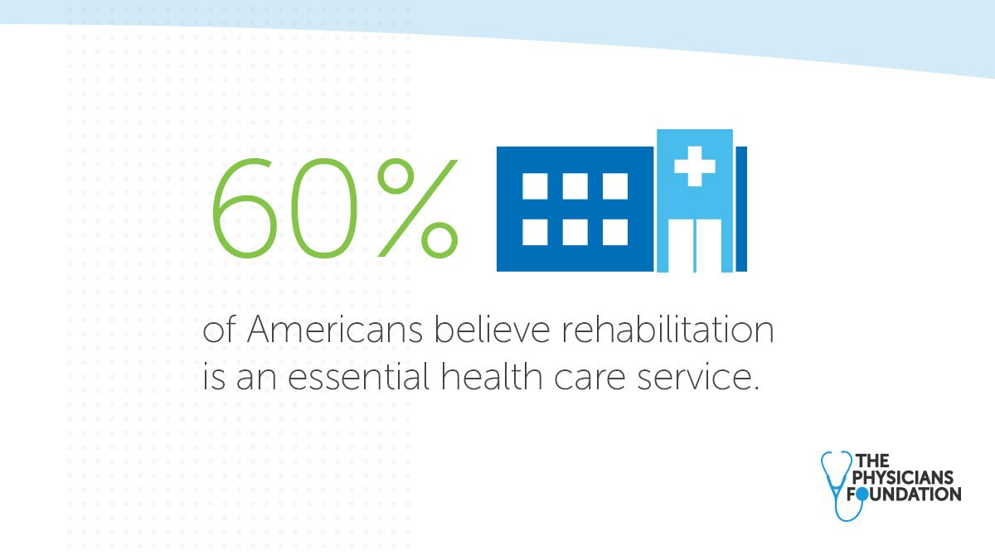
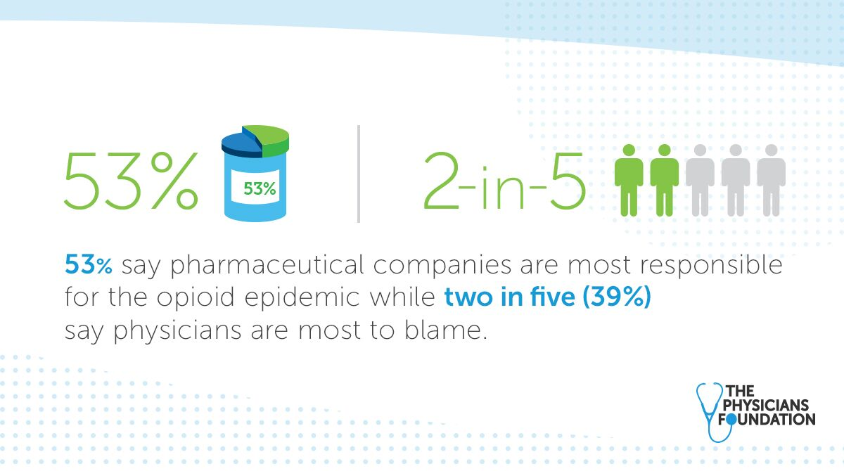
OSMAP 2019
The Most Pressing Things on Patients’ Minds: Opioids
35% of Americans know someone who has abused or is addicted to opioids.
21% know someone who has died because of opioid use.
60% of Americans believe rehabilitation is an essential health care service, while 45% believe care for substance abuse is essential.
53% of Americans say pharmaceutical companies are most responsible for the opioid epidemic… while two in five (39%) say physicians are most to blame.
Even though data from the 2018 Survey of America’s Physicians found that 69% of physicians are prescribing fewer pain meds.
Notes:
Our patients are well aware of the impact of the opiod epidemic on their communities. Over a third of them no someone who has become addicted, and just over one in five know someone who has died because of opiod abuse. A majority feel that rehabilitation is an essential health care service, while 45% feel that care for substance abuse is essential. A majority blame the pharmaceutical industry, however 39% feel that physicians are the most responsible.

Slide 7
Physician Wellbeing
The “Practice Transformation Initiative” in partnership with our AMA
Vital Signs Awareness Campaign
Notes:
Among many initiatives related to physician wellbeing, I would like to outline two current projects the Foundation is pursuing. The first is a major collaboration with our AMA in “The Practice Transformation Initiative”
And the second is an awareness campaign, “Vital Signs” which was launched several weeks ago around the issue of physician suicide

Slide 8
Practice Transformation Initiative Solutions for Increasing Joy in Medicine
Notes:
Over the past year, the physicians foundation has been pleased to support the practice Transformation Initiative

Slide 9
Program Objectives
Reduce clinician burnout by furthering practice transformation research focused on evidence-based interventions
Collaborate and learn from health systems committed to assessing clinician satisfaction and its correlation to workflow design and practice efficiency
Foster a network of organizations implementing evidence-based solutions, sharing best practices and driving sustainable change to improve Joy in Medicine
Notes:
The foundation has been very pleased to provide financial support to this AMA led initiative which seeks to reduce burnout, collaborate and learn from partner systems to gain insights on how to assess and improve physician wellbeing with very practical measures, as well as foster a growing network of organizations who may share their successes and drive change in addressing and improving the work environment of our physicians

Slide 10
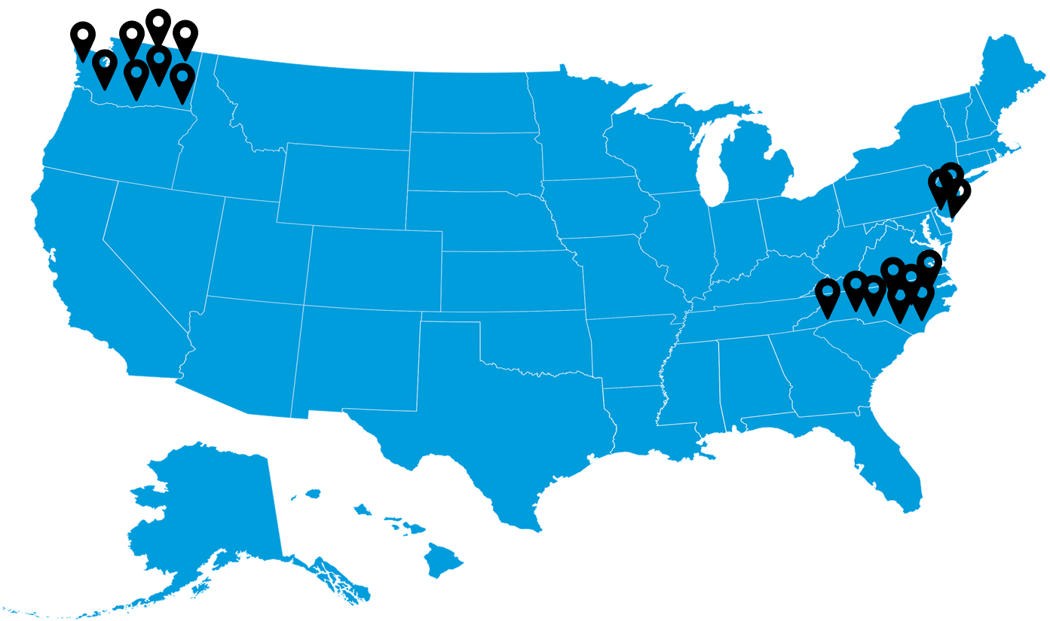
2019 Participating Organizations
North Carolina Medical Society | Washington State Medical Association | Medical Society of New Jersey
Boice-Willis Clinic | Allegro Pediatrics | St. Peter’s Medical Associates
Cancer Care of Western NC | Evergreen Health Medical Group | Lifeline Medical Associates
Catawba Valley Family Medicine | Family Care Network | Hackensack / Meridian Health
Chatuge Family Practice | Kaiser Permanente
Novant health Durham Internal Medicine Associates | MultiCare Health System
Piedmont Health Services | The Everett Clinic
Wake Emergency Physicians | UW Valley Medical Center
Wilmington Health Associates | Virginia Mason
*19 participating organizations
Notes:
The initial trial of this program began a year ago in three states, North Carolina, New Jersey, and Washington
In its first cohort, which began in early 2019, the Practice Transformation Initiative has engaged three state medical associations: North Carolina, Washington state, and New Jersey.
State medical associations were charged with recruiting practice sites to identify and implement a practice transformation intervention.
In total, cohort 1 has engaged 19 practice sites throughout the three state medical associations

Slide 11
Practice Transformation Interventions
Each practice site selected one of three interventions to implement over the course of their project engagement.
Pre-visit planning - Scheduling patients for future appointments at the conclusion of each visit, arranging for pre-visit lab testing, gathering the necessary information for upcoming visits, and spending a few minutes to huddle and handoff patients.
Pre-visit laboratory testing – Ordering patient laboratory tests for completion before upcoming appointments. This gives physicians the opportunity to discuss results with patients at their visit, eliminating the need to review results later, and coordinate follow-up care.
Synchronized annual prescription renewal – Process of renewing all of a patient's stable medications for the typical maximum duration of 12 to 15 months.
AMA physician coaches hosted a series of virtual meetings with practice sited to describe the interventions in detail and to provide coaching to sites as they implemented their interventions. These virtual meetings also allowed practice sites to connect with one another and share learnings and pain points.
Notes:
It involves the implementation of three practice transformation interventions, with support from expert coaches, as well as pre and post intervention assessments
Each of the 19 practice sites identified one of three interventions to participate in over the course of their engagement.
The three interventions included (1) pre-visit planning, (2) pre-visit laboratory testing, and (3) synchronized annual prescription renewal.
Each practice site was responsible for identifying a core intervention team within their organization and for developing a work plan to ensure that the intervention is implemented is a timely manner and engages key stakeholders.

Slide 12
Mini Z Burnout Survey
10-item survey used to assess rates of burnout within practice sites
Survey was customized across each participating state to include demographic information from survey respondents
Survey deployed in Fall 2019 to control and intervention groups of the practice sites to gather baseline measurements; distributed to over 3500 physicians
Survey will be deployed post-intervention (Spring 2020) to assess changes in burnout and professional well-being
Each state medical association will receive aggregate data from across their cohort and comparison data to the national benchmark from the AMA well-being data lab
Notes:
A standardized survey, “The mini Z” was performed on this cohort of practices as well as controls this Fall, and will be performed again in the spring. Participating state medical associations will receive the data, and it is our hope that a growing database on burnout will develop from this initial pilot.
We are looking forward to this groundbreaking study of actually implementing practice level change and assessing the impact of various strategies for reducing burnout, and enhancing physician wellbeing
The Mini-Z burnout survey is a 10-item survey used to assess stress, burnout, work control, chaos, values alignment, teamwork, documentation, time pressure, excess electronic medical record use at home, and EMR proficiency for physicians and advanced practitioners.
State medical associations worked closely with the AMA to customize their state surveys to include the standard 10-item Mini-Z in addition to questions pertaining to demographic information.
Each of the 19 practice sites deployed the Mini-Z survey to both a control and intervention group to gather baseline measurements in Fall 2019.
The survey will be re-deployed post-intervention (Spring 2020) to assess changed in burnout and professional well-being
Each state medical association will receive aggregate data from across their cohort AND comparison data to the national benchmark from the AMA well-being data lab.
These data will help states determine their current state of well-being

Slide 13
OSMAP 2019
Physician Wellbeing
Physicians have the highest suicide rate of any profession and more than twice that of the general population. It's estimated that one million Americans lose their physician to suicide each year.
To recognize National Physician Suicide Awareness Day, we launched Vital Signs to help raise greater awareness about the physician suicide epidemic and to provide physicians the tools to attend to their own wellbeing.
Vital Signs is designed to empower physicians, their colleagues and loved ones, to check in on one’s another’s wellbeing.
Notes:
I have been addressing my personal concerns about physician wellbeing to this group for several years now, and I am very pleased to update you on our most recent initiative regarding this. Several weeks ago, we launched an awareness campaign regarding Physician Suicide, “Vital Signs”
We hope to not only empower physicians, their colleagues, and loved ones to be more aware of the issue of burnout, but also provide a simple roadmap for beginning the process of addressing it before it escalates.

Slide 14
OSMAP 2019
Physician Wellbeing
In September during Vital Signs launch, we:
Published commentaries in KevinMD, Saving a physician from burnout saves patients too,​ and The Hartford Courant , Physicians have the highest suicide rate of any profession. Why aren’t we talking about it?
Engaged with physicians directly at the American Conference on Physician Health
Garnered engagement from 14+ county and state medical societies
Received 2,000+ people visiting the Vital Signs webpage to learn more to attend to their wellbeing
Notes:
We have developed and made available a number of resources, as well as pursued engagement from your state and county medical associations. Copies of these materials are available in the back, and links to all of these are available on our website. I encourage each of you to take a look at them

Slide 15
Join Us in Preventing Physician Suicide
We invite you to share this campaign via events, listservs, social channels or on your website. If you do share the campaign, please let us know and if sharing on social media, mention @PhysiciansFound on Twitter and @The Physicians Foundation on LinkedIn.
Share a Piece of Your HEART: Share Vital Signs with your networks to help others learn the warning signs to look for in someone who may be suicidal. [With the HEART acronym, we hope to help you easily remember these signs.]
Vital Signs
Handout
Shareable social media content
A Newsy Investigation Documentary: Unspoken: Doctor Depression and Suicide
Open Your HEART: Check in with colleagues and loved ones and support them when needed.
Conversation Starter
physiciansfoundation.org/vitalsigns
Notes:
Aside from raising your own awareness and sensitivity to the warning signs of burnout, we encourage you to share this campaign on social media, as well as making the tools we have available through your state and county societies

Slide 16
Coming Attractions:
The 2020 Survey of
America’s Physicians
Notes:
In 2020, the physicians foundation will be launching it’s biennial survey of America’s physicians. This has, historically been the largest survey ever performed of our nation’s doctors. In the upcoming election year, we believe that this offers an unprecedented opportunity for physicians to voice their concerns and opinions regarding the future of healthcare in our country, a voice which our patients have consistently insisted should be of critical importance in shaping our healthcare system.
We will be reaching out to each state medical association to assist us in reminding you to participate when the email invitation arrives. I would ask you, as leaders in your states and at the national level to encourage your state staff and colleagues to make this coming years survey a record breaker in terms of response. Your voices are compelling on their own, however sheer numbers matter a lot to the media and policy planners in increasing the impact of physicians insights.

Slide 17
Thank You!
Notes:
I want to thank you once again for allowing me to share the foundation’s work with you, and look forward to hearing from you individually at the reception, as I always am interested in hearing suggestions and insights from this group.

