Slide 1

Surprise Billing: Ensuring Congress Avoids California’s Unintended Consequences
David H. Aizuss, MD
Immediate Past President
California Medical Association

Slide 2

How Did We Get Here?
Bad behavior in the market
Narrow payor networks
High deductible plans
Inadequate benefits
Notes:
Bad Behavior in the Market:
Payors were significantly narrowing their networks or refusing to contract with physicians.
Regulators were refusing to enforce even minimal network adequacy standards and reporting requirements.
Provider Directories were inaccurate, at best, leaving patients without the proper information to determine whether a physician was in-network or not.
Health Plans and Insurers were also selling products that were providing incomplete coverage for patients, that carried with them huge out of pocket costs.
This caused patients to delay care and require services that are provided in in-patient, hospital settings where balance billing was more prevalent.

Slide 3
How Did We Get Here?
Political Pressures
  Emergency services balance billing prohibition
    Prospect Medical Group, Inc V. Northridge Emergency Medical Group
  18 bills introduced during 2000-2015
  Consumer complaints
Notes:
Political Pressures:
2009 – Prospect case prohibited balance billing for emergency services of patients in Knox Keene licensed health plans.
Set out criteria for proper reimbursement of emergency services
This was the first instance of balance billing prohibitions in the state.
2015 was not the first time California legislators had seen balance billing legislation either.
In the era of short term limits, from 2000-2015, 18 bills were introduced that attempted to address balance billing, CMA was able to stop all of those.
The final straw came in the form of Consumer complaints.
News stories were in the paper about patients undergoing serious surgeries for serious conditions who were receiving “Surprise Medical Bills”
One in particular was a relative of a legislator who had had enough, and introduced AB 533.

Slide 4
California Legislation
AB 533 – OON Rate: 100% of Medicare in all settings
  Supporters: Health Committee Chairs, Assembly and Senate leadership, labor unions, health plans, consumer groups and Chamber of Commerce
  CMA defeated on concurrence
AB 72 – OON Rate: Greater of 125% of Medicare or payors’ average contracted rate
Notes:
In early 2015, AB 533 was introduced, this will would have set the interim rate at 100% of Medicare in ALL settings.
No average contracted rate.
No appeals process
No network adequacy enforcement tools
This bill was bad
CMA was able to stop this bill on Assembly concurrence, the very last stage in which to stop a bill in the legislative process
Supporters of the bill still were adamant that something get done on the issue.
CMA was at the table with the supporters putting forward proposals very similar to the New York Model:
Reasonable and customary rates
80% of billed charges according to the Fair Health database
Baseball style arbitration in the dispute resolution process
More strict network adequacy standards and better enforcement
However, unlike in New York, California’s Governor and regulators were on the side of the health plans.
The Brown administration supported the health plans’ position every step of the way.
CMA was fighting an uphill battle
As a result of stakeholder negotiations, AB 72 was amended and passed into law in 2016.
This was the best CMA could do under the circumstances… we don’t like it… and this is NOT a win for us by any means.

Slide 5
AB 72 (Effective July 1, 2017)
Limits billing practices of out-of-network physicians providing non-emergent, covered services at in-network facilities
Insurers must reimburse at interim rate - greater of 125% of Medicare or insurer's average contracted rate for same service in that region
PPOs - physicians can avoid billing prohibition by obtaining advanced consent from patient
Independent dispute resolution process (IDRP) available
Notes:
Limits out-of-network physicians from billing patients
Doesn’t apply to emergency services (Prospect)
Doesn’t apply to non-covered services
Doesn’t apply to services provided in non-contracted facilities
Interim payment
Payors are required to honor the assignment of benefit and pay the physician directly
Consent
Must be obtained at least 24 hours before scheduled procedure
Meeting this criteria is difficult for most hospital-based physicians who don’t know which patients they are seeing until the day of the procedure, therefore, can’t meet the 24 hr advance notice requirement
Dispute resolution process
Dispute process is NOT working – I’ll talk more about that in a minute.

Slide 6
AB 72: Unintended Consequences
Disincentivized contracting
Low interim rate has shifted too much leverage to insurers
Predatory payor behavior:
  Cancelling long-standing contracts
  Imposing significant rate cuts on hospital-based physicians
  Refusing to renew contracts
  Reducing patient access to in-network physicians
  Could jeopardize emergency on-call system
Notes:
Disincentivized contracting
Practices are reporting that some insurers are terming 20 year contracts
Some insurers are requiring huge rate cuts in order to stay contracted. One anesthesia group was told they would have to take a 42% cut in order to remain contracted.
Some insurers are simply not renewing contracts if the contracted rate was above the interim rate.
Anthem targeted hospital-based physicians by imposing rate cuts on its contracted physicians in an effort to lower its average contracted rate:
19-70% for pathologists
Up to 30% for some anesthesia services
19% for radiologists
Insurers are closing their panels and refusing to add new physicians to their panels
Contract cancellations, significant 25%+ rate payment cuts, less access to in-network physicians and on-call specialists
The low interim rate has tipped the scales overwhelmingly in favor of the insurers

Slide 7
AB 72: Unintended Consequences
Accelerating consolidation of independent physicians with hospitals and private equity firms driving up costs
IDRP not working
  Arbiter has affirmed insurer’s payment amount in 100% of filings
  Process is burdensome for physicians
Notes:
(NOTE: Be careful about hospital consolidation since many AMA physicians employed by hospitals)
Accelerating consolidation
A recent RAND study confirmed this. And it is well documented that consolidation leads to higher costs
Consolidation of independent practices seeking refuge in hospital systems and private equity groups which can drive up costs
IDRP not working
Docs have to bundle claims by same payor and doc-can’t bundle with other specialists in the group. If you are trying to bundle the max number of claims (50), it will take a while to get there.
Tons of documentation required to submit IDRP
Process takes up to 6 months to complete through DMHC
Unqualified arbiter under DMHC (certified coder) who has sided with insurers on 100% of the filings

Slide 8
AB 72: IDRP Challenges
Arbiters lack training and qualifications
Unfair burden of proof on physician
No process to allow physician submission of contracted rate
Lack of training on how to consider evidence
Failure to consider all relevant information
100% of decisions have been in favor of insurer
Notes:
Reviewer qualifications
DMHC is using a certified coder. In contrast, CDI (our other regulator) has an option for a physician to be included in the review with the coder. The NY model uses a reviewer with training in health care billing, reimbursement and usual and customary charges in conjunction with a physician.
Unfair burden of proof
Using the interim rate as the starting point for decision making so that burden of proof is entirely on physician, rather than starting at zero where burden of proof would be equal.
Inability to submit contracted rate info
Physicians have to redact rate information they submit in support of their request for additional reimbursement because both parties can see the submission. But, they can’t just redact the payor name on the EOB. The formatting and typeface on the EOB are a dead giveaway as to which payor it is.
CMA suggested that physicians be allowed to submit a de-identified list of contracted rates with other payors. The arbiter has ruled it was not credible evidence.
Lack of training on how to consider evidence
Reviewers are dismissing evidence regarding inadequate physician networks and the insurer’s unwillingness to contract with physicians as irrelevant.

Slide 9
AB 72: CMA’s Physician Survey
88% said AB 72 allowed insurers to shrink physician networks, decreasing patient access in their community
79% said AB 72 negatively impacted the availability of ER and on-call specialists who respond to emergencies
94% have experienced contracting difficulties since AB 72
91% agree that federal bills modeled after AB 72 will accelerate consolidation of independent practices with larger systems
77% agree that federal bills modeled after AB 72 will disproportionately harm rural areas
Notes:
CMA received responses from 855 physician practices representing thousands of physicians from a broad range of practice sizes and medical specialties from 52 counties representing urban, suburban and rural areas.

Slide 10
Federal Legislation: Surprise Billing
Political environment similar to California:
  Narrow networks
  Consumer complaints: 18% of emergency visits and 16% of in-network hospital stays resulted in at least one out-of-network charge for ERISA plans (Kaiser Family Foundation)
  ERISA self-insured plans running relentless national ads
  New player: private equity ran multi million dollar ad campaign
  Strong bipartisan agreement to eliminate
Notes:
Statistics from the Kaiser Family Foundation (Kff)
The federal legislation only applies to ERISA large self-insured employer plans that are regulated by the Fed Govt. All other insurers and plans are regulated by the States.

Slide 11
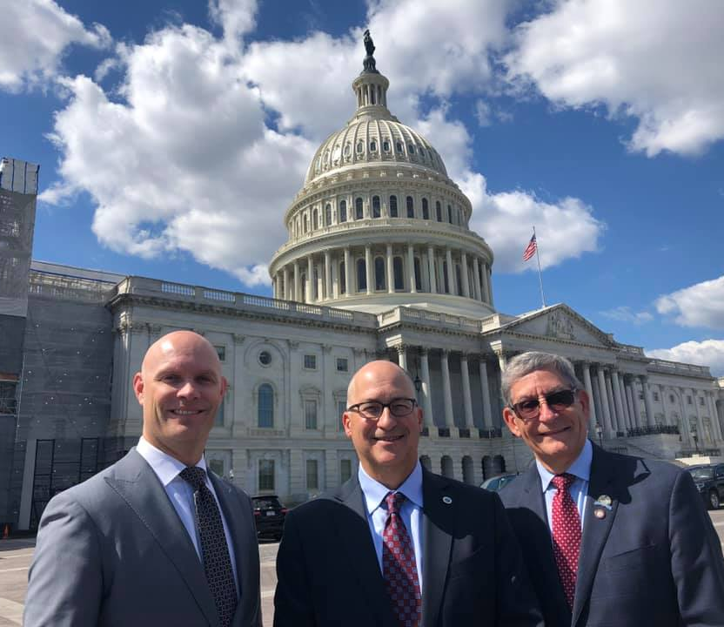
Federal Advocacy
CMA physician leaders made multiple advocacy trips to DC to warn Congress about negative impacts of AB 72
Notes:
Organized medicine has successfully slowed down bad bills
Congress looking for more thoughtful approaches: Congress finally realized that this is not about surprise billing anymore, it is about giving insurance companies even greater leverage in the market which will harm physician practices, access to care and drive consolidation.
(NOTE: Be careful about hospital consolidation since many AMA physicians employed by hospitals)

Slide 12
CMA’s Message to Congress: Avoid AB 72
Any legislative fix must:
Protect patients from surprise bills
Resolve disputes via fair baseball arbitration process (not IDR)
Arbitration criteria to include appropriate rates from an independent database
Ensure insurers maintain appropriate network of physicians

Slide 13
Unified Support for HR 3502 Ruiz/Roe
Based on proven, successful New York model
Protects patients from surprise bills
Establishes baseball arbitration system to resolve disputes
Payment criteria includes 80 percentile of billed charges from independent FAIR Health Database
Few cases to IDR because insurers are incentivized to resolve disputes
Premiums and costs stable
Notes:
All of organized medicine – AMA, CMA, states and specialties in support of HR 3502 Ruiz/Roe
RE: If you get asked why NY law not gaining traction in Congress – it’s the CBO Score. Members of Congress have said that the Surprise billing legislation does not need to save money but it cannot cost money. CBO’s estimate of the NY model (based on the 80th percentile of billed charges) shows a significant cost to the federal government which has harmed our efforts to achieve the NY model. You don’t have time to explain the CBO score on surprise billing but suffice it to say, it is not based on reality.

Slide 14
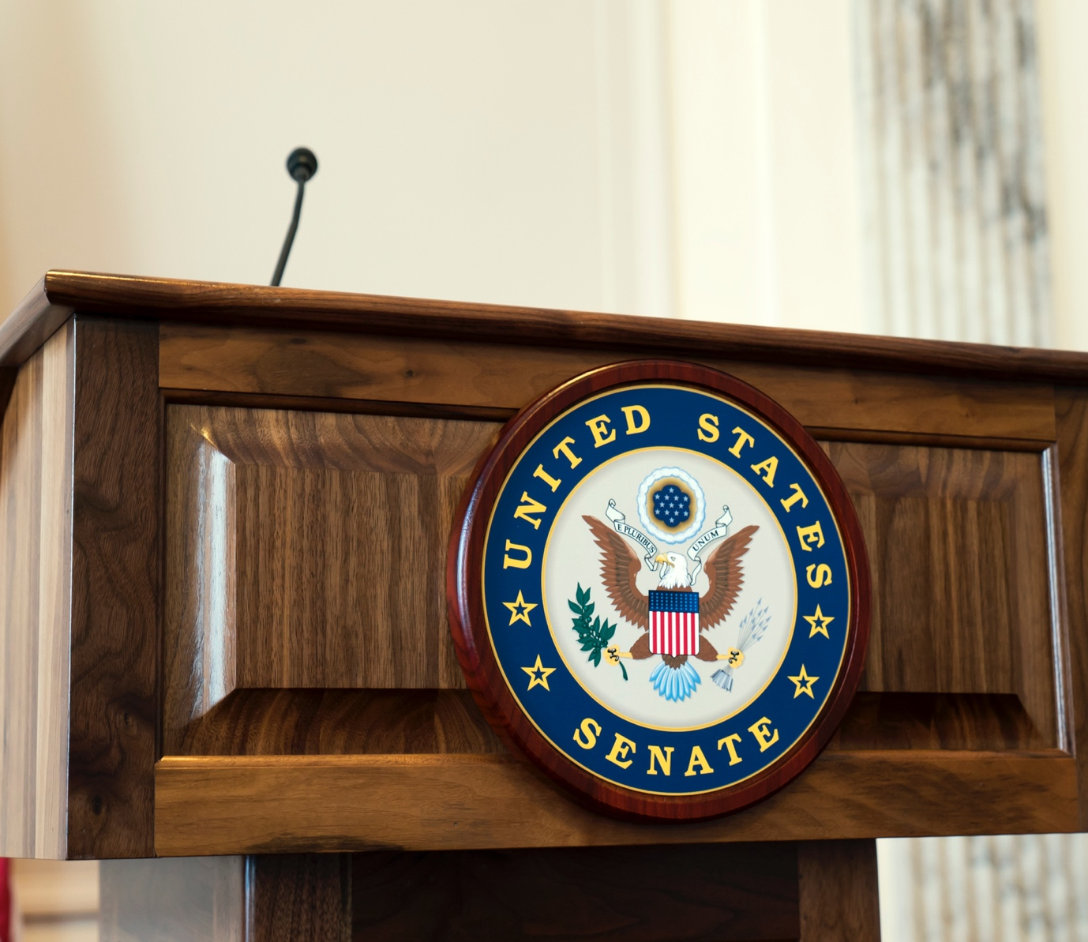
Future Federal Advocacy
AMA, CMA, states and national specialties are united
Stopped bad bills from moving further through Congress
Slowed the progress to ensure more thoughtful solutions
Continuing to support Ruiz/Roe framework
Notes:
CMA worked very hard to unify the states, specialties and AMA and we are proud to be part of this team. And I am convinced we have been successful because we have been unified.
Again, Congress finally realized that this is not about surprise billing anymore, it is about giving insurance companies even greater leverage in the market which will harm physician practices, access to care and drive consolidation.

Slide 15

Future California Advocacy
  AB 1174 attempts to address payor contracting abuses
  Implementation hearings, IDRP fixes & network audits
Notes:
In 2019, as previously discussed, we went after payors that are abusing AB 72 and forcing severe rate cuts or cancelling contracts outright.
In 2020, CMA will be advocating that the legislature exercise its oversight authority and ensure that the bill is properly implemented by fair and unbiased regulators.
AB 1174 was introduced in 2019 and is a 2-year bill so can be taken up in 2020.
Should the regulators not take action, the CMA will also be pursuing legislation o fix the IDRP process and address the interim payment rate.
CMA will also be advocating for a audit to be conducted on plan networks to provide a clear picture as to whether or not networks are adequate and plans are providing the best level of care.
We are also engaging with the Newsom administration to address some of the unintended consequences and misguided implementation of AB 72.

