Slide 1
CA Leads on Vaccines
Presentation to the Organization of State Medical Association Presidents
David H. Aizuss, M.D., CMA President
June 7, 2019

Slide 2
California Exemption Trends - 2010
Source: California Department of Public Health, Immunization Branch
Notes:
The immunization community began to get concerned about the rise of personal belief exemptions after seeing a steep increase PBE rates after 2000.
Andrew Wakefield’s fraudulent case series suggesting that there was a link between MMR and development disorders in children was published in the Lancet in1998.
To get a PBE, a parent only needed to submit a letter to the school that immunization was contrary to his/her beliefs.

Slide 3
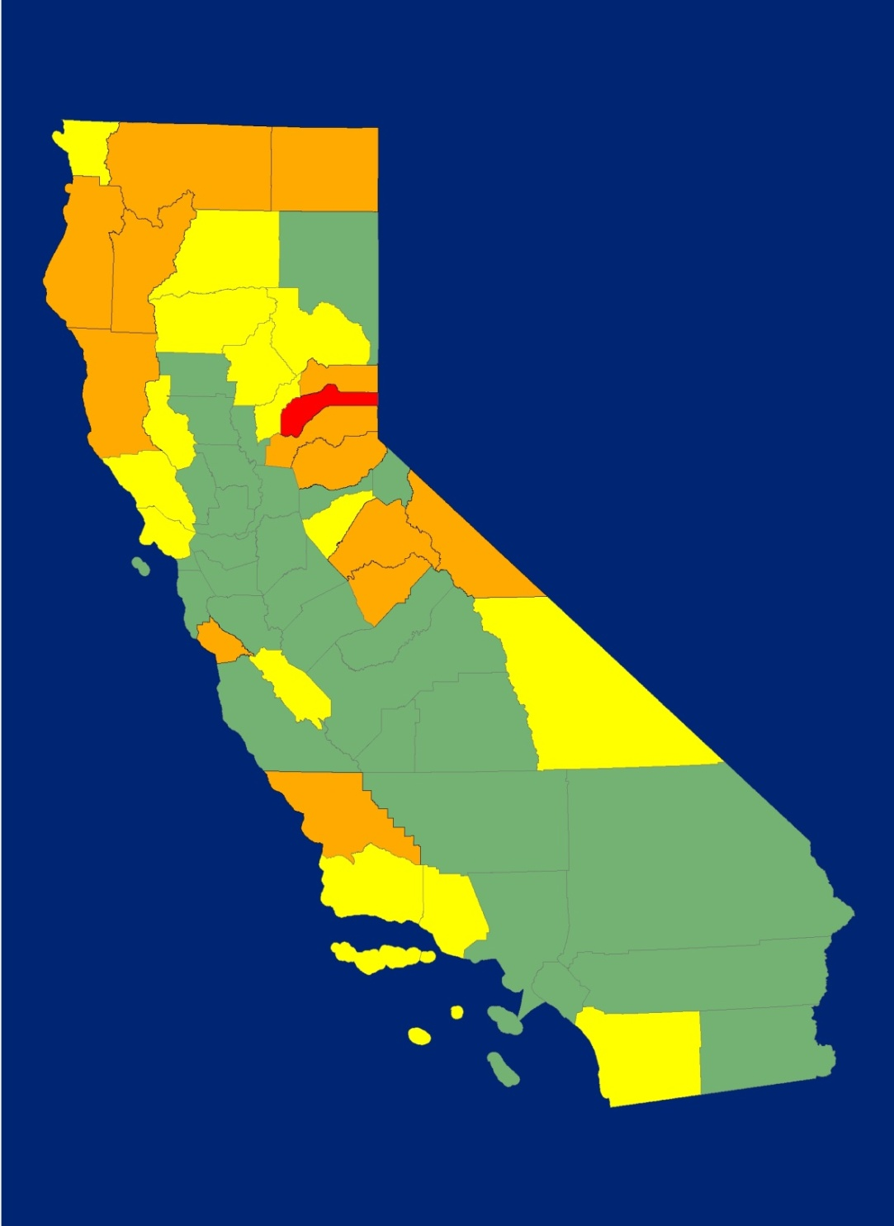
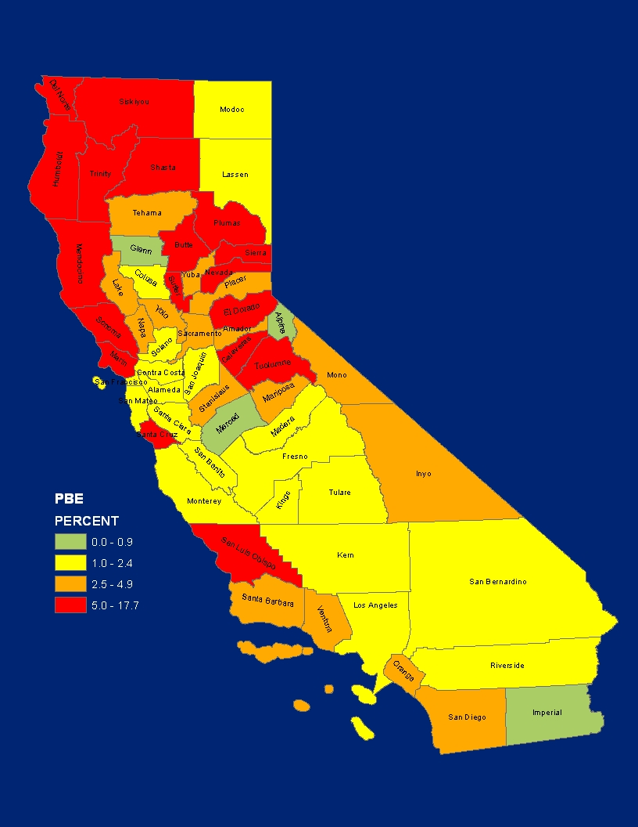
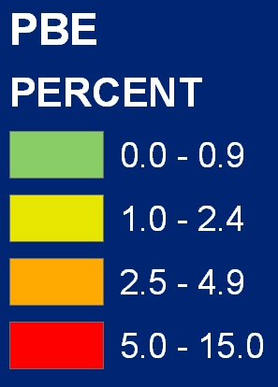
PBEs Among Children Entering Kindergarten
2000
2010
Source: California Department of Public Health, Immunization Branch
Notes:
This slide shows how the increase in PBEs looked by geographic region. In 2000, only one county had over 5% PBEs and most of the state – and the most densely populated areas of the state - were at levels that established community immunity. By 2010, community immunity was at risk in many parts of the state.

Slide 4
AB 2109 – Personal Belief Exemptions 2012
Authored by Dr. Richard Pan, Assemblymember
Required a parent or guardian seeking an exemption to show evidence that they had received information from a health care practitioner about the benefits and risks of the immunization, as well as the risks of the diseases a child could contract.
Effective January 1, 2014
Notes:
It was in this landscape that Dr. Pan and CMA joined to work on legislation to address the high rates of PBE use.
Dr. Pan an Assembly member at this time.
AB 2109 was based on a law in Washington State.
CMA co-sponsored AB 2109 with California Immunization Coalition and AAP.
It was not without controversy.
National anti-vaccine advocacy group, the National Vaccine Information Center (NVIC), rallied opposition that argued AB 2109 was discriminatory because “complementary and alternative medicine” providers were not authorized to sign the form documenting that a parent/guardian had received the necessary information.
Rob Schneider of SNL and Deuce Bigalow fame came to Sacramento to lobby against the bill.

Slide 5
AB 2109 - Governor’s Signing Message
I am signing AB 2109 and am directing the Department of Public Health to oversee this policy so parents are not overly burdened in its implementation. Additionally, I will direct the department to allow for a separate religious exemption on the form. In this way, people whose religious beliefs preclude vaccinations will not be required to seek a health care practitioner's signature. Sincerely, Edmund G. Brown Jr.
Notes:
Governor’s signing message opened a loophole to the requirement by establishing a “religious exemption.”

Slide 6
PBE Rates between AB 2109 and SB 277
Source: California Department of Public Health, Immunization Branch
Notes:
The 2014-15 was the first full school year that AB 2109 was in effect. The first data on AB 2109’s impact was released in 2015. Though the Governor’s signing message weakened the statute, there was still a small decrease in PBE rates.

Slide 7
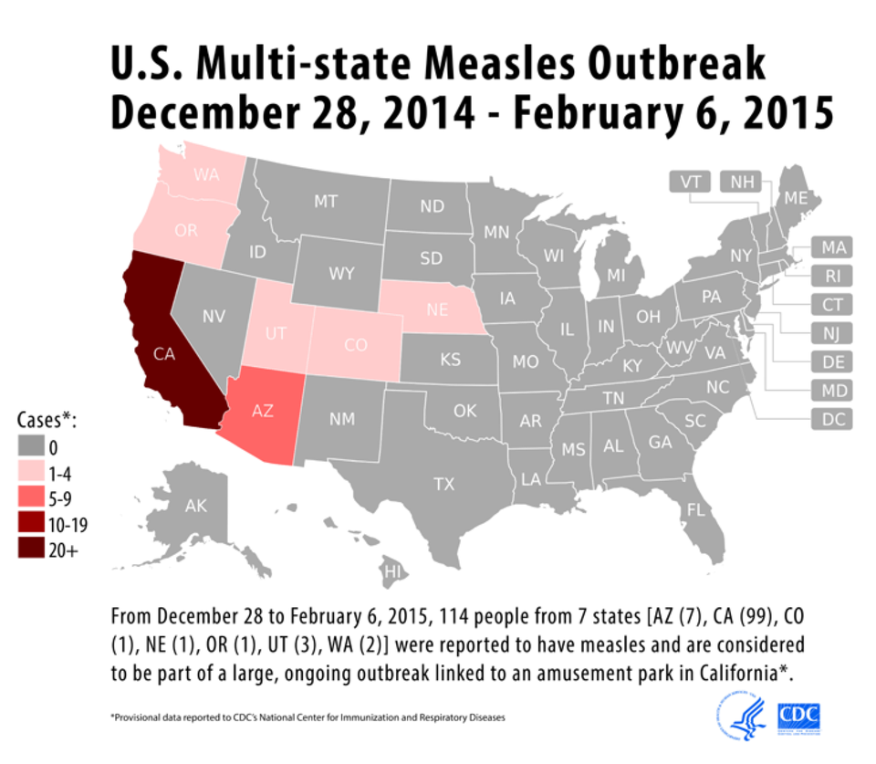
“Disneyland” Measles Outbreak
Notes:
In the winter of 2015, California became the center of a measles outbreak. The outbreak was traced to a case at Disneyland and then spread across California and the West Coast. And so people started calling it the “Disneyland Outbreak.”

Slide 8
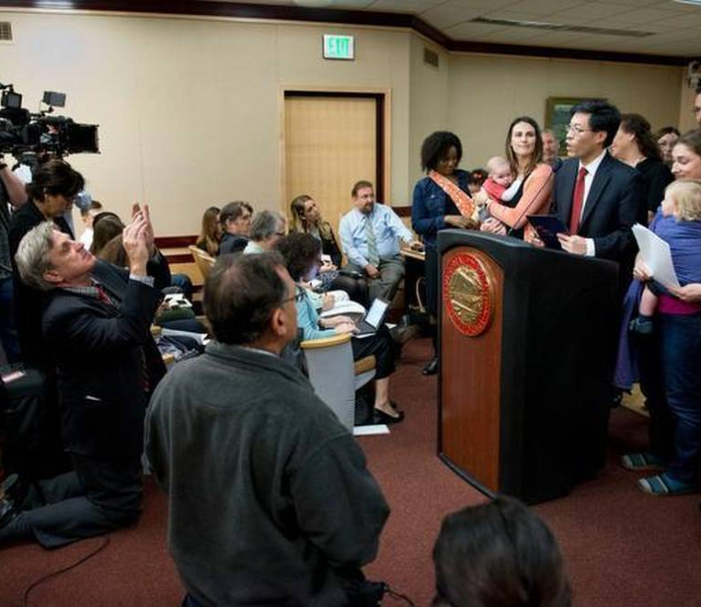
SB 277 – Elimination of PBEs 2015
Introduced – February 4, 2015
5 policy committee hearings
3 Floor votes
Signed by Gov. – June 30, 2015
Notes:
It was in the fallout of the measles outbreak that SB 277 was introduced.
At this point, Dr Pan had moved from the Assembly into the Senate.
This is a picture from the bill’s introduction. From day one, the bill caused a flurry of activity and opened the flood gates of opposition.
While most bill hearings before a policy committee take approximately 10 minutes, the hearings for SB 277 were, on average, 5 hours each. There were five of these hearings.

Slide 9
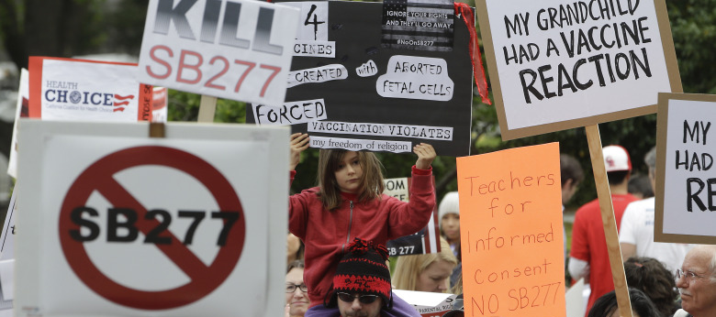
SB 277 Opposition
Notes:
Arguments made by the opposition:
Constitutionality – Legality of mandatory vaccination
Right to education issues
Volume of confusing information
Vaccine safety
Downplaying /denial of disease risk
There was also serious threats to legislators, CMA staff and other lobbyists working on the bill. CMA established security at its offices during the SB 277 fight. Lobbyists working on the bill were instructed to work in pairs over concerns over potential harassment. Parent advocates were targeted online and sometimes in their communities.

Slide 10
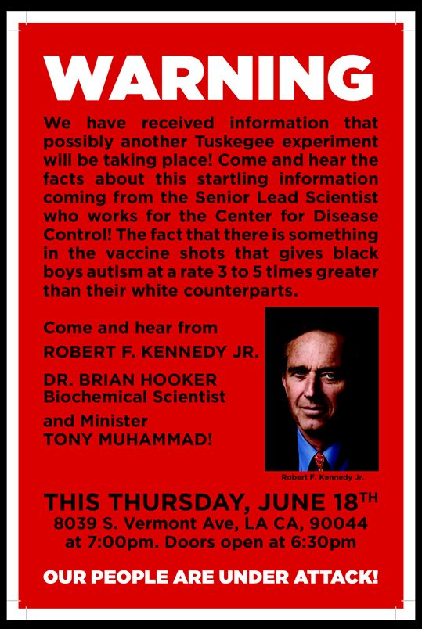
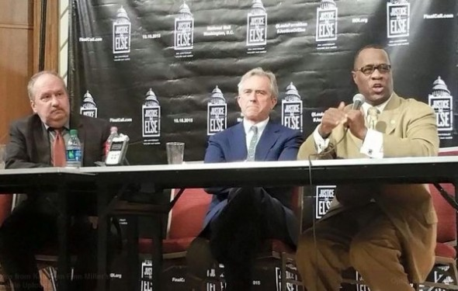
Opposition Events Held Around the State
An event in Los Angeles included Robert Kennedy, Jr., and representatives from the Nation of Islam.
Notes:
The event flier suggested the bill was like the Tuskegee experiment.

Slide 11
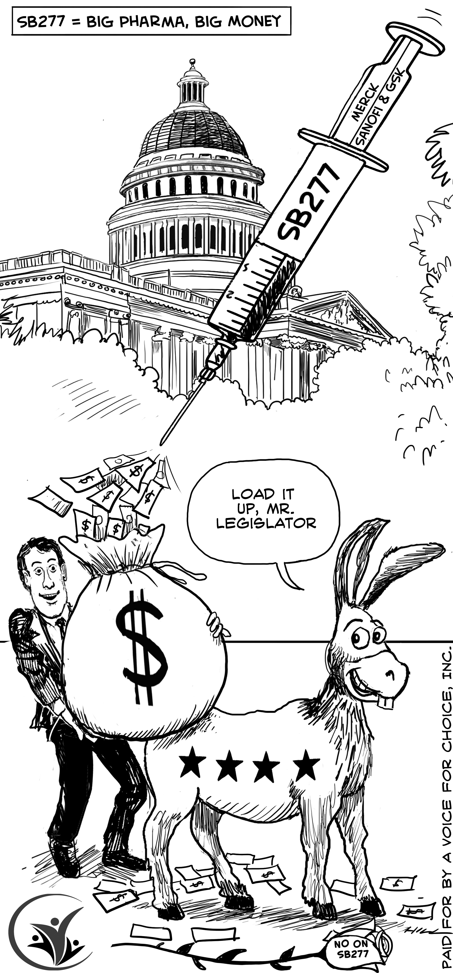
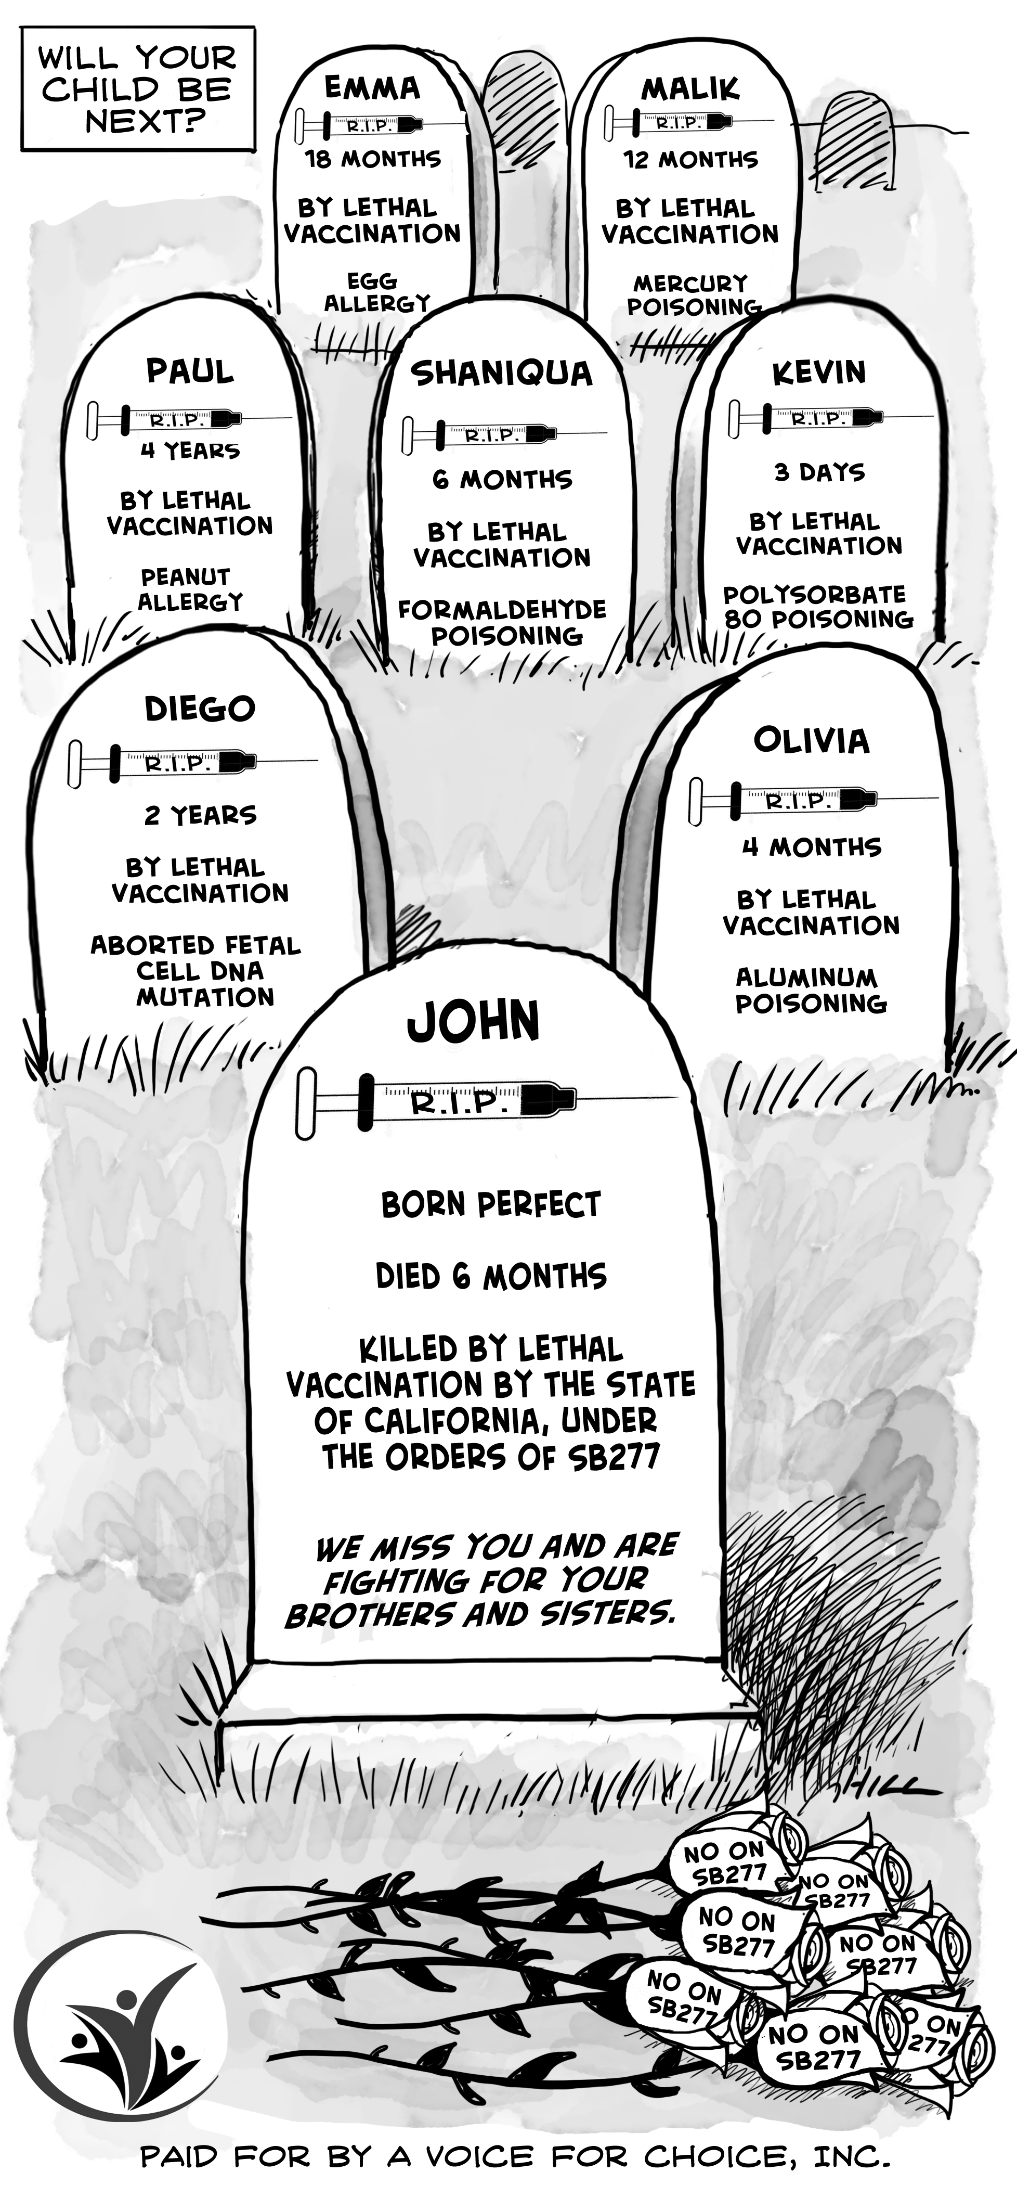
Anti-SB 277 Ads
Sacramento Bee – Week of June 22, 2015
Notes:
These ads ran in the Sacramento Bee during the time that SB 277 was being considered by the Governor. You’ll note they suggest that vaccination kills and that legislators were accepting bribes.

Slide 12
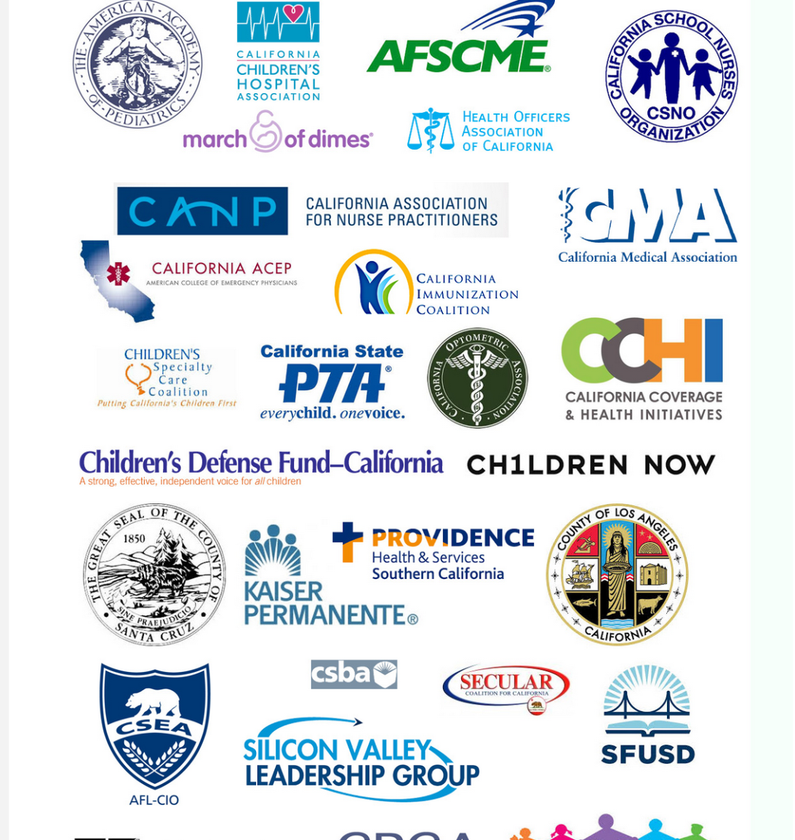
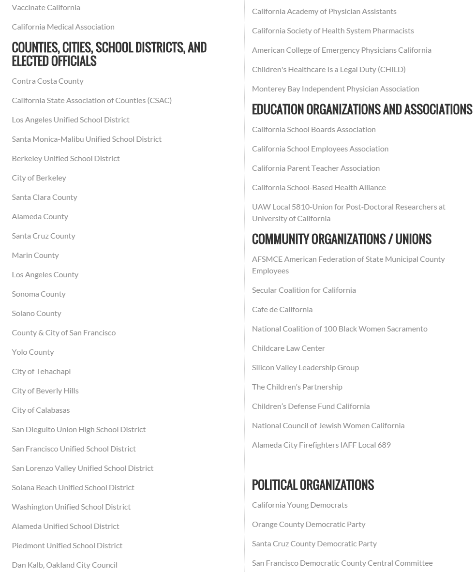
SB 277 Organizational Support
Notes:
To counter the opposition, we built a phalanx of support from cities and counties, education groups, local political organizations. This slide reflects only a portion of the supporters.

Slide 13
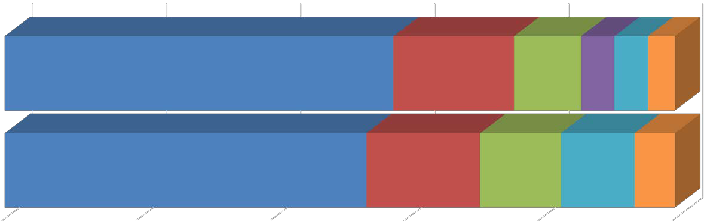
Increase in Permanent Medical Exemptions
All Required IZ
Conditional Entrants
Overdue
PBEs
PMEs
Other
2016-17
.5%
2017-18
1.1%
90% 92% 94% 96% 98% 100%
*Other children lacking required immunizations under criteria specified in SB 277.
Figure 7. Percentage of Public School Kindergarten Students by Reported Admission Status by School Year, 2016-2017 and 2017-2018
Source: California Department of Public Health, Immunization Branch
Notes:
After SB 277’s implementation, vaccination rates of children entering kindergarten are nearing all time-highs. BUT California saw a significant increase in the number of permanent medical exemptions. (See the aqua slice of the graph.) Additionally, these PMEs tend to cluster so that there are many schools that are well below the immunization rates required to establish community immunity.
Coinciding with the increase in PMEs, immunization advocates saw physicians selling medical exemptions online.

Slide 14
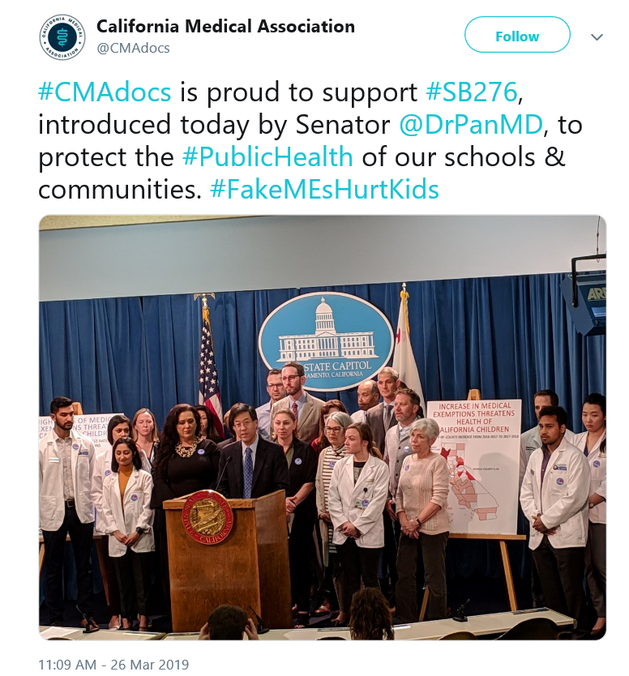
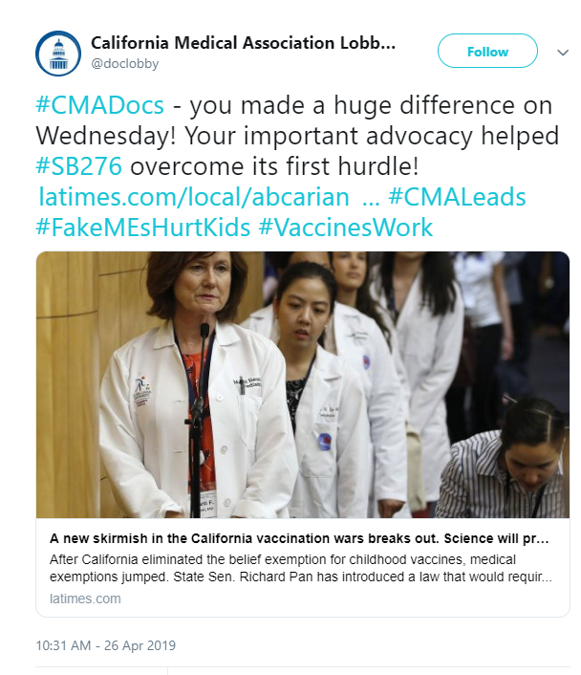
SB 276 – Medical Exemptions 2019
Notes:
This led to a new vaccine bill. SB 276 requires exemption from vaccination to be certified by a public health officer (a physician) before the exemption is granted.
The bill has passed its house of origin. It now awaits action in the second house (Assembly).
The opposition argues that the bill undermines the physician/patient relationship.

Slide 15
Lessons Learned
Having a physician legislator as author has been instrumental.
Parents who vaccinate are the best messengers.
Stay above the fray.
Message discipline is essential.

Slide 16
Gov.’s Controversial Comment
Governor Newsom supports vaccination but last weekend said..
“I like doctor-patient relationships. Bureaucratic relationships are more challenging for me. I’m a parent. I don’t want someone that the governor appointed to make a decision for my family.”
Notes:
Here’s an example of what happens when there’s not message discipline. The Governor’s statement, which seems to pull straight from opposition talking points, has now created a firestorm. It has even gotten a tweet of support from Robert Kennedy Jr. It wasn’t the Governor’s intent to sounds like someone who opposes vaccination, but he did. And we are all now working to address it.

Slide 17
Final chapter of SB 276
Still to come…
Notes:
So stay tuned.

Slide 18
David H. Aizuss, M.D., President daizuss@oaveyes.com

