Slide 1
AMA State Advocacy and the Urgency of the Moment in Medicine
Barbara L. McAneny, MD, FASCO, MACP
President
American Medical Association

Slide 2
New CDC numbers show plateau in overdose deaths

Slide 3
Progress to end opioid epidemic – highlights of new report
Every state has seen a decrease in prescribing over the last five years – 33 percent drop nationally.
PDMP use increasing; 435 million queries in 2018— triple the total from 2016. ​
Treatment capacity is increasing. More than 66k physicians are certified to provide buprenorphine to treat opioid use disorder.​
Physicians are enhancing their education -- nearly 700k physicians and others took CME in pain management and substance use disorders in 2018.​
Naloxone prescriptions increased from 136k in 2016 to nearly 600k in 2018.
(Source: AMA Opioid Task Force 2018 Progress Report)

Slide 4
New recommendations from the Opioid Task Force
Remove prior authorization, step therapy and other administrative burdens for MAT
Enforce state and federal mental health and substance use disorder parity laws
Remove barriers to pain care
Increase access to treatment for pregnant women and mothers
Support access to treatment within the civil and criminal justice systems

Slide 5
Prior authorization and other barriers to treatment
2018 survey of pain medicine specialists:
93% have been required to submit a prior authorization for non-opioid pain care, often spending hours on such requests;
68% have had to hire additional staff;
83% of pain medicine specialists said that they or their patients have been required to reduce the quantity or dose of medication they have prescribed.

Slide 6
11 states eliminate prior authorization for MAT; More to come
2019 – New Jersey, Arkansas, Colorado, Iowa, New York, Missouri, Virginia, Maine, Vermont, Washington agree to remove prior auth from MAT for substance use disorder.
October 2018 - Landmark agreement in Pennsylvania ends prior auth for MAT under state-regulated plans.
Access to MAT will also be available in Pennsylvania on the lowest cost sharing tier.
AMA calls on other states to follow in their footsteps.

Slide 7
Defending Title X
“The patient-physician relationship relies on trust, open conversation and informed decision-making, and the government should not be telling physicians what they can and cannot say to their patients.”
— AMA President Dr. Barbara McAneny

Slide 8
AMA policies to support reproductive health
Early termination of pregnancy is a medical matter between patient and physician.
The AMA strongly condemns any governmental interference into the practice of medicine that compromises physicians’ ability to use their medical judgment to determine treatment that is in the best interest of patients.
The AMA is working with states addressing this issue and offering legislative support, as well as potential litigation support.

Slide 9
Working with the Federation to protect the ACA
The AMA has acknowledged the ACA is flawed, and policymakers need to fix problems, gaps, and unintended consequences.
At the state level, Medicaid expansion should be a priority to reduce the number of low-income uninsured individuals in non-expansion states.
Congress should pursue policies that expand eligibility for tax credits inversely related to income, as well as increase tax credit amounts for populations including young adults.
Notes:
[Joel to handle]

Slide 10
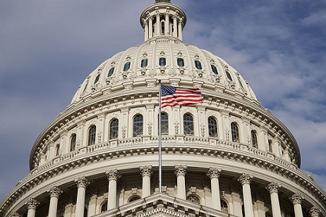
AMA proposals to correct ACA shortcomings
Expand eligibility for premium tax credits to five times the federal poverty level.
Offer enhanced premium tax credits to young adults while maintaining the existing tax credit structure, which is inversely related to income.
Address the ACA’s “family glitch” and lower the threshold that determines if an employee’s premium contribution is “affordable.”
Support state efforts to expand Medicaid eligibility to 133 percent of the federal poverty level

