Slide 1
MMS and SIF Advocacy
Henry L. Dorkin, MD, FAAP
President, Massachusetts Medical Society

Slide 2
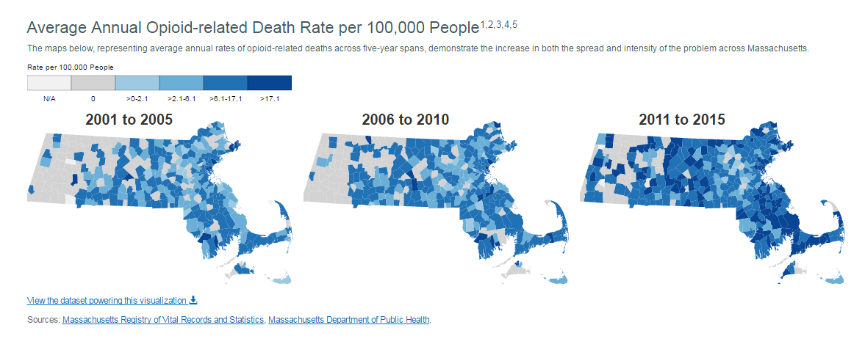
Opioid Crisis in Massachusetts
Notes:
Like all of you, we are in the midst of an opioid crisis that has impacted most of us professionally and personally.
The Massachusetts Medical Society has worked for the last few years to address prescribing habits as well as education of physicians and patients.
Our focus has been to prevent dependency.
To some extent, our efforts have worked. We have had 10,000 unique users of our free online CME programs on opioid prescribing. Between the beginning of 2015 and the beginning of 2016, we saw a more than 20% drop in prescriptions.
But the epidemic rages on, especially among those it had already touched. Last year, the state saw 2,000 opioid-related overdose deaths. We need to save lives.

Slide 3
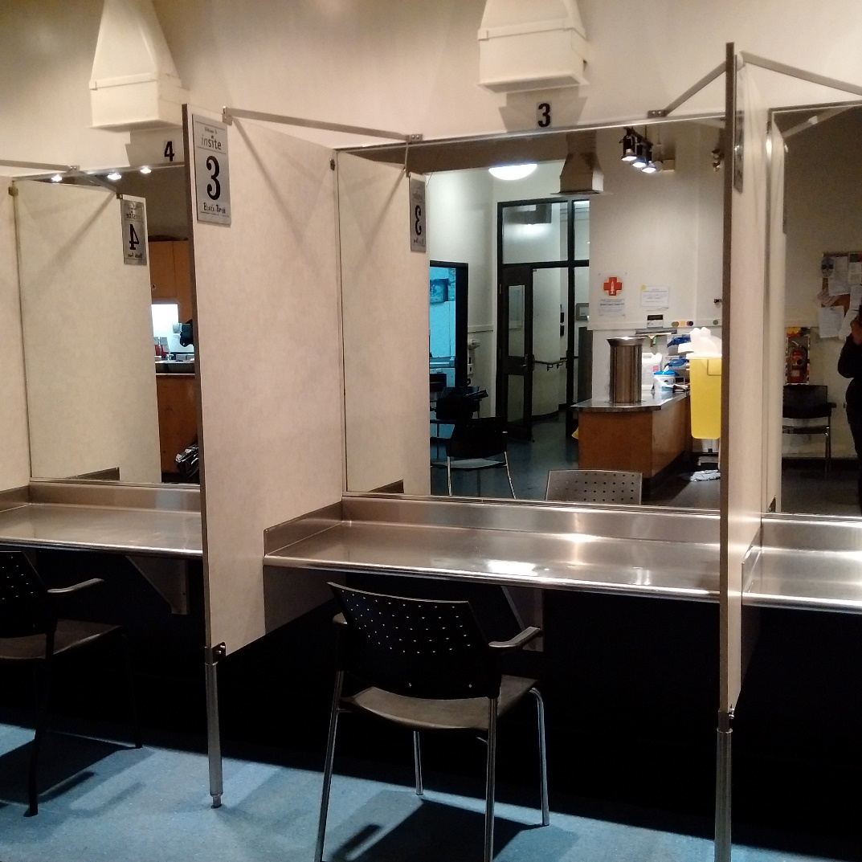
What is a Supervised Injection Facility? (SIF)
Notes:
Medically supervised injection facilities, also known as supervised or safe injection facilities (SIFs) or supervised consumption facilities, are a harm-reduction strategy designed to reduce overdoses and other harms associated with illegal drug use.
Specifically, a SIF is a legally approved public health facility that offers a hygienic environment where people can inject previously acquired illicit drugs under the supervision of trained staff. Some facilities also allow people to smoke illicit drugs.
Staff are medical professionals who are prepared to provide emergency care, including naloxone, when needed.
Importantly, SIFs do NOT supply illicit drugs to the patients. The patients themselves must bring their own.

Slide 4
History of the MMS and Supervised Injection Facilities
That the MMS perform an internal evidence-based study of the ethical, legal, and liability considerations and feasibility of a medically supervised injection facility in Massachusetts
That at the conclusion of an internal study of medically supervised injection facilities, the Board of Trustees will report back to the House of Delegates, no later than A-17, with recommendations for an MMS advocacy position on SIF.
Notes:
At our 2016 Annual Meeting last spring, the House of Delegates passed this resolution, stipulating that we study the concept of SIFs and that the Board report back with recommendations.
While conducting the research, we continued our advocacy on other life-saving efforts, such as improved access to naloxone and access to comprehensive treatment for those in recovery.

Slide 5
Compelling Data
Overdose mortality decreased by 35 percent
30 percent increase in rate of detoxification, increase in methadone maintenance initiation
No reports of negative consequences to communities
Cost-effective harm reduction
Notes:
When we reviewed the data, we saw that there is a clear, evidence-based argument in support of SIFs as a harm reduction approach.
These data come from the SIF in Vancouver, Canada. Reduction in overdose mortality. Increase in methadone initiation.
It’s thought that SIFs can protect against infections such as HIV and hepatitis C. They can protect persons who inject drugs, especially women, from street violence associated with public injectable drug use.
Before SIFs opened in other countries, there were concerns of negative consequences in the community, but reality has not borne these out.
There has been a reduction in public injection and related litter.
There is little change in drug deals, and there is no increase in crime.
One important point – after initial reticence, both business leaders and law enforcement in Vancouver have expressed support for that city’s SIF.
Data in support of SIFs continue to emerge. We addressed cost-effectiveness in our report, and just last week, Johns Hopkins University supplemented it with new estimates: “at an annual cost of $1.8 million, a single SIF would generate $7.8 million in savings, preventing 3.7 HIV infections, 21 Hepatitis C infections, 374 days in the hospital for skin and soft-tissue infection, 5.9 overdose deaths, 108 overdose-related ambulance calls, 78 emergency room visits, and 27 hospitalizations, while bringing 121 additional people into treatment.”

Slide 6
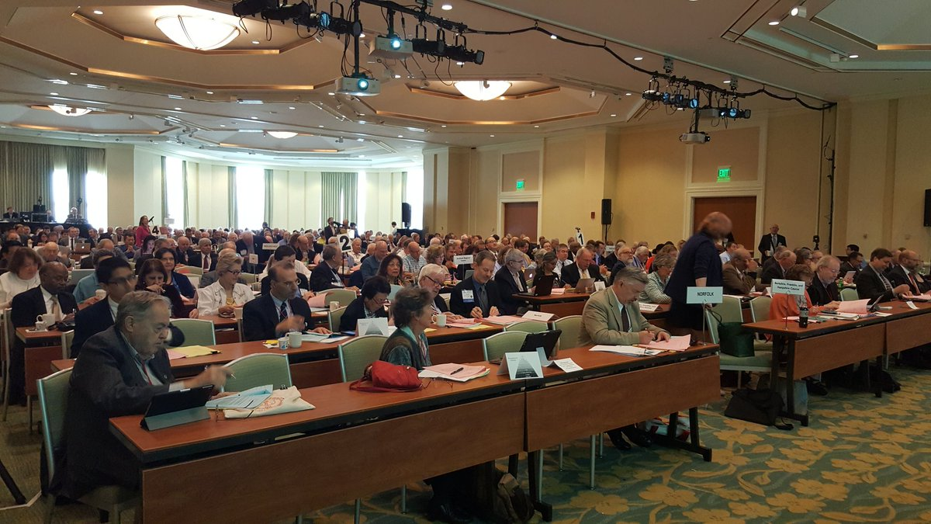
Annual Meeting 2017
“That the MMS advocate for a pilot supervised injection facility program in Massachusetts under the direction of a state-led task force convened by a state authority, such as the MA Department of Public Health, to discuss the legal considerations and paths forward…”
193-21
Notes:
With the research complete, at our recent Annual Meeting, our House overwhelmingly passed a resolution that we advocate for a pilot SIF program to be run by a state-led task force.
This is important – the MMS is not opening a SIF, nor are we saying that there should be open access statewide to SIF locations.
We’re saying that now, it is appropriate for the state to consider a pilot program to see if the success that other countries have reported would be reflected in the Commonwealth of Massachusetts.

Slide 7
So - Where do we go next?
Notes:
Since the resolution has passed, we have seen a groundswell of support. Media coverage was robust and remarkably favorable.
Our members have responded very positively, and now we are in the process of meeting with lawmakers and regulators to present the data and to clarify our position moving forward, given the specifics of and limitations of our resolution itself.
The future of this project is VERY uncertain, but so far, we do feel confident that it reflects our emphasis on public health and our members’ willingness to be innovative in the face of the opioid epidemic.

Slide 8
Learn more
Visit our website: www.massmed.org
Email mjussaume@mms.org
Notes:
We’ll be handing out copies of our report, but you can download more copies, along with our public-facing FAQ, off our website.
Or, if you prefer, email Michele Jussaume at the address on the screen.
Thank you.

