Slide 1



24/7 Virtual Policy & Membership Engagement System
Notes:
NEXT SLIDE

Slide 2
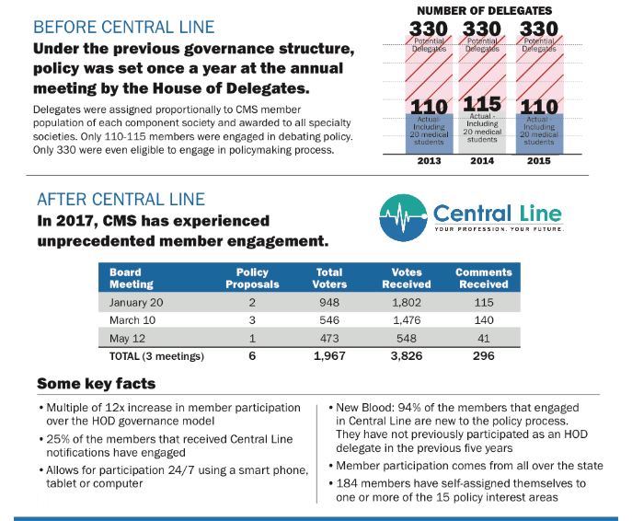
Increased Engagement
Notes:
What members are saying
Before I get into the latest legislative session, it’s important to quickly set the stage by explaining how we got here. There’s no better way of telling that story than to just share what physician members like you are saying.
CMS has commissioned 4 surveys of its members focused on the relationship between physicians and insurance companies:
It’s clear from the results of these surveys that insurers have significant market power over physicians, while we at the same time depend on insurers for the survival of our practices.
There are obviously serious problems with network adequacy which have negative effects on our ability to care for patients.
There are many interesting things about these surveys and if I could make one point it is this:
We have seen a continued focus across these surveys on the following core set of issues facing physician members:
1. Need for universal access to affordable health insurance and health care for all Coloradans.
2. Need for a reduction in onerous administrative requirements from government and commercial payers that take time away from patient care.
3. Need for transparency and fairness in contracting, authorization and reimbursement from commercial payers, and fairness in reimbursement from government payers.
NEXT SLIDE

Slide 3

How It Works
Notes:
What members are saying
Before I get into the latest legislative session, it’s important to quickly set the stage by explaining how we got here. There’s no better way of telling that story than to just share what physician members like you are saying.
CMS has commissioned 4 surveys of its members focused on the relationship between physicians and insurance companies:
It’s clear from the results of these surveys that insurers have significant market power over physicians, while we at the same time depend on insurers for the survival of our practices.
There are obviously serious problems with network adequacy which have negative effects on our ability to care for patients.
There are many interesting things about these surveys and if I could make one point it is this:
We have seen a continued focus across these surveys on the following core set of issues facing physician members:
1. Need for universal access to affordable health insurance and health care for all Coloradans.
2. Need for a reduction in onerous administrative requirements from government and commercial payers that take time away from patient care.
3. Need for transparency and fairness in contracting, authorization and reimbursement from commercial payers, and fairness in reimbursement from government payers.
NEXT SLIDE

Slide 4
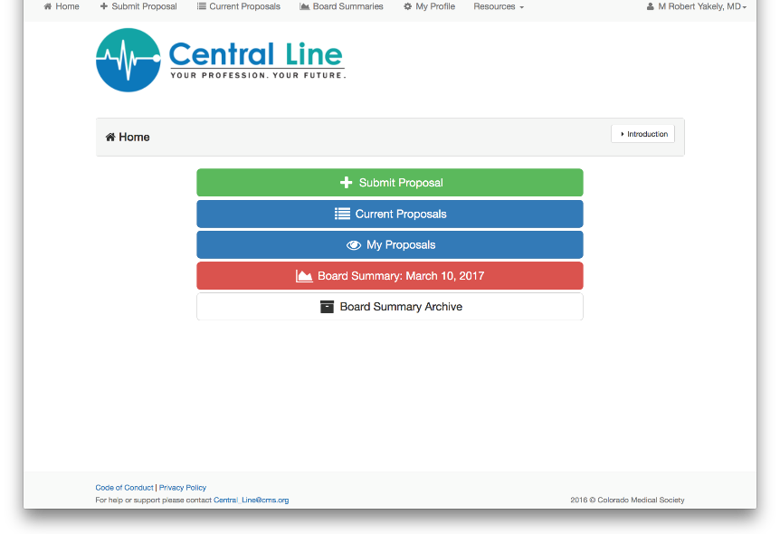
Landing Page
Notes:
What members are saying
Before I get into the latest legislative session, it’s important to quickly set the stage by explaining how we got here. There’s no better way of telling that story than to just share what physician members like you are saying.
CMS has commissioned 4 surveys of its members focused on the relationship between physicians and insurance companies:
It’s clear from the results of these surveys that insurers have significant market power over physicians, while we at the same time depend on insurers for the survival of our practices.
There are obviously serious problems with network adequacy which have negative effects on our ability to care for patients.
There are many interesting things about these surveys and if I could make one point it is this:
We have seen a continued focus across these surveys on the following core set of issues facing physician members:
1. Need for universal access to affordable health insurance and health care for all Coloradans.
2. Need for a reduction in onerous administrative requirements from government and commercial payers that take time away from patient care.
3. Need for transparency and fairness in contracting, authorization and reimbursement from commercial payers, and fairness in reimbursement from government payers.
NEXT SLIDE

Slide 5
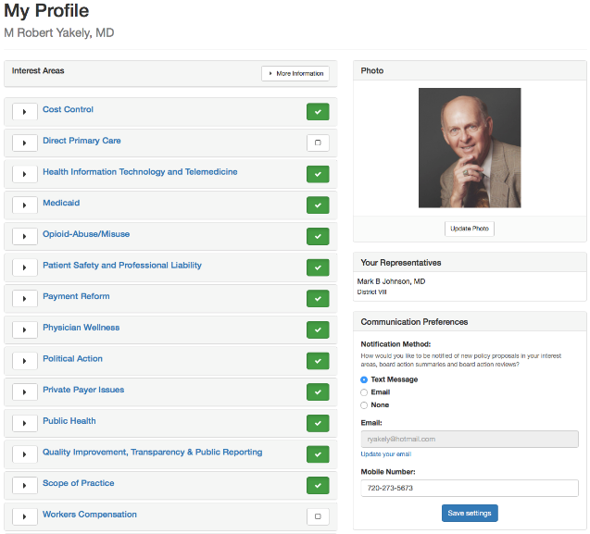

Member Profile Page
Notes:
What members are saying
Before I get into the latest legislative session, it’s important to quickly set the stage by explaining how we got here. There’s no better way of telling that story than to just share what physician members like you are saying.
CMS has commissioned 4 surveys of its members focused on the relationship between physicians and insurance companies:
It’s clear from the results of these surveys that insurers have significant market power over physicians, while we at the same time depend on insurers for the survival of our practices.
There are obviously serious problems with network adequacy which have negative effects on our ability to care for patients.
There are many interesting things about these surveys and if I could make one point it is this:
We have seen a continued focus across these surveys on the following core set of issues facing physician members:
1. Need for universal access to affordable health insurance and health care for all Coloradans.
2. Need for a reduction in onerous administrative requirements from government and commercial payers that take time away from patient care.
3. Need for transparency and fairness in contracting, authorization and reimbursement from commercial payers, and fairness in reimbursement from government payers.
NEXT SLIDE

Slide 6
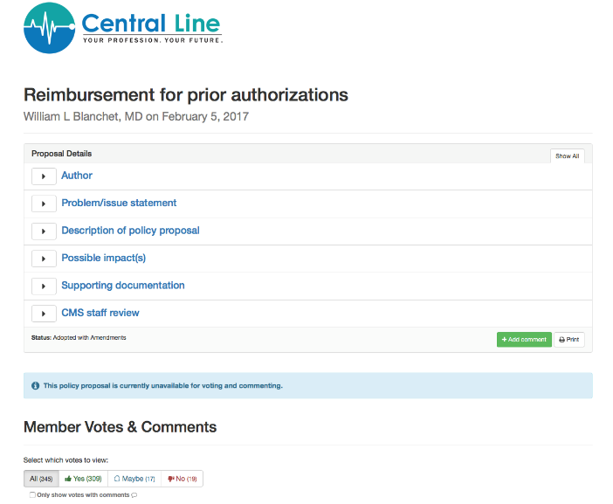
Policy Proposal
Notes:
What members are saying
Before I get into the latest legislative session, it’s important to quickly set the stage by explaining how we got here. There’s no better way of telling that story than to just share what physician members like you are saying.
CMS has commissioned 4 surveys of its members focused on the relationship between physicians and insurance companies:
It’s clear from the results of these surveys that insurers have significant market power over physicians, while we at the same time depend on insurers for the survival of our practices.
There are obviously serious problems with network adequacy which have negative effects on our ability to care for patients.
There are many interesting things about these surveys and if I could make one point it is this:
We have seen a continued focus across these surveys on the following core set of issues facing physician members:
1. Need for universal access to affordable health insurance and health care for all Coloradans.
2. Need for a reduction in onerous administrative requirements from government and commercial payers that take time away from patient care.
3. Need for transparency and fairness in contracting, authorization and reimbursement from commercial payers, and fairness in reimbursement from government payers.
NEXT SLIDE

Slide 7

Coffee Shop Friendly
Notes:
What members are saying
Before I get into the latest legislative session, it’s important to quickly set the stage by explaining how we got here. There’s no better way of telling that story than to just share what physician members like you are saying.
CMS has commissioned 4 surveys of its members focused on the relationship between physicians and insurance companies:
It’s clear from the results of these surveys that insurers have significant market power over physicians, while we at the same time depend on insurers for the survival of our practices.
There are obviously serious problems with network adequacy which have negative effects on our ability to care for patients.
There are many interesting things about these surveys and if I could make one point it is this:
We have seen a continued focus across these surveys on the following core set of issues facing physician members:
1. Need for universal access to affordable health insurance and health care for all Coloradans.
2. Need for a reduction in onerous administrative requirements from government and commercial payers that take time away from patient care.
3. Need for transparency and fairness in contracting, authorization and reimbursement from commercial payers, and fairness in reimbursement from government payers.
NEXT SLIDE

Slide 8
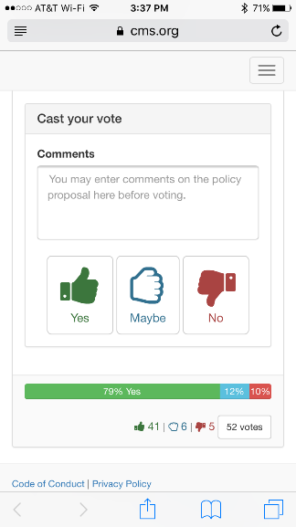
Members Vote on all Policies
Notes:
What members are saying
Before I get into the latest legislative session, it’s important to quickly set the stage by explaining how we got here. There’s no better way of telling that story than to just share what physician members like you are saying.
CMS has commissioned 4 surveys of its members focused on the relationship between physicians and insurance companies:
It’s clear from the results of these surveys that insurers have significant market power over physicians, while we at the same time depend on insurers for the survival of our practices.
There are obviously serious problems with network adequacy which have negative effects on our ability to care for patients.
There are many interesting things about these surveys and if I could make one point it is this:
We have seen a continued focus across these surveys on the following core set of issues facing physician members:
1. Need for universal access to affordable health insurance and health care for all Coloradans.
2. Need for a reduction in onerous administrative requirements from government and commercial payers that take time away from patient care.
3. Need for transparency and fairness in contracting, authorization and reimbursement from commercial payers, and fairness in reimbursement from government payers.
NEXT SLIDE

Slide 9
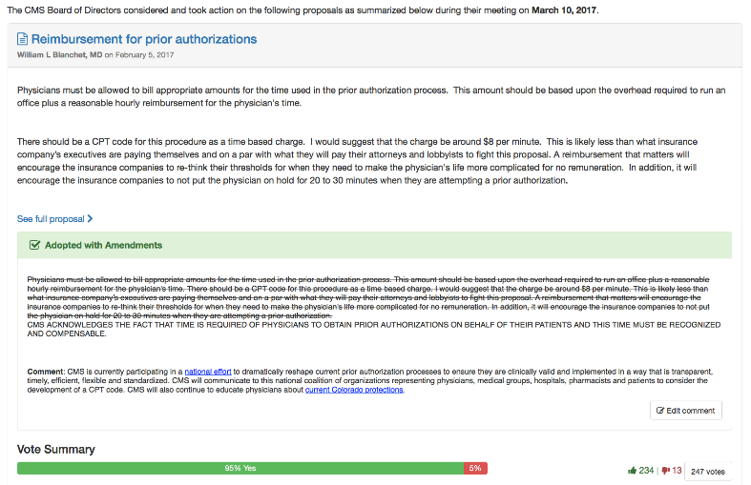
Board of Directors Decision
Notes:
What members are saying
Before I get into the latest legislative session, it’s important to quickly set the stage by explaining how we got here. There’s no better way of telling that story than to just share what physician members like you are saying.
CMS has commissioned 4 surveys of its members focused on the relationship between physicians and insurance companies:
It’s clear from the results of these surveys that insurers have significant market power over physicians, while we at the same time depend on insurers for the survival of our practices.
There are obviously serious problems with network adequacy which have negative effects on our ability to care for patients.
There are many interesting things about these surveys and if I could make one point it is this:
We have seen a continued focus across these surveys on the following core set of issues facing physician members:
1. Need for universal access to affordable health insurance and health care for all Coloradans.
2. Need for a reduction in onerous administrative requirements from government and commercial payers that take time away from patient care.
3. Need for transparency and fairness in contracting, authorization and reimbursement from commercial payers, and fairness in reimbursement from government payers.
NEXT SLIDE

Slide 10
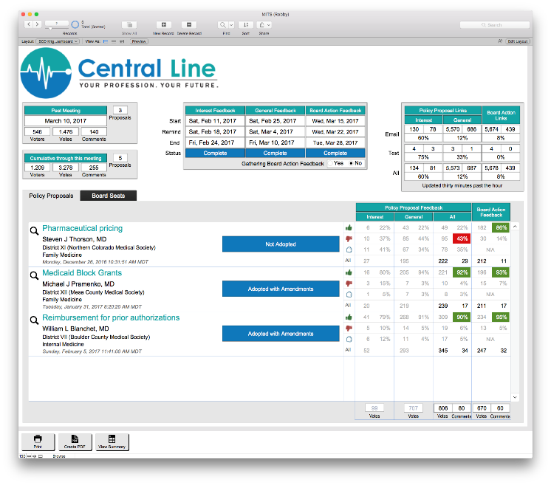
Board Decision Dashboard
Notes:
What members are saying
Before I get into the latest legislative session, it’s important to quickly set the stage by explaining how we got here. There’s no better way of telling that story than to just share what physician members like you are saying.
CMS has commissioned 4 surveys of its members focused on the relationship between physicians and insurance companies:
It’s clear from the results of these surveys that insurers have significant market power over physicians, while we at the same time depend on insurers for the survival of our practices.
There are obviously serious problems with network adequacy which have negative effects on our ability to care for patients.
There are many interesting things about these surveys and if I could make one point it is this:
We have seen a continued focus across these surveys on the following core set of issues facing physician members:
1. Need for universal access to affordable health insurance and health care for all Coloradans.
2. Need for a reduction in onerous administrative requirements from government and commercial payers that take time away from patient care.
3. Need for transparency and fairness in contracting, authorization and reimbursement from commercial payers, and fairness in reimbursement from government payers.
NEXT SLIDE

Slide 11
24/7 Virtual Policy & Membership Engagement System
Notes:
What members are saying
Before I get into the latest legislative session, it’s important to quickly set the stage by explaining how we got here. There’s no better way of telling that story than to just share what physician members like you are saying.
CMS has commissioned 4 surveys of its members focused on the relationship between physicians and insurance companies:
It’s clear from the results of these surveys that insurers have significant market power over physicians, while we at the same time depend on insurers for the survival of our practices.
There are obviously serious problems with network adequacy which have negative effects on our ability to care for patients.
There are many interesting things about these surveys and if I could make one point it is this:
We have seen a continued focus across these surveys on the following core set of issues facing physician members:
1. Need for universal access to affordable health insurance and health care for all Coloradans.
2. Need for a reduction in onerous administrative requirements from government and commercial payers that take time away from patient care.
3. Need for transparency and fairness in contracting, authorization and reimbursement from commercial payers, and fairness in reimbursement from government payers.
NEXT SLIDE

