Slide 2
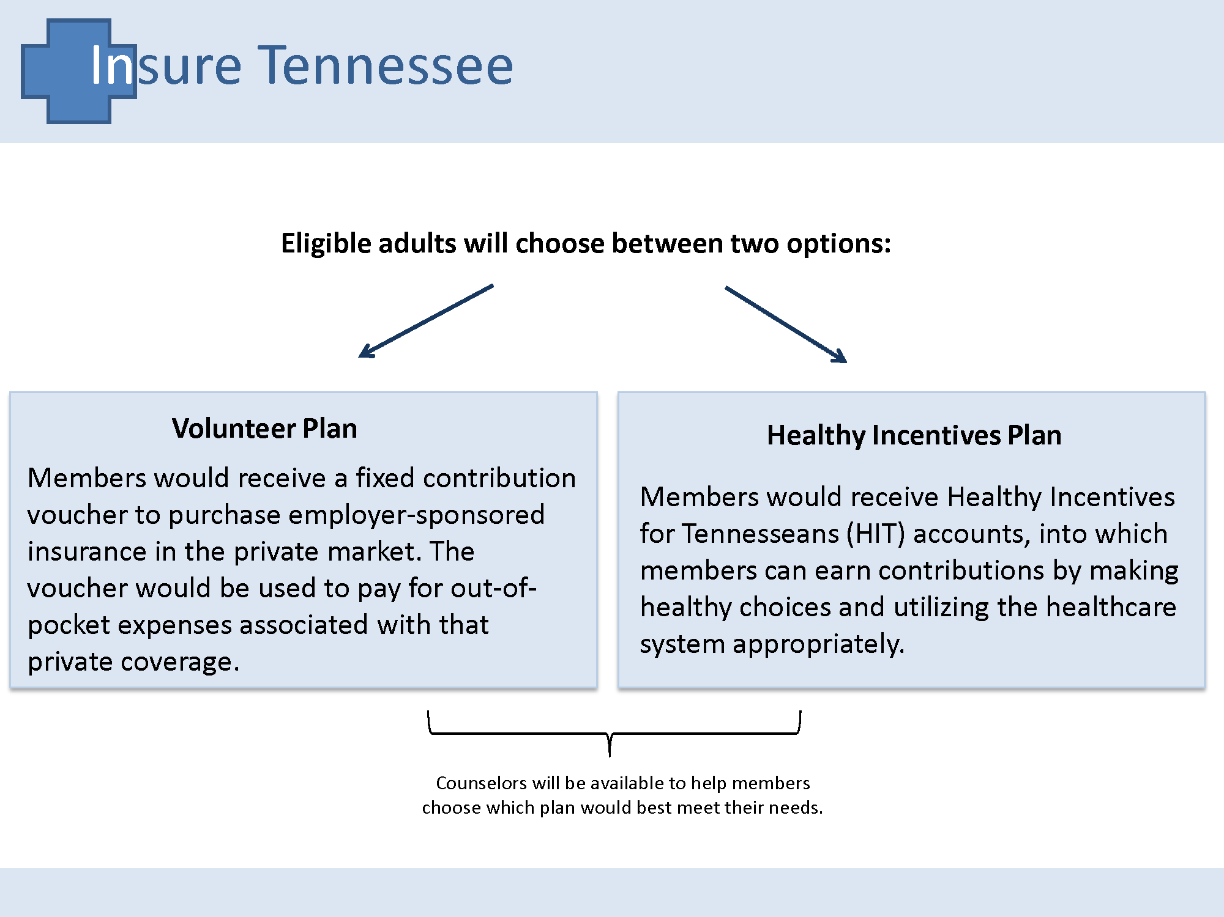

Slide 7
Medicaid and Insuring the Poor – Where are we heading? NEJMed 375 1405 (2016)
Effect of Medicaid Coverage on ED Use – NEJMed 375 1505 (2016)

