Slide 1
BRIAN BLASE
An Analysis of Insurer Performance Selling Exchange Plans and the Future
of the Affordable Care Act

Slide 2
ACA Main Coverage Provisions
Medicaid Expansion
Exchanges
Premium Tax Credits
Cost Sharing Subsidies
Individual Market Rules
Guarantee Issue
Modified Community Rating

Slide 3
What was expected for the exchanges when the law passed?

Slide 5
2016 Exchange Enrollment
12.7 Million People Signed Up
11 Million Average During Year

Slide 6
What is the Make-up of the Risk Pool?

Slide 7
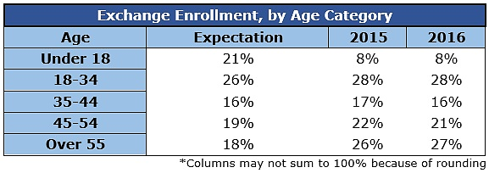
Skewing Older Than Expected

Slide 8
Skewing Poorer Than Expected

Slide 9
Affordable Care Act in 2014: Significant Insurer Losses Despite Substantial Subsidies
Reinsurance payments equaled $7 billion in 2014.
$833 per enrollee.
20% of premiums.
Average premiums would have needed to be 26% higher in 2014 in order to cover insurer expenses without reinsurance program.

Slide 10
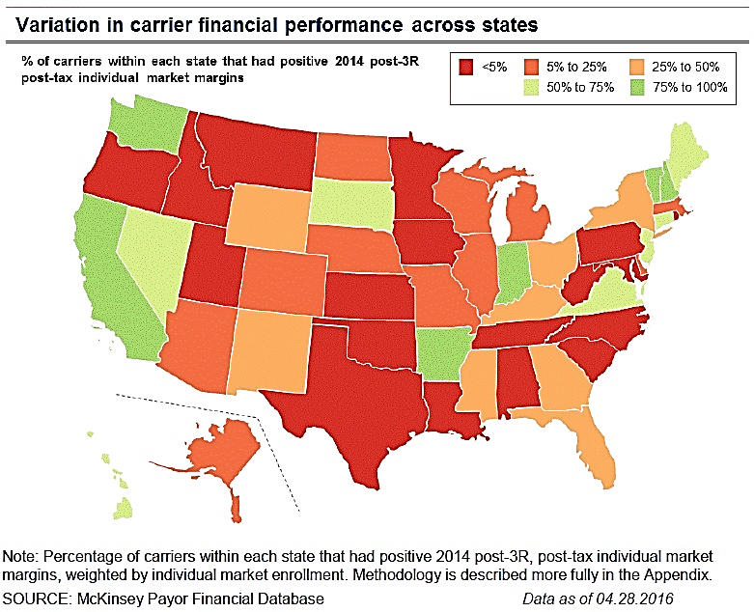

Slide 11
Payments Per Enrollee in 2014
State | Premium Income | Claims | Reins-urance | Risk Corridor
California | $4,361 | $3,701 | $661 | -$103
Florida | $4,760 | $4,734 | $807 | $181
North Carolina | $4,966 | $5,462 | $877 | $513
Ohio | $4,770 | $4,611 | $867 | $224
Tennessee | $3,857 | $5,232 | $897 | $657
Nationally | $4,437 | $4,433 | $833 | $273

Slide 12
State-Level Factors Correlated with Insurer Performance
Decision to adopt the President’s transition policy
Decision to expand Medicaid
Existence of a co-op
Functionality of the exchange platform

Slide 13
Carrier-Level Factors Correlated with Insurer Performance
Carrier Type (Co-ops—Worst; Kaiser—Best)
Plan Design (HMOs Performed Better Than PPOs)
Size of Provider Network (Smaller Performed Better Than Larger)

Slide 14
2015 Preliminary Results Show Higher Individual Market Losses
Spending Per Enrollee Up 69% between 2013 and 2015. (58% more than increase for workplace coverage.)
Insurers’ losses likely went from $400 per enrollee in 2014 to $1,000 per enrollee in 2015. (Low premium increases and large increase in medical claims).
McKinsey: “Aggregate losses may have doubled.”

Slide 15
Plans Not Attractive to Healthy and Young Without Large Subsidies

Slide 16
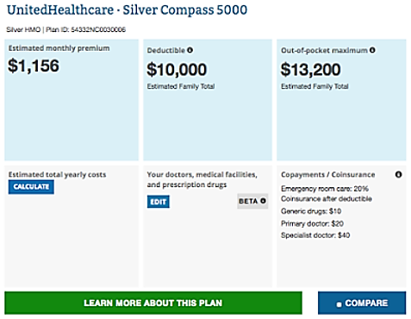

Slide 17
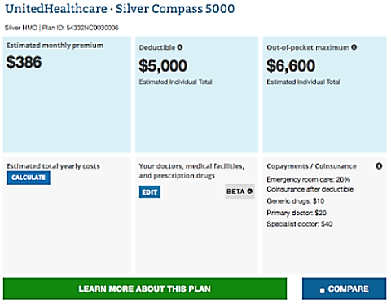

Slide 18
Many People Have Figured Out How to Take Advantage of ACA Rules

Slide 19
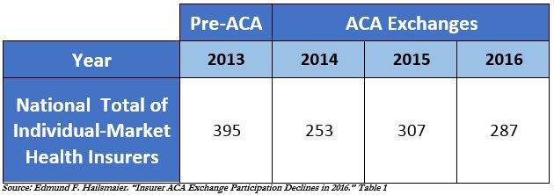
Declining Participation of Health Insurers

Slide 21
Premiums Rising for 2017
Weighted average requested premium increase: 21%
In six states — Arizona, Iowa, Kansas, Nebraska, Oklahoma, and Texas — gross premiums requests are more than 30% on average
Subsidized enrollees receive some protection from rising premiums.

Slide 22
What do enrollees think
of the coverage?

Slide 23
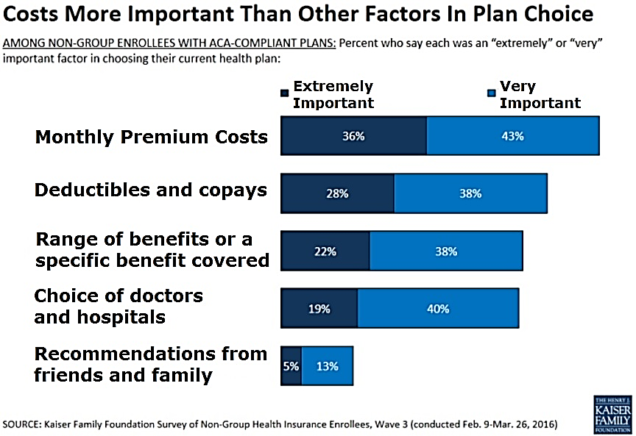

Slide 25
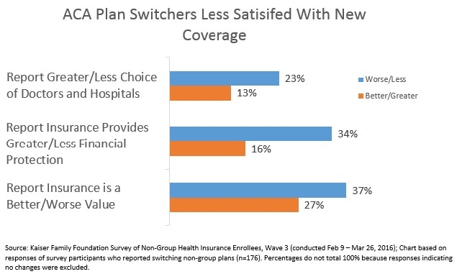

Slide 26
What does the future hold?

Slide 27
More Positive View
McKinsey: “The individual market has little risk of entering a classic insurance ‘death spiral’ as long as the federal government continues to offer subsidies to those with incomes below 400% of the FPL. Given the unique regulatory conditions of this market, the key determinants of its stability are not the traditional factors (risk and cost of care for this segment), but rather the ongoing subsidy payments.”

Slide 28
More Negative View
The ACA has caused significant adverse selection in the individual market and the exchanges are becoming high risk pools for sick people and people with income below 200% of the FPL.

Slide 29
Importance of Risk Adjustment
Intended to transfer money from insurers enrolling a healthy population to insurers enrolling a sicker population.
Lots of complaints and potentially adverse outcomes.
Insurers are very concerned about how this works.

Slide 30
What Republicans would like to do?
Return insurance market regulation to the states.
Replace Medicaid expansion and income-related subsidies with flat tax credits.

Slide 31
Potential Compromise
Additional State Flexibility
Redesign Subsidies
Repeal Cadillac Tax And Others

Slide 32
Source: Congressional Budget Office

