Slide 1
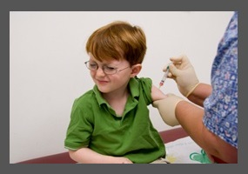
The WV Immunization Law - Holding the line
Hoyt J. Burdick, MD, FACP, FCCP
Previous WVSMA President
WV OMSS Chair
AMA Alternate Delegate

Slide 2
When childhood communicable diseases were expected…

Slide 3
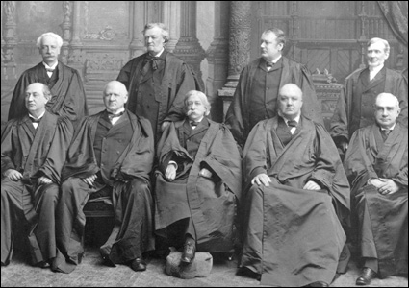
1905 Supreme Court – Jacobsen vs. Mass.
States may require children document that they
have had mandatory vaccinations before they
enter childcare and elementary school.

Slide 4
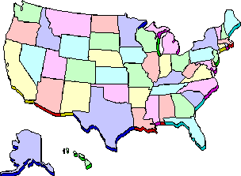
All States recognize Medical Exemptions
Compromised immune systems
Prior adverse reactions to immunizations
Allergy to vaccine components
Certain types of moderate or severe illnesses

Slide 5
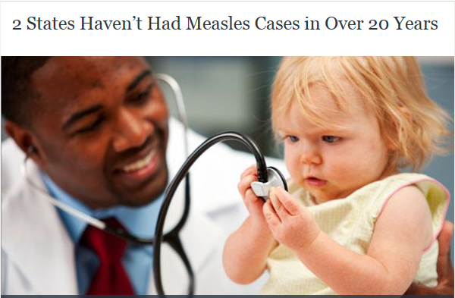
WV and MS leading the nation
WV laws date back to 1880’s
Modified from time to time, but retained only medical exemptions
Vaccination rate of 96 % (Mississippi: 99.7%)

Slide 6
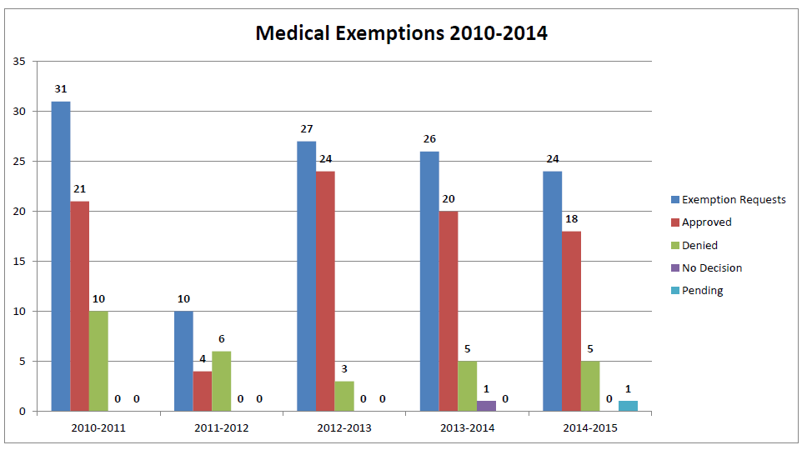
WV Childhood Immunizations: Medical Exemptions

Slide 7
States with legislation pertaining to non-medical exemptions in 2015
AK
WA
WA
MT
ND
ME
VT
OR
MN
VT
ID
WI
NY
NH
MA
WY
SD
MI
RI
NV
NE
IA
PA
CT
UT
IN
OH
NJ
CO
IL
DE
CA
WV
CA
KS
MO
VA
MD
KY
AZ
TN
NC
DC
AZ
NM
OK
AR
SC
MS
AL
GA
MS
TX
LA
HI
FL
Relax /Add PBE
Strengthen/Eliminate non-medical exemption
Notes:
To achieve multi-colored gradient, go to format-fill-gradient and then select colors by choosing “stops.”

Slide 8
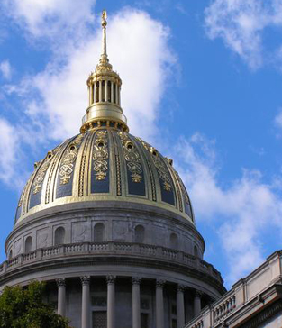
Legislative Drama : through the final 13 minutes
Bill to create a uniform and efficient method for obtaining medical exemptions
Amendment to remove authority of public health to require new vaccinations and added religious exemptions.

Slide 9
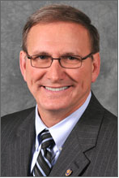
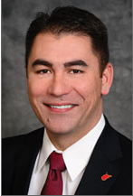
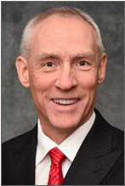
Legislative Drama : undoing a bad amendment
Chairman Ron Stollings, MD
Family Medicine
Senator Tom Takubo, MD
Pulmonary, Critical Care
Delegate Matt Rohrbach, MD
Gastroenterology
Concern that if DHHR had authority to add vaccines, it might add HPV (religious exemption clause might apply)
The legislature, not the DHHR (public health) should make determinations about health care mandates

Slide 10
Legislative Drama : down to the wire
House passed amended bill on final day (62-36)
Senate rejected House version with no time for bicameral conference committee (bill should have died)
11:47 PM, House approved Senate version (87-10) without amendment
The Governor vetoed due to an error in the title paragraph
Corrected in special session – law effective June 16, 2015

Slide 11
AMA A15 – Constitution and Bylaws
Resolution 007
Educational materials on vaccine efficacy to states
Encourage elimination of philosophical and religious exemptions
Mechanism for qualified public health officials to determine required vaccines, medical exemptions and science-based info for licensed physicians on specific exemptions by vaccine type
Resolution 008
Physicians have an obligation to accept immunization unless there is a recognized medical reason

Slide 12
AMA A-15 – Constitution and Bylaws
Resolution 009
Educate and encourage parents reluctant to vaccinate their children
Resolution 010
Reaffirm AMA Policy ending non-medical exemptions
Eliminate non-medical exemptions for federally funded educational programs including Head Start
Support state medical society efforts to eliminate non-medical exemptions in state statutes

Slide 13
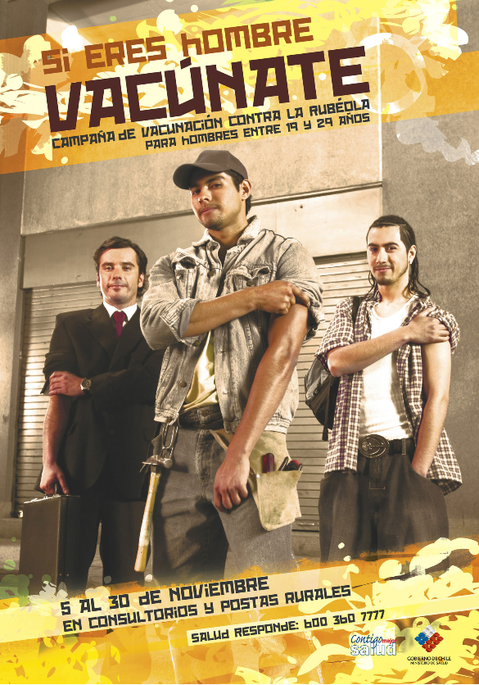
Rubella eliminated from the Americas !
The Americas region is the first
WHO region to eliminate rubella.
Last confirmed case: Argentina, 2009
Smallpox eliminated – 1971
Polio eliminated- 1994
April 29, 2015

Slide 14
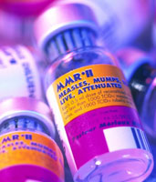
Long-term measles-induced immunomodulation increases overall infectious disease mortality
Measles depletes B and T lymphocytes
Measles-associated immune memory loss lasts 2-3 years
Immunologic sequelae of measles drive interannual fluctuations in non-measles mortality
Immunization prevents measles, but also reduces non-measles infectious disease mortality
Measles vaccination protects polymicrobial herd immunity
Science 8 May 2015: vol. 348 no. 6235, pp. 694-699

