Slide 1
Strengthening Patient-Physician Trust in Accountable Care Organizations: Challenges and Solutions
Susan Dorr Goold, MD, MHSA, MA
Professor of Internal Medicine and Health
Management and Policy
Center for Bioethics and Social Sciences in Medicine
University of Michigan

Slide 2
ACOs
Any health care provider group that cares for more than 5,000 Medicare FFS beneficiaries can form an ACO and apply to participate in Medicare “shared savings.”
Plan A) ACO shares savings but suffers no loss if its expenditures are higher than the benchmark
Plan B) ACO can share a greater portion of the savings at the risk of having to pay back a portion of Medicare’s losses if its expenditures are higher than the benchmark.
Both require an ACO to report and meet 33 national quality measures
NOTE: There are other ACOs

Slide 3
Accountable
1: subject to giving an account : answerable
2: capable of being accounted for : explainable
-Merriam-Webster online dictionary

Slide 4
Care
1: suffering of mind : grief
2a : a disquieted state of mixed uncertainty, apprehension, and responsibility
b : a cause for such anxiety
3a : painstaking or watchful attention
b : maintenance
4: regard coming from desire or esteem
5: charge, supervision
<under a doctor's care>
6: a person or thing that is an object of attention, anxiety, or solicitude
-Merriam-Webster online dictionary

Slide 5
Organization
1a : the act or process of organizing or of being organized
b : the condition or manner of being organized
2a : association, society
b : an administrative and functional structure (as a business or a political party); also : the personnel of such a structure
Merriam-Webster online dictionary

Slide 6
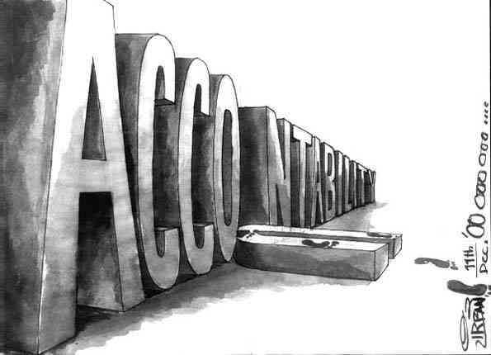
Accountability
Personal
Organizational
Professional
Political
Mutual
Development oriented – “The Paris Principle”

Slide 7
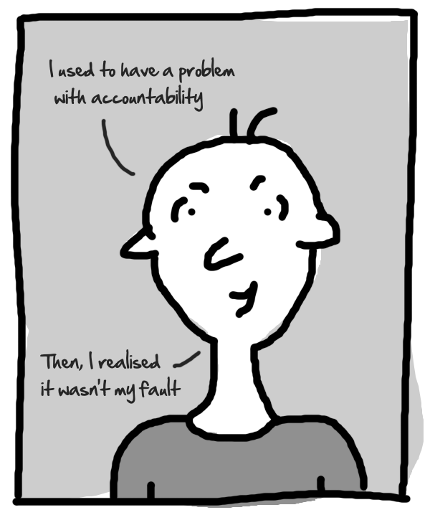
Personal Accountability

Slide 8
Accountability of organizations = Collective moral responsibility
Organizations are moral actors in modern society
Identity distinct from the sum of individuals
Act intentionally – internal decision-making structures and processes
Create role expectations with moral content
Doctors and nurses are patient advocates; administrators aim to maximize efficiency
Coordinate, subordinate actions and intentions of individuals
Respond to social conditions
Marketplace
Normative structure – goals, values, norms
Peter French (1979, 1984, 1985, 1992, 1995)
SD Goold, 2001

Slide 9
Accountable to whom?
Depends on the role of the organization or professional
Providing health care
Paying for health care
Combined payers + providers
Professional organizations (associations)
Patients (and their loved ones)
Potential (future) patients
Community
Employees and professionals
Payers
Society

Slide 10
Care
Attitude and activity directed toward another object
Intrinsically morally valuable when directed to another sentient being
Emphasizes relationships; recognizes moral agents as interconnected, in relationships that may have asymmetries of power and influence
Takes experiences and context into account (not=moral relativism)

Slide 11
Elements of Care
Sensitivity, attentiveness (recognize need)
Responsibility (take care of need)
Compassion
Competence (skill to provide care)
Annette Baier underscores trust, a basic relation between particular persons, as the fundamental concept of morality
Baier, Annette. Moral Prejudices: Essays on Ethics. Cambridge, MA: Harvard University Press, 1994

Slide 12
Professional Accountability
Moral obligations of physicians arise from
Power and status as professionals (Brody, The Healer’s Power)
Relationship between doctors and patients (or potential patients)
Vulnerability, imbalanced relationship
Professional’s duty to seek and deserve trust from patient(s)
Honesty & openness
Seek the patient’s good; use discretionary power on behalf of patients
Seek excellence in knowledge and skill
Respectful treatment
(more)
Patients also have moral responsibilities (e.g., to be truthful, to trust wisely)

Slide 13
Challenges to trust in physicians
Patient interest and organizational interest not aligned
E.g., recommend something that is (slightly) better for the patient but much more expensive?
E.g., persuade patient to have a “quality measure” done?
Patient expectations, requests and demands
Need for quality relationships and quality discussion (continuity, time, skill)
Shared decision-making; giving patient’s preferences serious weight
Need for evidence to inform discussions
Benefit of patient-oriented materials, tools
Perception of patient, family that doctor is trying to save money for the organization may breed distrust
Notes:
NOTE – recommending something you think is NOT better but more expensive is not trustworthy

Slide 14
Challenges to trust in physicians
Physician compensation
All ways of paying physicians carry incentives
FFS - $50 vs. $1000 for 20 minute service
Salary
Prepaid, capitated - large # patients, doctors vs. small #
Rewards (bonuses) and penalties (risks) – how much? For what?
Doctors respond to money (just like everyone else)
Recognize possible inclination
Doctors respond to their patients
Policies and procedures hurt patients
Gaming the system, lying vs. working to change

Slide 15
Trust in healthcare institutions
Provider organizations
Entrusted with health, well-being, treatment decisions, and private information of patients and potential patients
→competence, beneficence, confidentiality, more.
Payer organizations
Entrusted with pooled, limited resources and the financial well-being of individuals confronting illness, especially catastrophic illness.
→ fair and prudent use of resources, fidelity to and beneficence for the patient in need of resources.
Places where clinical professionals work
Safeguard trust-based relationships.
Employers
Result of social investment
Notes:
Employers
Social investment - trusted with the control and prudent use of community resources, and frequently with overseeing the health of the community

Slide 16
Challenges to Trust in ACOs
Planning and management for efficiency (administrative competence) vs. recognizing individuality of patients
Planning and management for efficiency (administrative competence) vs. uncertainty of predictions
E.g., being prepared for public health crisis or economic crisis
Supporting clinicians’ duties of advocacy for patients
Fostering trust - e.g., continuity, time with nurses and doctors
Measured quality is not the only or all of quality
‘study to the test’ phenomenon
Caring for the underserved
Seeking and addressing health disparities
Community health

Slide 17
Physicians AND healthcare organizations have moral responsibilities in health care
Physicians - stronger obligations of advocacy, some obligations of resource stewardship and fairness
Organizations - greater obligations of administrative competence, resource stewardship and fairness
Both - obligations of competence, albeit in different ways
Both - accountable to patients, potential patients, and society
Physicians’ actions affect trust in themselves, other physicians, and organization
E.g., responding to patient requests
Organization’s actions affect trust in organization and physicians
E.g., handling medical harm, compensation of physicians, continuity, time

