Slide 1
The Physicians Foundation
OSMAP General Session
November 9, 2012

Slide 2
The Physicians Foundation Overview
National non-profit organization formed in 2003 and dedicated to:
Improving the delivery of healthcare to all patients
Advancing the work of practicing physicians
Sustaining the viability of medical practice
Pursues mission through grantmaking, research, national surveys and policy studies
Given more than $28 million in grants
Conducted three nationwide surveys of physicians
Graduated over 100 physician leaders from our Academy

Slide 3
The Physicians Foundation Signatory Medical Societies
Alaska State Medical Association Medical Society of Northern Virginia
California Medical Association Medical Society of the State of New York
Connecticut State Medical Society Nebraska Medical Association
Denton County Medical Society (Texas) New Hampshire Medical Society
El Paso County Medical Society (Colorado) North Carolina Medical Society
Florida Medical Association South Carolina Medical Association
Hawaii Medical Society Tennessee Medical Association
Louisiana State Medical Society Texas Medical Association
Medical Association of Georgia Vermont Medical Society
Medical Society of New Jersey Washington State Medical Association

Slide 4
The Physicians Foundation Board Members
Louis J. Goodman, PhD, Texas Medical Association
Alan Plummer, MD, Medical Association of Georgia
Walker Ray, MD, Medical Association of Georgia
Robert Seligson, North Carolina Medical Society
Larry Braud, MD, Louisiana State Medical Society
Don Alexander, Tennessee Medical Association
Subhi Ali, MD, Tennessee Medical Association
Karl Altenburger, MD, Florida Medical Association
John Arveson, Washington State Medical Association
Todd Atwater, South Carolina Medical Association
James Cross, MD, Aetna, Inc.
Lawrence Downs, Esq., Medical Society of New Jersey

Slide 5
The Physicians Foundation Board Members
William Guertin, California Medical Association
Paul Harrington, Vermont Medical Society
Ripley Hollister, MD, El Paso County Medical Society (Colorado)
Sandra Johnson, Nebraska Medical Association
Palmer Jones, New Hampshire Medical Society
Alex Malter, MD, Alaska State Medical Society
Gerald McKenna, MD, Hawaii Medical Association
Gary Price, MD, Connecticut State Medical Society
Philip A. Schuh, Medical Society of the State of New York
Claudia Tellez, Medical Society of Northern Virginia
Joseph Valenti, MD, Denton County Medical Society (Texas)

Slide 6
The Physicians Foundation Communication Activities
External Communications
Developed and launched new website
Offers access to comprehensive array of research studies, white papers, grant opportunities and other resources
Visit us at www.physiciansfoundation.org
Annual Report and Grants brochure being sent to all medical societies
Next round of physician leadership grantmaking underway
White papers on scope and blueprint for American medicine at our meeting next week
Notes:
The Physicians Foundation has also focused its attention this year on developing materials that clearly and transparently explain the work of the Foundation
We encourage you to visit our newly designed website, where you can find a comprehensive array of research studies, white papers, grant opportunities and other resources
This year we have created a Foundation brochure and 2011/2012 annual report that will be mailed to key constituencies including medical societies

Slide 7
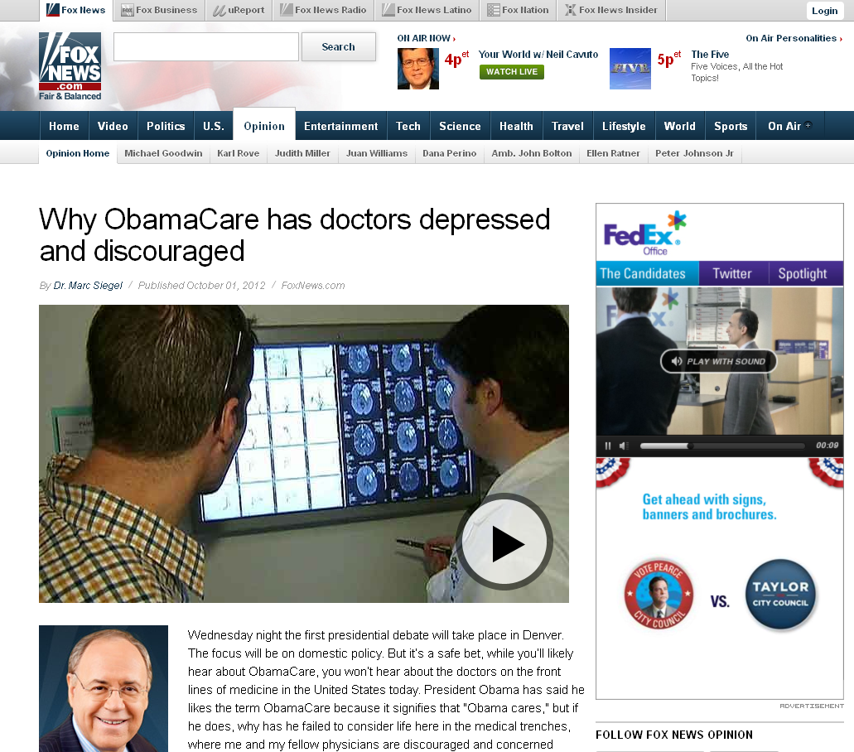
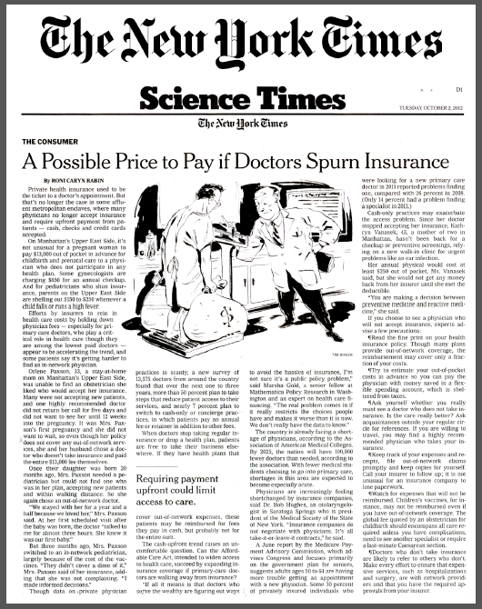
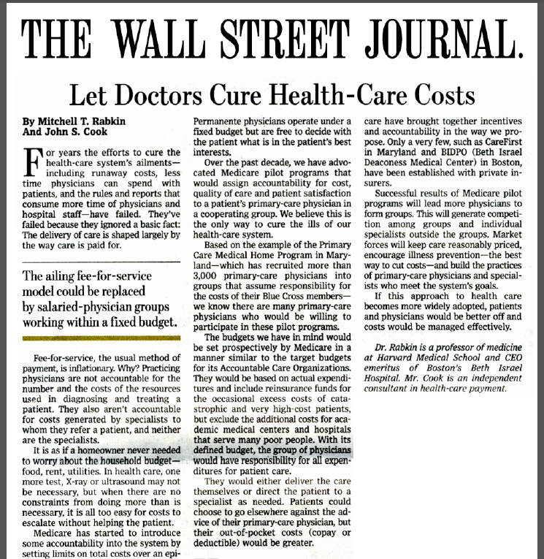
The Physicians Foundation Communication Activities
Media Coverage
Notes:
The work that we have done has greatly interested the media, and we’ve seen The Physicians Foundation written about in top-tier and national media outlets, including The New York Times, The Wall Street Journal, The Washington Post, Reuters and Fox News
We’ve established the Foundation as an expert source for several trade publications, including HealthLeaders, Medical Economics, Healthcare Finance News, Physicians Practice and others
Now let me share with you in more detail some of the work we have been involved in this year, which has helped to garner this kind of media attention…

Slide 8
The Physicians Foundation Research Activities
2012 Biennial Physicians Survey
Conducted large-scale physician survey in 2012:
Surveyed nearly 14,000 physicians on current practice patterns, professional morale and perspectives on the state of medicine and the healthcare system

Slide 9
The Physicians Foundation Research Activities
2012 Biennial Physicians Survey
Key findings include:
80 percent cited ‘patient relationships’ as the No.1 most satisfying aspect of practicing medicine
More than 50 percent of physicians will cut back on patients in the next one to three years
52 percent of physicians have limited access for Medicare patients or are planning to do so; 26 percent of physicians have already closed their practices altogether to Medicaid patients
77 percent of physicians are pessimistic about the future of medicine
58 percent of physicians would not recommend medicine as a career to their children

Slide 10
The Physicians Foundation Research Activities
2012 Biennial Physicians Survey
Secured more than 50 media placements in 2012
Held face-to-face meetings with top healthcare industry reporters / policy analysts at The New York Times and Forbes
Led Editorial Board briefing at The Wall Street Journal with Dan Henninger (Deputy Editorial Page Director) and two members of his team
Shared state data with medical societies to include results in communications, especially for local media contacts
Notes:
Secured coverage more than 50 media placements in outlets such as The New York Times, Fox News Broadcast, Forbes.com, Medical Economics, Modern Healthcare, Hospitals & Health Networks, HealthLeaders, Pittsburgh Tribune-Review, South Florida Sun-Sentinel and more

Slide 11
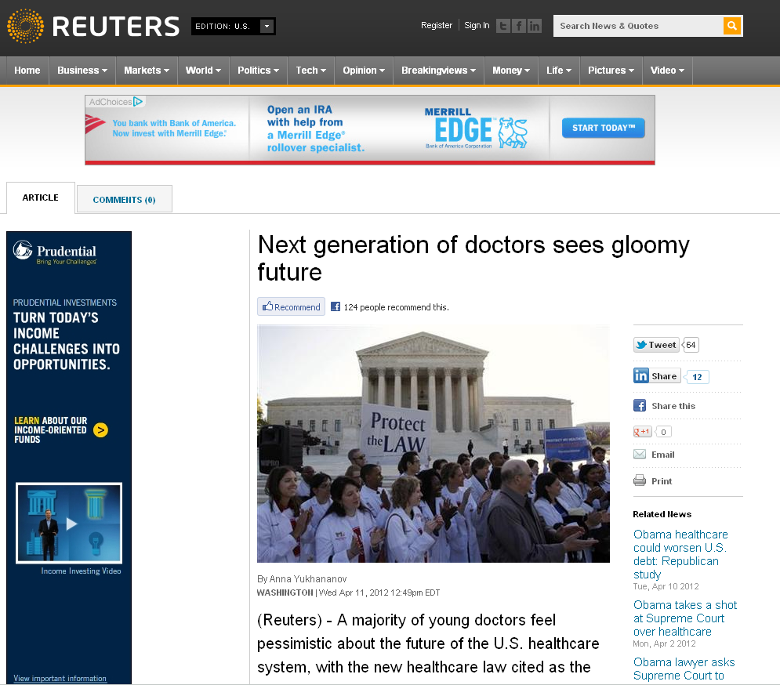
The Physicians Foundation Research Activities
Next Generation Physician Survey
Fielded national random sample survey to obtain insight into thoughts of young physicians (40 and younger) on the state of U.S. healthcare
Notes:
Secured exclusive with Reuters, which was picked up by several national, regional and trade outlets, including Yahoo! News, CNBC.com, MSNBC.com, Chicago Tribune, Politico, Kaiser Health News, Modern Healthcare, HealthLeaders and more
Key findings include:
Fifty-seven percent of young physicians (40 years of age and under) are pessimistic about the future of the U.S. healthcare system
Young physicians cited “the new healthcare law” as the leading reason for their pessimism. Specifically, when asked about the Affordable Care Act (ACA), nearly twice as many respondents believe that the legislation will hurt their practices compared to those who think it will have a positive effect (49 percent and 23 percent, respectively)
Only 35 percent of these newly minted physicians consider themselves “highly satisfied” with their current practice arrangements. For more than half of the respondents (65 percent), financial considerations, including income and cash flow, were the primary drivers in choosing their current practice arrangements. A quarter (25 percent) of survey respondents noted that they chose their current arrangement because it was “the only job available.”

Slide 12
The Physicians Foundation Research Activities
Next Generation Physician Survey
Key findings include:
57 percent of young physicians are pessimistic about the future of the U.S. healthcare system:
Cited “the new healthcare law” as the leading reason for pessimism:
49 percent of respondents believe that the legislation will hurt their practices compared to 23 percent of those who think it will have a positive effect
Only 35 percent consider themselves “highly satisfied” with their current practice arrangements:
Financial considerations, including income and cash flow, were the primary drivers in choosing their current practice arrangements
A quarter of survey respondents noted that they chose their current arrangement because it was “the only job available”
Only 12 percent of physicians who are currently employees of large hospital groups would stay in their current position if given a choice
Notes:
Secured exclusive with Reuters, which was picked up by several national, regional and trade outlets, including Yahoo! News, CNBC.com, MSNBC.com, Chicago Tribune, Politico, Kaiser Health News, Modern Healthcare, HealthLeaders and more
Key findings include:
Fifty-seven percent of young physicians (40 years of age and under) are pessimistic about the future of the U.S. healthcare system
Young physicians cited “the new healthcare law” as the leading reason for their pessimism. Specifically, when asked about the Affordable Care Act (ACA), nearly twice as many respondents believe that the legislation will hurt their practices compared to those who think it will have a positive effect (49 percent and 23 percent, respectively)
Only 35 percent of these newly minted physicians consider themselves “highly satisfied” with their current practice arrangements. For more than half of the respondents (65 percent), financial considerations, including income and cash flow, were the primary drivers in choosing their current practice arrangements. A quarter (25 percent) of survey respondents noted that they chose their current arrangement because it was “the only job available.”

Slide 13
The Physicians Foundation Research Activities
Consumer Survey
Fielded national random sample survey of more than 2,000 U.S. adults to understand consumer attitudes toward primary care physicians and the U.S. healthcare system
Notes:
Secured coverage in national and trade outlets, including The Washington Post, Modern Physician Medical Economics and more
Key findings include:
79 percent of consumers who visited their family doctor or primary care physician (PCP) at least once in the past year said they were “very satisfied” or “extremely satisfied” with their visits
Factors related to personalized care, time spent with their doctors and empathy are the main drivers for overall satisfaction
Consumers and physicians express similar viewpoints on the importance of the physician-patient relationships - 80 percent of physicians indicated that the patient relationships are the number one most satisfying aspect of practicing medicine, according to the 2012 Biennial Physicians Survey
A majority of respondents (53 percent) are negative about the future of healthcare in the U.S., versus 22 percent who are positive
39 percent believe the impact of PPACA on healthcare will be negative, vs. 26 percent who feel the impact will be positive
Insurance companies (75 percent) and pharmaceutical / drug companies (74 percent) are cited as main healthcare cost drivers
55 percent feel insurance companies are negatively impacting quality of care

Slide 14
The Physicians Foundation Research Activities
Consumer Survey
Key findings include:
79 percent of consumers who visited their family doctor or primary care physician (PCP) at least once in the past year said they were “very satisfied” or “extremely satisfied” with their visits:
Factors related to personalized care, time spent with their doctors and empathy are the main drivers for overall satisfaction
Consumers and physicians express similar viewpoints on the importance of the physician-patient relationships
A majority of respondents (53 percent) are negative about the future of healthcare in the U.S., versus 22 percent who are positive
Consumers cited insurance companies (75 percent) and pharmaceutical / drug companies (74 percent) as main healthcare cost drivers
55 percent feel insurance companies are negatively impacting quality of care
Notes:
Secured coverage in national and trade outlets, including The Washington Post, Modern Physician Medical Economics and more
Key findings include:
79 percent of consumers who visited their family doctor or primary care physician (PCP) at least once in the past year said they were “very satisfied” or “extremely satisfied” with their visits
Factors related to personalized care, time spent with their doctors and empathy are the main drivers for overall satisfaction
Consumers and physicians express similar viewpoints on the importance of the physician-patient relationships - 80 percent of physicians indicated that the patient relationships are the number one most satisfying aspect of practicing medicine, according to the 2012 Biennial Physicians Survey
A majority of respondents (53 percent) are negative about the future of healthcare in the U.S., versus 22 percent who are positive
39 percent believe the impact of PPACA on healthcare will be negative, vs. 26 percent who feel the impact will be positive
Insurance companies (75 percent) and pharmaceutical / drug companies (74 percent) are cited as main healthcare cost drivers
55 percent feel insurance companies are negatively impacting quality of care

Slide 15
The Physicians Foundation Research Activities
Expert Perspectives on the Future of Medical Practice
White Papers authored by Jeff Goldsmith; and Steven Issacs & Paul Jellinek:
Goldsmith report explores critical issues affecting practicing physicians including the impending doctor shortage
Isaacs/Jellinek paper includes new models and strategies physicians can use to survive – and even thrive – in today’s evolving healthcare environment
Commissioned white paper on Scope of Practice to explore status of this issue in different states, to complement AMA SOPP
Notes:
Released, “The Future of Medical Practice: Creating Options for Practicing Physicians to Control their Professional Destiny” by Jeff Goldsmith, PhD
Released, “Survival of the Fittest. A Review of Promising Models for the Maintenance of Independent Private Medical Practice”
Secured coverage in trade outlets including, Modern Physician, Healthcare Finance News, Physician Practice and more

Slide 16
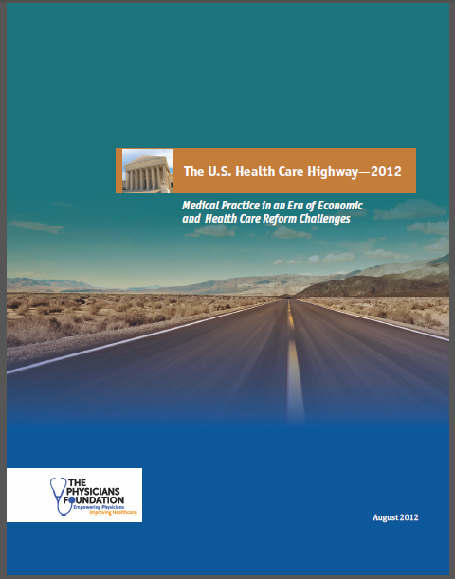
The Physicians Foundation Research Activities
Visions of the Future of Healthcare
Commissioned “The U.S. Health Care Highway—2012” as a follow up report to “A Roadmap for Physicians to Health Care Reform”
Commissioned “The Blueprint for American Healthcare” white paper to focus on possible models for the healthcare system from the physicians’ and patients’ perspectives
Wrote white paper on “The Cost of Care”

Slide 17
The Physicians Foundation Grantmaking Activities
Grantmaking with the States
Issued Physician Leadership RFP for projects & initiatives focused on Innovation and Education
Hosted Physician Leadership Webinar to provide best practices in leadership and share successes of past grantees
Issued nine large grants to states for improving medical practice viability
Reviewing dozens of grants for physician leadership
Considering grantmaking for cost of care studies, red tape reduction and integrated medical systems

Slide 18
The Physicians Foundation Grantmaking Activities
Grantmaking examples:
Awarded $588,762 to six organizations for Medical Practice Support
Awarded $35,000 to LSMS Educational and Research Foundation to study EMR adoption inhibitors
Awarded $190,000 to California Medical Association Foundation for the Physician/Payor Initiative

Slide 19
The Physicians Foundation Work in Progress
New round of leadership RFPs for state societies issued for 2013
Ongoing physician workforce simulation with University of North Carolina at Chapel Hill due in late 2013
Identification of the rules and regulations, both public and private that are not cost-effective nor improve patient care
Putting final touches on Foundation “Healthcare Watch List” for 2013
Notes:
Watchlist: confusion and uncertainty; red tape reduction; erosion of autonomy, bigger better?; end of life??????

Slide 20
What Does the Future Hold for The Physicians Foundation?
Continued Grantmaking to advance medical practice and to support physicians
Commission White Papers on the key issues of the day like cost drivers & physician directed medical models
Leadership education for physicians nationally and locally
Media communications and surveys of physicians and patients

Slide 21
Questions or Comments?

