Slide 1
Pre-Authorizations for Lab Tests: A New Strategy in Florida
Alan B. Pillersdorf, M.D. FACS
President Florida Medical Association

Slide 2
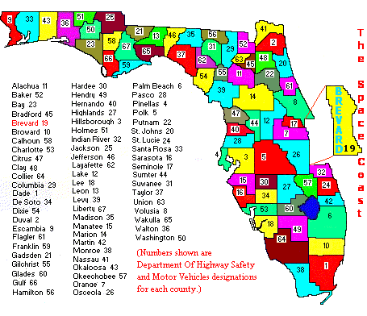
Florida Medical Association
Eight Districts: A,B,C,D,E,F,G,H
32 County Medical Societies and Associations
28 Specialty Organizations
35 Board Members
20,000 Members
38 Full Time Employees

Slide 3
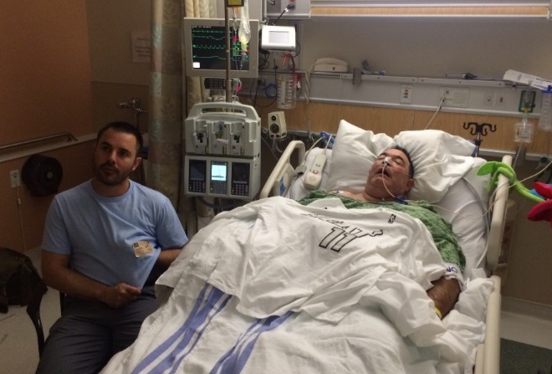
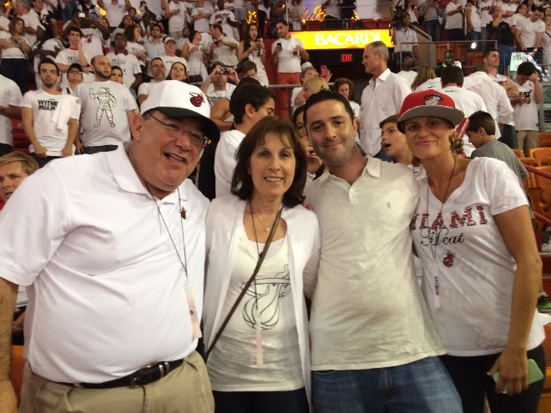
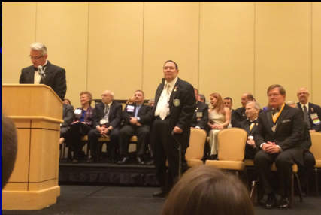
The World can change fast
May 30th, 2014
Three weeks in JFK ICU June 3rd - June 24th 2014
July 26th, 2014 FMA Installation
June 1st, 2014

Slide 4
How The Health Care Dollar is Spent:
Hospital Care 31%
Physician Services 21%
Pharmaceuticals 10%
Nursing Homes 8%
Administrative Costs 7%
All other (diagnostic, medical device) 23%
Percentage of costs that are profit 25-30%

Slide 5
A New Policy Has Been Started in Florida.
Beacon LBS: Lab Benefit Solutions

Slide 8
Beacon LBS

Slide 9
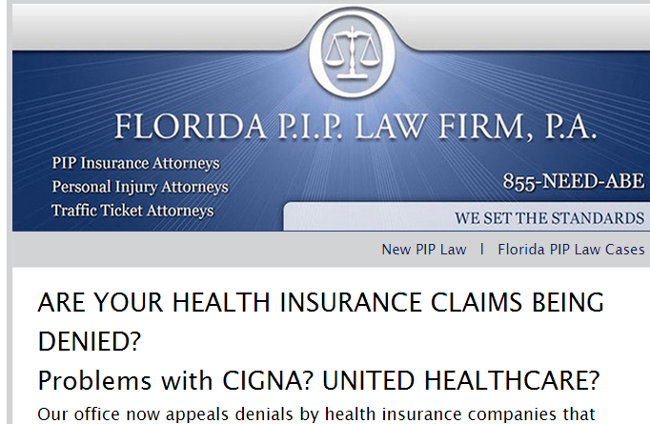
Law Suits

Slide 10
We must Educate our Elected Officials
Dr. Brent Schillinger, Dr. Alan Pillersdorf, Congresswoman Lois Frankel, Tenna Wiles, Dr. Stephen Babic

Slide 11
Accountable Care Organizations
ACO’s are charged with coordinating care.
ACO’s are incentivized to look at cost savings, and receive bonuses if they are successful.
Are designed to prevent unnecessary ordering of tests/accountability.

Slide 12
What Used to be the most Rewarding Part of Being A Doctor is Diagnosing.

Slide 13
FMA Policy & Strategy
POLICY: Insurance Industry is Using Severe Tactics to Limit Physicians ability to order necessary tests, even by qualified prescribers.
STRATEGY:
Medical/Legal Committee being formed to improve relations with the Florida Trial Bar and to find legal remedies for these complex problems.

Slide 14
Consequences of Pre-Authorizations Now Tying Up Our Offices
Less Face Time with Physician
Increases the Argument that APRN can work independently (work force issues)
Decrease Access to Care
Delays Treatment
Increases Complications
Patients Do Not seek appropriate care
Physician Burnout

Slide 15
Less Face Time with Physician
The more time Physician’s spend explaining needed tests to office staff; the less time spent with patients.

Slide 16
Increases the Argument that Nurse Practioners Should Work Independently
Physician’s time not being utilized properly supports the argument for Independent NPs

Slide 17
What Advanced Practice Registered Nurses (APRN) Want:
Full Prescriptive Authority
Autonomous Independent Practice
Allow to Baker Act Patients
To determine Permanent Impairment Rating and MMI in workman compensation
To prescribe physical and occupational therapy
Enpanelment for all third party payors
Allow APRN to be primary care providers
Allow APRN to sign death certificates
Allow APRN to sign fetal demise and birth certificates.
Authorize APRN to order all diagnostic and lab tests.
Designate APRN as Medicaid primary care physicians
Allow APRN to be medical director of Florida Health Care Homes.
Place all authority of APRN and RN and LPN under Board of Nursing.
Change payment to any willing provider

Slide 18
Decrease Access To Care
Time is wasted with unnecessary phone calls getting pre-authorization
As of today, 10/1/2014, United Insurance (commercial) requires physicians to obtain a pre-authorization for the following labs:
Any thyroid panel (T3,T4)
HIV
Hepatitis C
Hepatitis B
ANA
Clostridium difficile toxin
Factor V Leiden
H Pylori
Strept Culture or DNA
Any syphilis test
Vitamin D level (at least 40% of people Vitamin D deficient, and in Hispanics it is closer to 70%)
Drug screening
Protein electrophoresis (or IFE)
Any routine genital culture

Slide 19
Delays Treatment
Time waiting for tests to be authorized can have major negative impact on Treatment options.
Ordering a simple test can take hours with unnecessary phone calls: a patient not getting thyroid medication in a timely fashion.

Slide 20
Increases Complications
Prolonged wait time for treatment leads to more complications.

Slide 21
Patients Do Not Receive Appropriate Care In A Timely Fashion
Patients end up suffering with long waits and untimely results

Slide 22
Physician Burnout
Physicians in the United States suffer from more burnout than other workers in the United States
According to a national survey of more than 7000 US physicians:
37.9% exhibited high levels of emotional exhaustion,
29.4% showed evidence of a high level of depersonalization, and
12.4% had a low sense of personal accomplishment.

Slide 23
Conflict Resolution
Listen to Understand
Accentuate the Positive
State Your Case Tactfully
Attack the Problem, Not the Person
Avoid the Blame Game
Focus on the Future, Not the Past
Ask the Right Kind of Questions
Pick Your Battles
Celebrate Agreement

Slide 24
We need to speak with a unified voice, and show that we care, and we are advocates for physicians and patients.

Slide 25
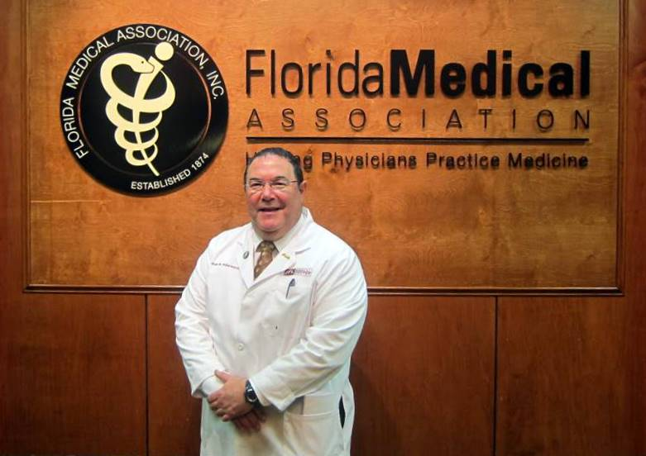
Florida Medical Association
“We chose a great specialty, we need to enjoy it, because it took years to get here. Work hard, and play hard, but appreciate everything”
Alan B. Pillersdorf, M.D. FACS

