Slide 1
The Physicians Foundation
Report to OSMAP
Alan L. Plummer, MD
Vice-President
Chairman, Grants Committee
June 6, 2014

Slide 2
The Physicians Foundation Overview
National non-profit organization formed in 2003 and dedicated to:
Improving the delivery of healthcare to all patients
Advancing the work of practicing physicians
Sustaining the viability of medical practice
Pursues mission through grant-making, research, national surveys and policy studies
Given more than $33 million in grants
Conducted three nationwide biennial surveys of physicians
Graduated over 110 physician leaders from our Leadership Academy

Slide 3
The Physicians Foundation Signatory Medical Societies
Alaska State Medical Association Medical Society of Northern Virginia
California Medical Association Medical Society of the State of New York
Connecticut State Medical Society Nebraska Medical Association
Denton County Medical Society (Texas) New Hampshire Medical Society
El Paso County Medical Society (Colorado) North Carolina Medical Society
Florida Medical Association South Carolina Medical Association
Hawaii Medical Society Tennessee Medical Association
Louisiana State Medical Society Texas Medical Association
Medical Association of Georgia Vermont Medical Society
Medical Society of New Jersey Washington State Medical Association

Slide 4
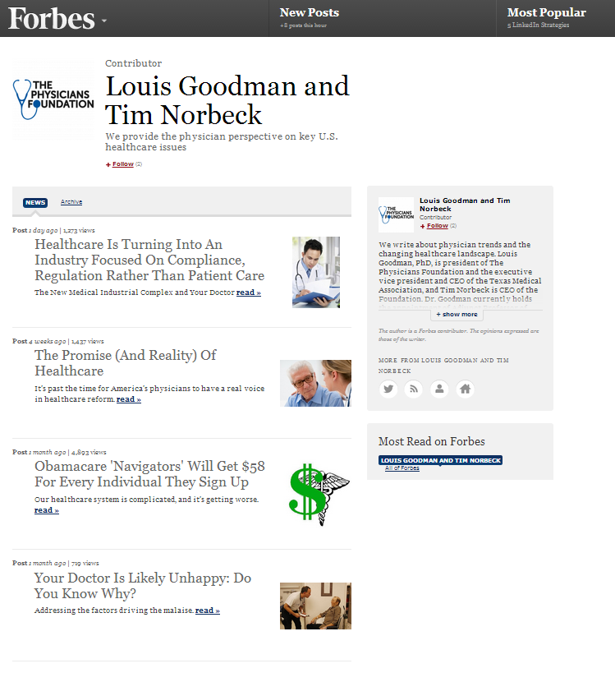
The Physicians Foundation Communications Activities
The Physicians Foundation Forbes Channel
Launched channel in October 2013
Foundation perspective on key healthcare issues
Rising healthcare costs
Regulatory impacts on physician morale and patient care
Increasing complexity of healthcare system
Notes:
The most recent Forbes op-ed posted on May 28 and suggests four steps to reduce healthcare costs without causing an adverse impact on the access to care promised by the ACA.

Slide 5
The Physicians Foundation Grant-making Activities
Grant-making Overview
Over $33 million awarded since 2005
133 research and leadership grants awarded
55 physician leadership grants, over $5.5 million awarded
Physician Leadership Academy
Will be hosted at Duke University June 18-21, 2014
Graduated over 110 physician leaders

Slide 6
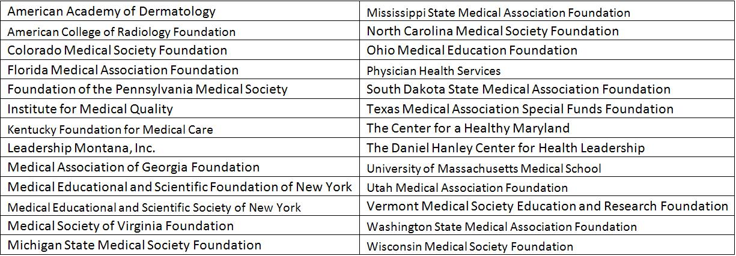
The Physicians Foundation Grantmaking Activities
There have been 28 Physician Leadership Grants awarded since 2012

Slide 7
The Physicians Foundation Grant-making Activities
UNC FutureDocs Forecasting Tool
Goal: To engage clinicians, policy makers, educators, health systems and others in using tool to understand (and debate) workforce issues
First Open Source Physician Projection Model
Designed to harness power of interactive data and maps to visualize supply, utilization, shortages / surplus of physicians
Maps provide way to understand geographic imbalances and pockets of regionalized care
Beta testing currently in progress

Slide 8
The Physicians Foundation Grant-making Activities
Next few examples show surplus/shortage estimates for outpatient endocrine and respiratory services
Based on “relative” shortage measure for each clinical service area (CSA) in each geography = supply of visits physicians in that total service area (TSA) can provide divided by the utilization of visits needed by population in the TSA
<.85=shortage .85-1.15=in balance >1.15=surplus

Slide 9
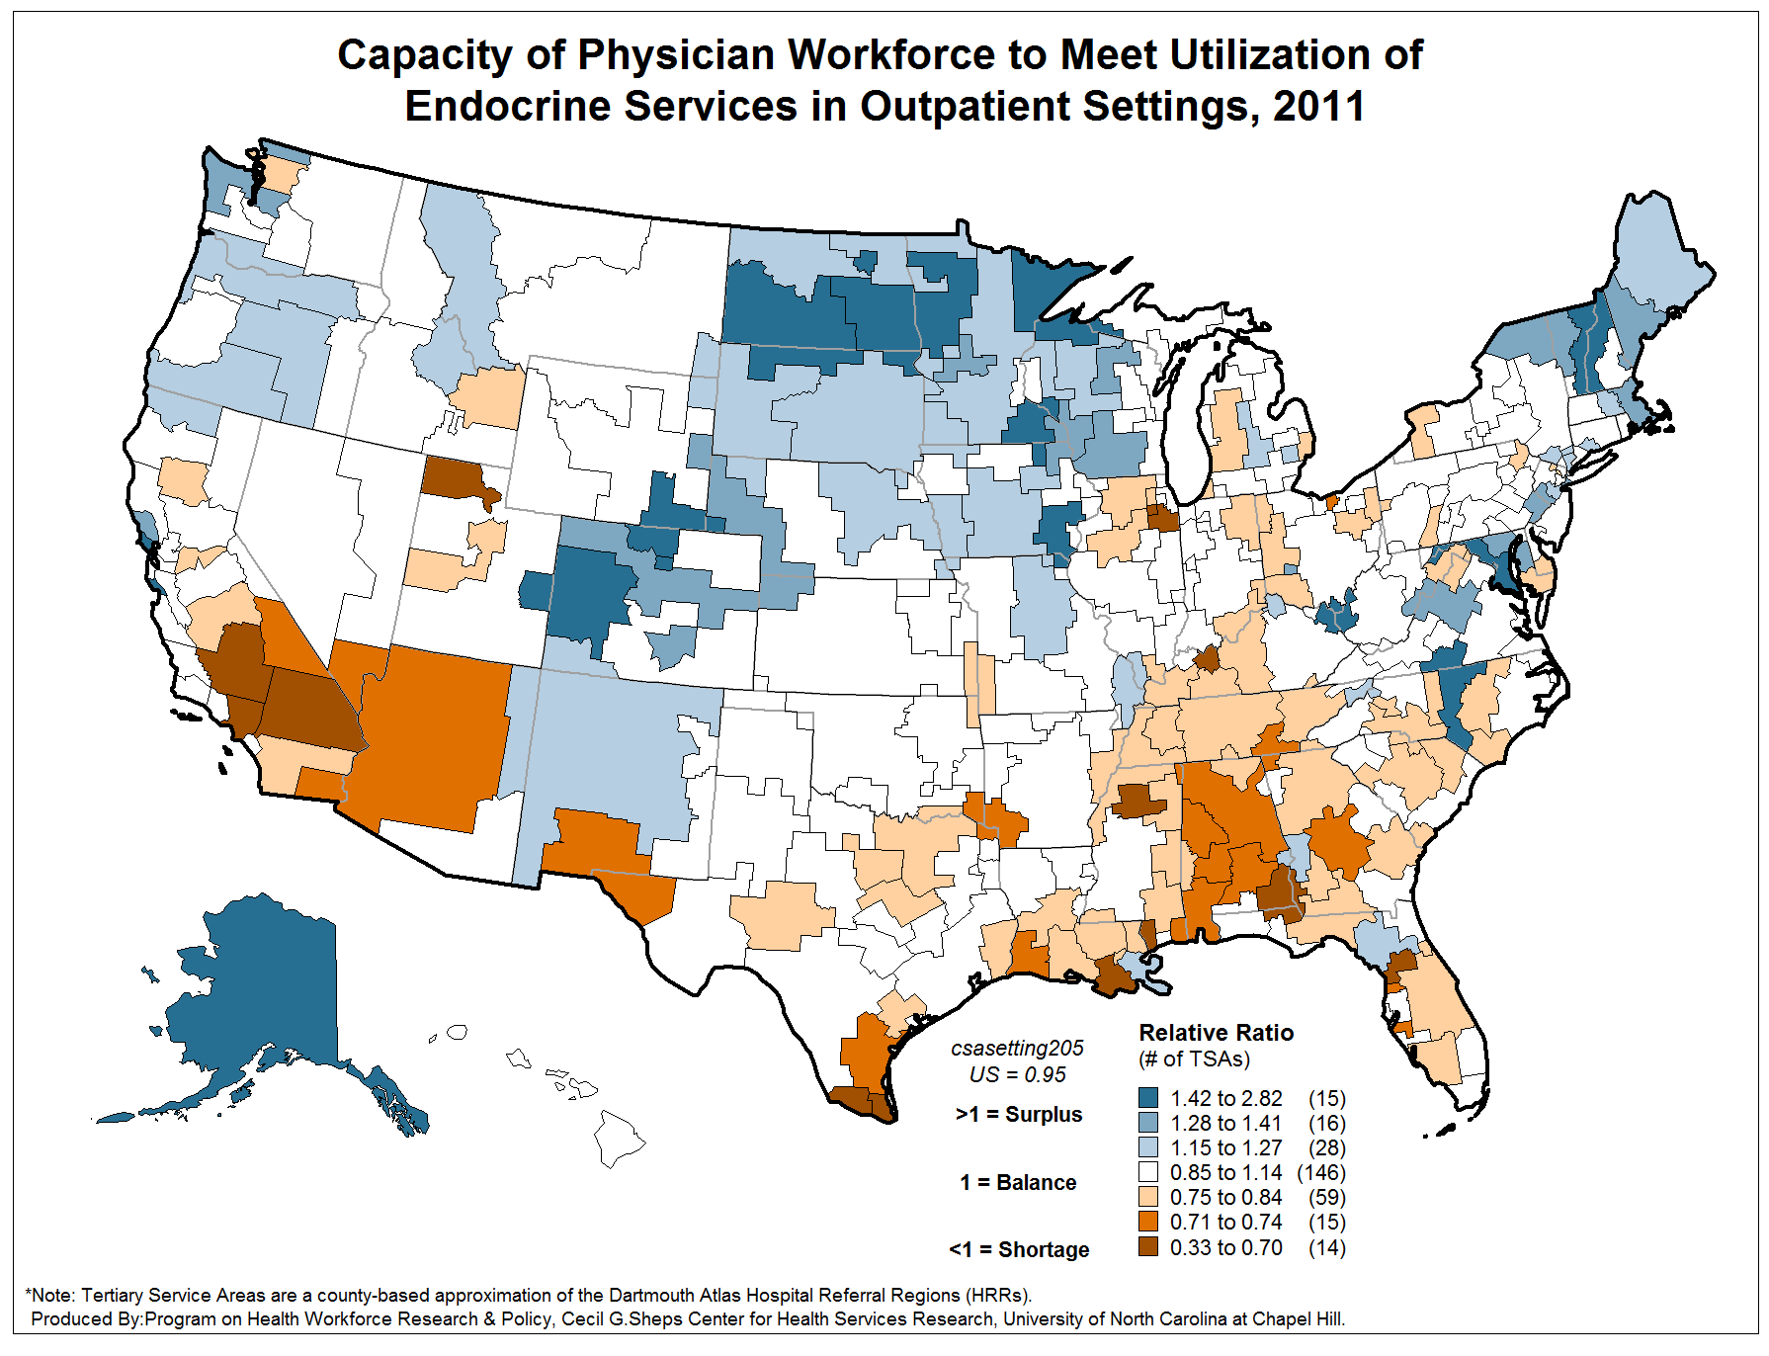
Ocala, FL
Mobile, AL

Slide 10
The Physicians Foundation Grant-making Activities
How to address shortage? Example: Outpatient Endocrine
Outpatient Endocrine is provided by:
Endocrinologists, 55%
Family Medicine, 10%
Nephrology, 6%
13 Other specialities, 29% ( Each < 4%)
Based on 1 FTE physician doing 2400 visits per year, shortage could be addressed by additional:
~ 20 FTE Endocrinologists
~ 11 FTE Endocrinologists, ~8 FTE Family Medicine,
~1 FTE Nephrologist
Something in between and/or something else
-or-
-or-

Slide 11
The Physicians Foundation Grant-making Activities
How to address shortage? Example: Outpatient Endocrine
Would suggest:
Due to lower per population ratio, Ocala plans to increase number of endocrinologists
But Mobile may find it easier to attract the endocrinologists for the same reason

Slide 12
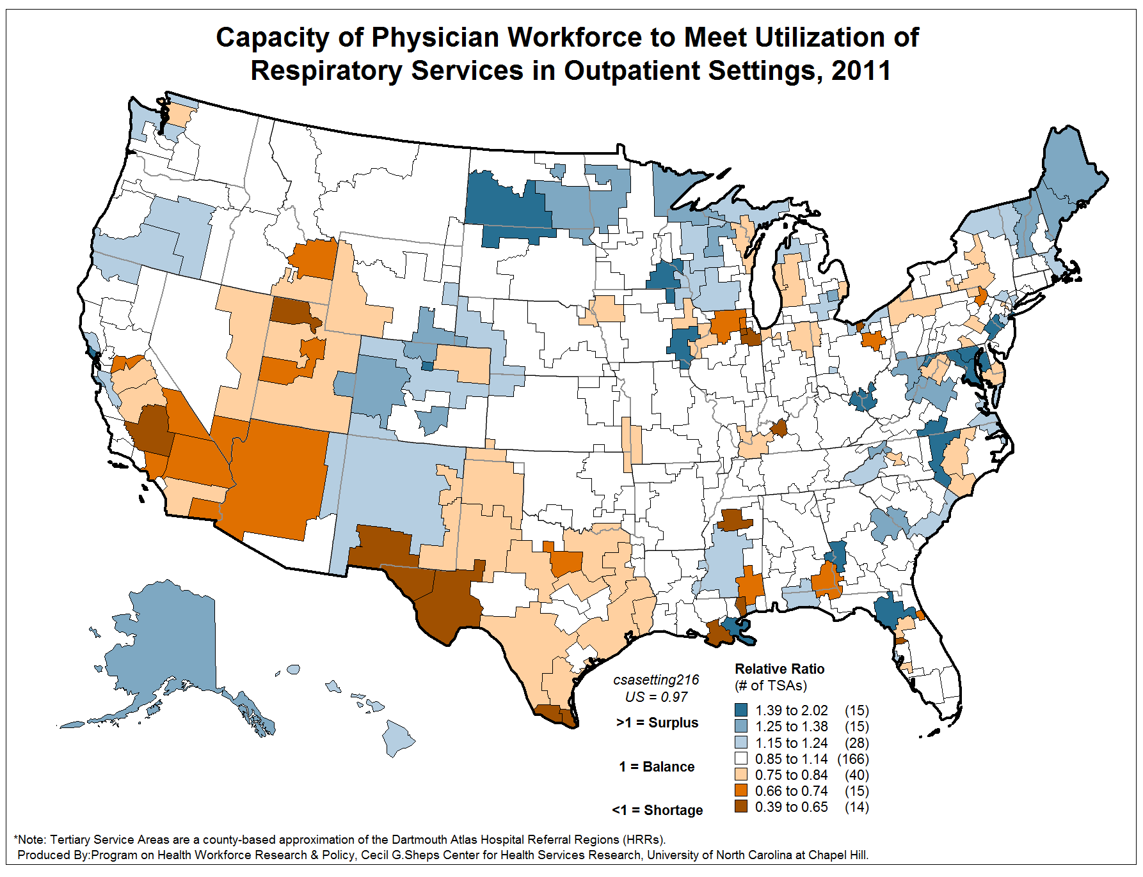
Sioux City, IA
Paducah, KY

Slide 13
The Physicians Foundation Grant-making Activities
How to address shortage? Example: Outpatient Respiratory
Outpatient Respiratory is provided by:
Allergy / Immunology, 44%
Pulmonology, 14%
ENT, 12%
Family Medicine, 9%
General Pediatrics, 8%
8 Other specialities, 12% ( Each < 4%)

Slide 14
The Physicians Foundation Grantmaking Activities
How to address shortage? Example: Outpatient Respiratory
Suggests:
Due to low per pop supply, Sioux City increase supply of ENT & Pulmonology
But Paducah may be able to attract this supply
Neither is likely to increase supply of Allergy by
10 each due to national lack of supply of allergists
to provide this

Slide 15
The Physicians Foundation Grant-making Activities

Slide 16
The Physicians Foundation Grant-making Activities
Health Leads
Expanding core model of providing critical personal services that will improve the health of poor and disadvantaged patients and families
The Foundation awarded $1M additional funds in 2013
Making progress in California, Tennessee and Texas markets
Launched new site last week in Oakland, CA at Kaiser Permanente

Slide 17
The Physicians Foundation Research Activities
Research Activities to Date
Funded 24 research reports since 2008
Over $4 million granted to date
Current Projects
2014 Biennial Survey
ACA Critical Issues Part III
Physician-led Integrated Delivery Systems

Slide 18
The Physicians Foundation Research Activities
2014 Biennial Survey
Currently conducting biennial large-scale physician survey
Surveying physicians on current practice patterns, professional morale and perspectives on the state of medicine and the healthcare system (still open)
Physicians can participated at the following link: http://bit.ly/1n4sHYh

Slide 19
The Physicians Foundation Research Activities
The Patient Protection and Affordable Care Act Part II
Second installment in a series of comprehensive research reports on the Affordable Care Act coverage expansion and mandates (released last week)
To read the full report, a PDF version can be downloaded on The Foundation’s website: http://www.physiciansfoundation.org/healthcare-research/aca-critical-issues-part-ii

Slide 20
The Physicians Foundation Research Activities
Physician-Led Integrated Delivery Systems (IDS)
The Council of Accountable Physician Practices (CAPP)
Literature review on physician-led IDS
Case examples of successful physician-led IDS
Elements required for successful physician-led systems
Comparison of physician vs. physician and hospital partnership
Recommended measures and data on cost and quality

Slide 21
The Physicians Foundation OSMAP Collaboration
We want to hear from you!
What are pressing topics you would like to see The Foundation address?
How can we collaborate better to drive meaningful change for our physicians?
Email us at info@physiciansfoundation.org
Follow us on Twitter at @PhysiciansFound for latest news

Slide 22
Questions or Comments?

