Slide 1
The Physicians Foundation Report to OSMAP
Louis J. Goodman, PhD
President and Chairman

Slide 2
The Physicians Foundation Overview
National non-profit organization formed in 2003 and dedicated to:
Improving the delivery of healthcare to all patients
Sustaining the viability of medical practice
Pursues mission through grantmaking, national surveys and policy studies
Given more than $31 million in grants
Conducted three nationwide surveys of physicians
Graduated over 100 physicians from our Leadership Academy

Slide 3
The Physicians Foundation Signatory Medical Societies
Alaska State Medical Association Medical Society of Northern Virginia
California Medical Association Medical Society of the State of New York
Connecticut State Medical Society Nebraska Medical Association
Denton County Medical Society (Texas) New Hampshire Medical Society
El Paso County Medical Society (Colorado) North Carolina Medical Society
Florida Medical Association South Carolina Medical Association
Hawaii Medical Society Tennessee Medical Association
Louisiana State Medical Society Texas Medical Association
Medical Association of Georgia Vermont Medical Society
Medical Society of New Jersey Washington State Medical Association

Slide 4
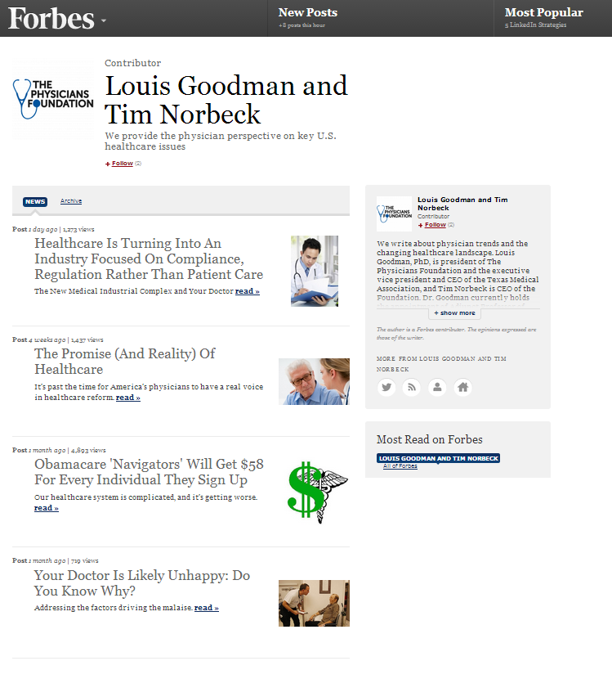
The Physicians Foundation Communications Activities
Physicians Foundation Forbes Channel
Launched channel in October
Foundation perspective on key healthcare issues
rising healthcare costs
regulatory impacts on physician morale
patient care
increasing complex healthcare system

Slide 5
The Physicians Foundation Communications Activities
Insights Series on YouTube
Short theme-oriented clips on key issues discussed at 2013 AAMSE Conference, including:
Physician Morale
Physician Workforce
Physician Shortage
Administrative Burdens
Let’s take a look…

Slide 6
The Physicians Foundation Communications Activities

Slide 7
The Physicians Foundation Communications Activities
Developing 2014 Physician Watch List
Third edition of Watch List
Grants & policy studies
Physician workforce needs and requirements

Slide 8
The Physicians Foundation Communications Activities
2014 Physician Watch List
Consolidation of Healthcare Systems
Growing Regulatory Burdens
ICD-10 requirements
Meaningful Use
Health Insurance Marketplace & Exchange Challenges
Privacy & Patient Data Mining
Macro Systemic Mistrust
SGR

Slide 9
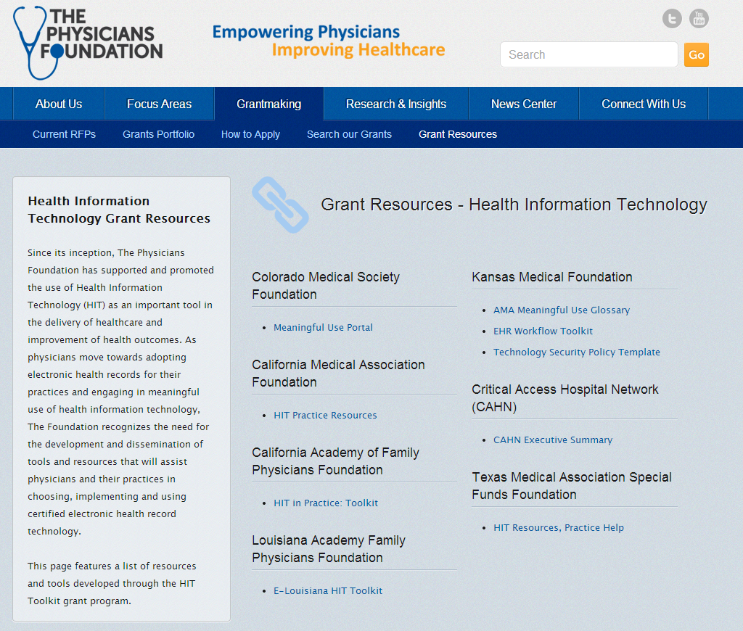
The Physicians Foundation Grantmaking Activities
Announced completion of grants assisting nearly 10,000 physician practices select & implement EHRs and develop leadership skills
HIT toolkits and grant resources available on Foundation website
Notes:
Details on grants featured in press release:
Colorado Medical Society Foundation (HIT grant – $150,000)
Conducted more than 10 physician workshops across the state on meaningful use and a statewide summit on EHR selection; developed online physician portal with resources
Maine Primary Care Association (HIT grant – $150,000)
Expanded data warehouse to provide EHR hosting for small practices
Connected small practices to statewide Health Information Exchanges
Florida Medical Foundation (PL grant – $72,000)
Developed 10 month emerging leader program designed to train younger physicians

Slide 10
The Physicians Foundation Grantmaking Activities
Upcoming Grants
AAMSE survey on employed physicians awarded in 2013
Health Leads awarded $1M additional funds in 2013
Resident & Fellow Physician Leadership Programs in 2014
UNC Chapel Hill physician developing workforce modeling tool in June 2014
Physician Leadership Academy for State Presidents
Looking at possible new University for 2014
Academy tentatively scheduled for late June
Notes:
AAMSE survey:
- The proposed report will serve as a resource for societies to first understand the changing landscape of physician employment by reporting on the current demographic changes in the physician workforce. The report will then provide a systematic review of the programs and services state medical societies have implemented (or are planning to implement) to serve the needs of employed physicians. The review will report the successes, challenges and any outcomes from each state’s programs. The report will be distributed to the AAMSE membership by late fall.
Health Leads:
Foundation awarded $1 million in unrestricted operating funds over three years to launch next phase of organizational impact
Specifically, the support will help Health Leads pursue an ambitious strategy of:
(1) rapidly growing Health Leads’ operational footprint to provide thousands of physicians with the tools and infrastructure to address their patients’ basic resource needs; and
(2) positioning Health Leads to lead the sector in realizing a healthcare system that addresses all patients’ basic resource needs as a standard part of quality care, through convening and engaging physician-leaders alongside a set of diverse healthcare stakeholders
Resident / Fellow Physician Leadership Grant:
- The PF will be inviting a targeted group to apply to develop a Physician Leadership curriculum for Residents. Once the curriculum is developed, the PF may release an RFP to organizations to implement the curriculum.

Slide 11
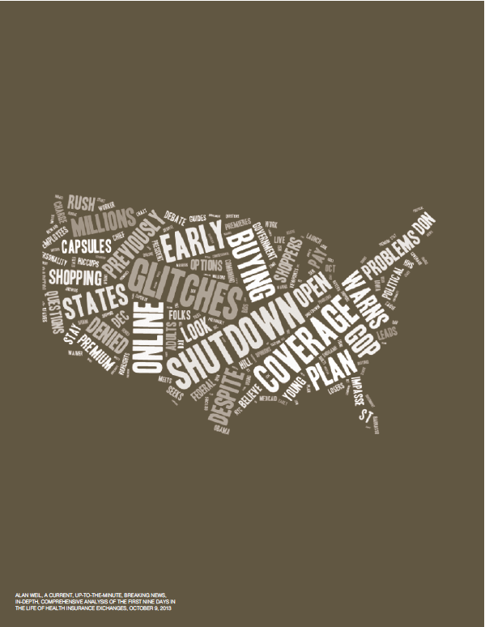
The Physicians Foundation Research Activities
ACA: From Theory to Boots on the Ground
First installment of three-part series on ACA coverage expansion and key mandates
Examines implementation of key provisions (particularly HIE) and ongoing challenges of health reform

Slide 12
The Physicians Foundation Research Activities
Physician-Led Integration White Paper
Seeking research consultant to draft paper that will address the following:
Survey and literature review on physician-led Integrated Delivery Systems (IDS)
Case examples of successful physician-led IDS including the steps followed in creating the physician-led IDS and lessons learned
Recommended measures and data on cost and quality of physician-led IDS
Quality measures initiative with MGMA
Reporting requirements
Cost to physicians
Notes:
The purpose of the research is to develop a study to test the hypothesis that physician-led delivery systems are better based on selected metrics

Slide 13
The Physicians Foundation OSMAP Collaboration
We want to hear from you!
What are pressing topics you’d like to see the Foundation research?
How can we better collaborate to drive meaningful change for our physicians?
Email us at info@physiciansfoundation.org

Slide 14
Questions or Comments?
Visit www.physiciansfoundation.org and follow us on Twitter at @PhysiciansFound for more information and the latest news

