Slide 1
AMA Meeting Minnesota – The Governance Journey
June 14, 2013
Bob Meiches, MD
CEO Minnesota Medical Association

Slide 2
Outline
Minnesota (MMA) Journey
What are other state medical societies doing?

Slide 3
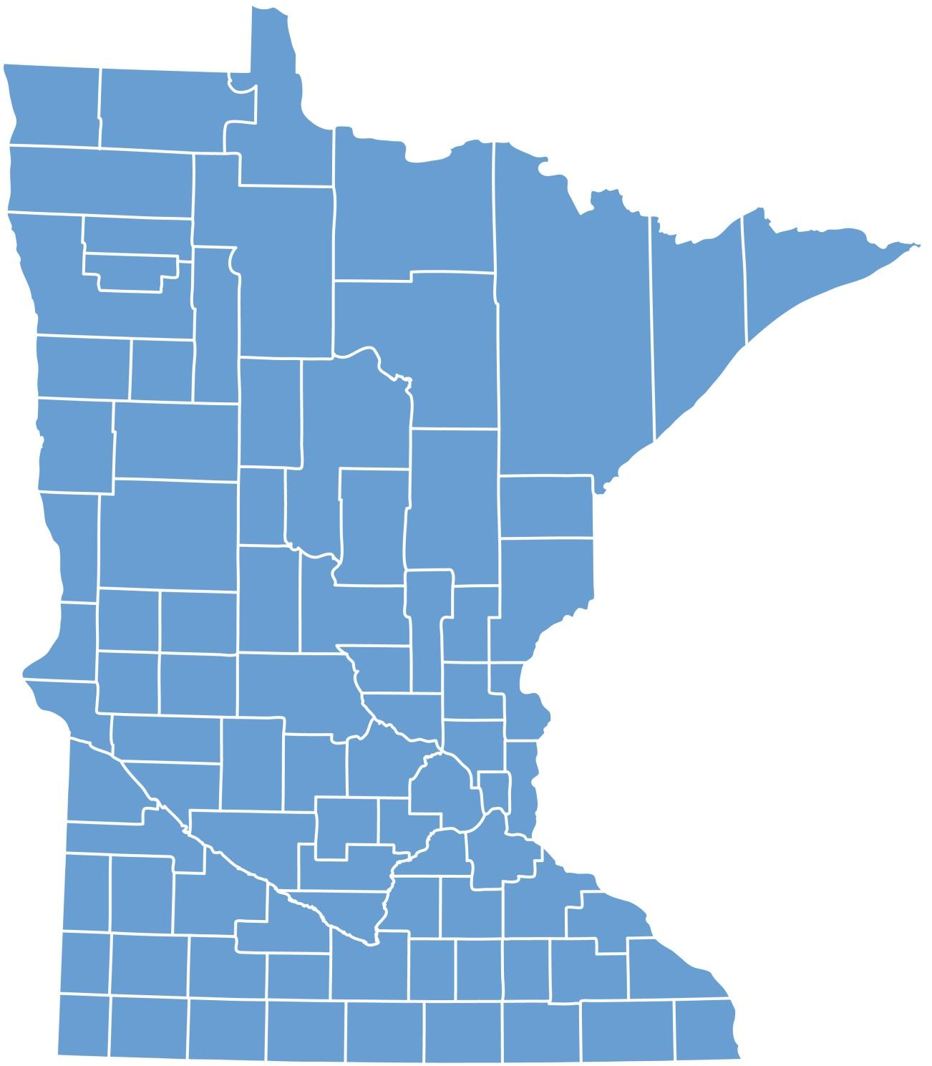
Population of Minnesota – 5.38 Million
*
*
*

Slide 4
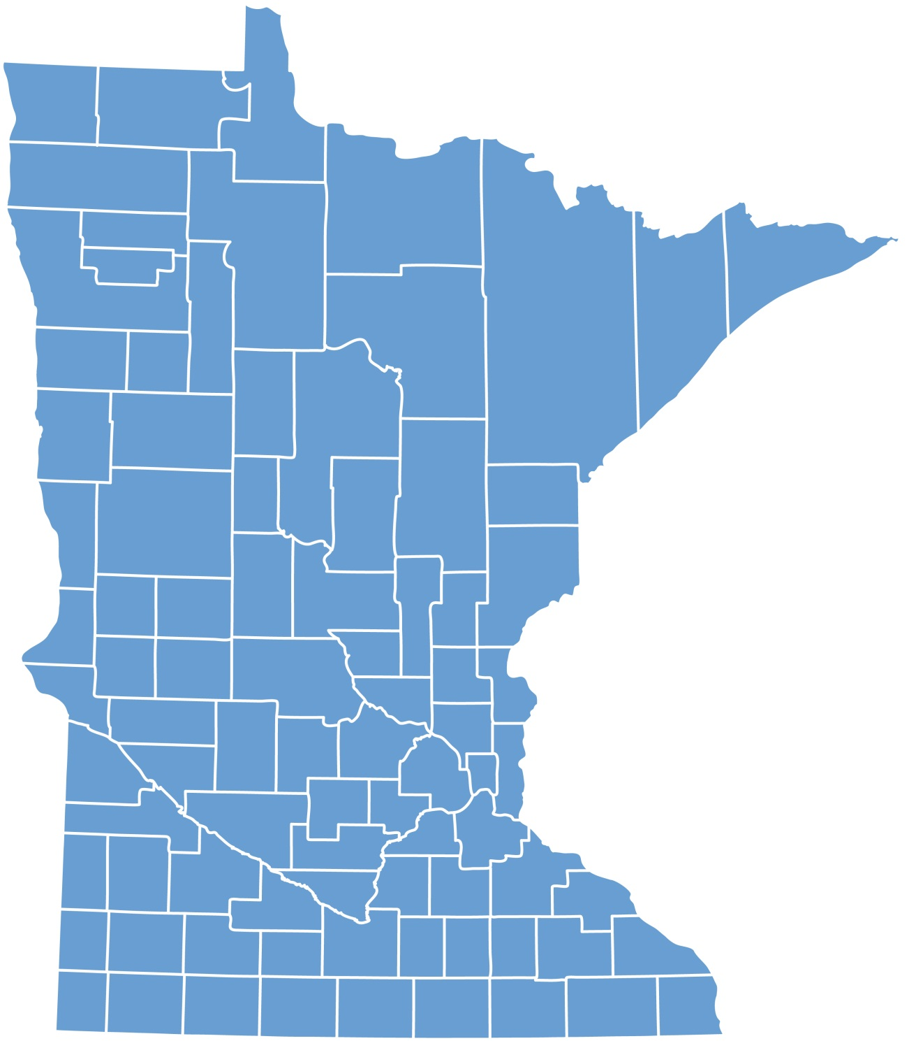
Population of Minnesota – 5.38 Million
20,000 Licensed MD/DO
*
*
*

Slide 5
Population of Minnesota – 5.38 Million
20,000 Licensed MD/DO
10,000 MMA Members
*
*
*

Slide 6
Population of Minnesota – 5.38 Million
20,000 Licensed MD/DO
10,000 MMA Members
50% in Twin Cities
*
*
*

Slide 7
Population of Minnesota – 5.38 Million
20,000 Licensed MD/DO
10,000 MMA Members
50% in Twin Cities
70 – 75% Large Integrated Systems
*
*
*

Slide 8
Population of Minnesota – 5.38 Million
20,000 Licensed MD/DO
10,000 MMA Members
50% in Twin Cities
70 – 75% Large Integrated Systems
Solo, Small Groups Rare
*
*
*

Slide 9
Population of Minnesota – 5.38 Million
20,000 Licensed MD/DO
10,000 MMA Members
½ in Twin Cities
70 – 75% Large Integrated Systems
Solo, Small Group Rare
Non-Profit - Hospitals, Health Plans
*
*
*

Slide 10
Governance
Internal
Policies
CEO
Strategic Direction
Leadership/Elections
Fiduciary Obligations
Ethical/Legal Considerations
External
Policies

Slide 11
MMA Governance
Much like AMA
House of Delegates
CMS/Sections/Specialty
Annual
Board of Trustees (31-31 members)
Executive Committee
AMA Delegation

Slide 12
Why?
Strategic Planning – governance is not static
Member Engagement waning
HOD
Survey Post-HOD
Member Surveys
“Future of MMA” work (association future)
New Ideas/Learning from others

Slide 13
What?
2010 – HOD Task Force
“We have a problem”
Tweaked the process
Balance the “democracy” of all voices with “expediency” of decision making and “fun” for members.

Slide 14
What?
2011 – House of Delegates Resolution
Task Force
House of Delegates and Board of Trustees
Report/Recommendations (TF & Board)
Board
Reduce Size – 31 to 12
Competencies & Geography
Keep Annual Meeting
Replace House of Delegates with Policy Council
All member elections

Slide 15
What?
2012 House of Delegates
Accept Board changes
Obtain additional member input on changes to House of Delegates and All member elections
Additional details needed
Continue to discuss

Slide 16
What?
2013 – Governance Task Force 2.0
Significant member input
Policy Forums (alternate to HOD)
Similar recommendations
Approved by MMA Board
Scheduled for House of Delegates September 2013 – Outcome Uncertain

Slide 17
Considerations
Early v Late Adopters
Frame as issue of polarity
Nimble yet Inclusive
How to optimize both features

Slide 18
Considerations
“Head”
Data
Input from members
Majority don’t care about governance
Those that do – majority want it changed
Best Practice
Other states
“Heart”
Fear, Loss, Change

Slide 19
Considerations
“You would never design it this way” argument not persuasive
Discussions have been distraction from core business
Staff Roles

Slide 20
State Medical Societies
Informal discussions with CEO’s
Governance Discussions/Changes
Over ½ pursuing
Those who are not
Changing Leadership
Content with status quo
Already made changes
Irrelevant – “natural selection”

Slide 21
State Medical Societies
What kind of changes – majority
“Right” size Board of Trustees
New approaches to Policy Setting
Decrease frequency or sunset HOD
All member elections
Officers – fewer
No single way to accomplish (TF for most)
No single preferred solution

Slide 22
State Medical Societies
Decrease Board Size
State leaders and staff very happy
Eliminate HOD
Over ten years
Happy with decision – won’t go back
Recent
Too early to tell

Slide 23
State Medical Societies
Smaller board taking hold
Different ways to engage members and leadership
HOD – attrition
Varied models (local) for policy setting as transition
No “Best practice”
No “Worst practice”

